Slide 1
「セルビアにおける環境汚染と日本の役割」
ひょうご環境創造協会
兵庫県環境研究センター
大阪大学
中野 武

Slide 2
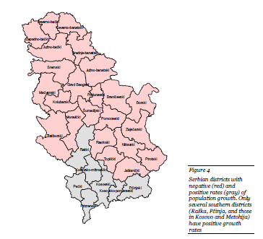
Serbia

Slide 3
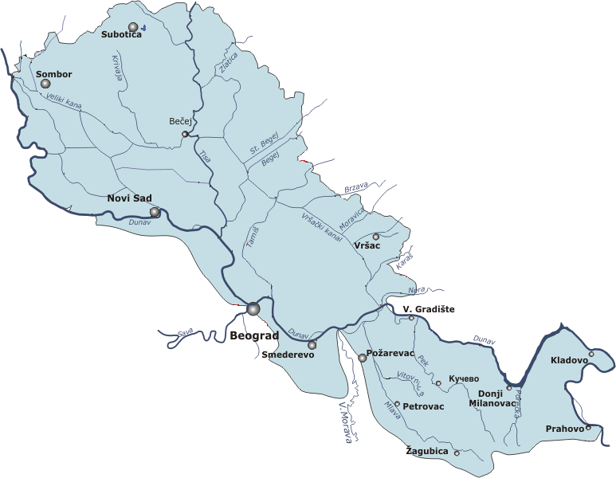
ドナウ川
588 km / total 2,783km.
Notes:
Rivers in Serbia belong to the basins of the Black, Adriatic and Aegean Seas. The longest river is Danube, transboundary river going through several European countries before entering Serbia and which flows 588 km through Serbia out of its total of 2,783km.

Slide 4
APPLICATION FORM FOR
JAPAN’S TECHNICAL COOPERATION
Determination of Hot Spots in the Danube River on Its Way through Serbia in Order to Establish the Capacities for Chemical Management and to Produce Remediation Proposals

Slide 5
The Red Mud Accident in Ajka (Hungary): Plant Toxicity and Trace Metal Bioavailability in Red Mud Contaminated Soil
Some transboundary pollutions ocured in River Danube such as Ajka alumina sludge spill,
red mud (highly alkaline a waste product of
the Bayer process which refines bauxite
into alumina) in western Hungary in 2010
Notes:
some transboundary pollutions ocured in River Danube such as Ajka alumina sludge spill, red mud (highly alkaline a waste product of the Bayer process which refines bauxite into alumina) in western Hungary in 2010
ABSTRACT: The red mud accident of October 4, 2010, in Ajka (Hungary) contaminated a vast area with caustic, saline red mud
(pH 12) that contains several toxic trace metals above soil limits. Red mud was characterized and its toxicity for plants was measured
to evaluate the soil contamination risks. Red mud radioactivity (e.g., 238U) is about 10-fold above soil background and previous
assessments revealed that radiation risk is limited to indoor radon. The plant toxicity and trace metal availability was tested with
mixtures of this red mud and a local noncontaminated soil up to a 16% dry weight fraction. Increasing red mud applications increased
soil pH to maximally 8.3 and soil solution EC to 12 dSm-1. Shoot yield of barley seedlings was affected by 25% at 5% red mud in soil
and above. Red mud increased shoot Cu, Cr, Fe, and Ni concentrations; however, none of these exceed toxic limits reported
elsewhere. Moreover, NaOH amended reference treatments showed similar yield reductions and similar changes in shoot
composition. Foliar diagnostics suggest that Na (>1% in affected plants) is the prime cause of growth effects in red mud and in
corresponding NaOH amended soils. Shoot Cd and Pb concentrations decreased by increasing applications or were unaffected.
Leaching amended soils (3 pore volumes) did not completely remove the Na injury, likely because soil structure was deteriorated.
The foliar composition and the NaOHreference experiment allow concluding that theNa salinity, not the trace metal contamination, is the
main concern for this red mud in soil.

Slide 6
The Cyanide Spill at Baia Mare, Romania
BEFORE, DURING AND AFTER
In 2000 Baia Mare Romania, cyanide spill
occurred into the Someş River by the gold
mining company.
Notes:
some transboundary pollutions ocured in River Danube such as Ajka alumina sludge spill, red mud (highly alkaline a waste product of the Bayer process which refines bauxite into alumina) in western Hungary in 2010
ABSTRACT: The red mud accident of October 4, 2010, in Ajka (Hungary) contaminated a vast area with caustic, saline red mud
(pH 12) that contains several toxic trace metals above soil limits. Red mud was characterized and its toxicity for plants was measured
to evaluate the soil contamination risks. Red mud radioactivity (e.g., 238U) is about 10-fold above soil background and previous
assessments revealed that radiation risk is limited to indoor radon. The plant toxicity and trace metal availability was tested with
mixtures of this red mud and a local noncontaminated soil up to a 16% dry weight fraction. Increasing red mud applications increased
soil pH to maximally 8.3 and soil solution EC to 12 dSm-1. Shoot yield of barley seedlings was affected by 25% at 5% red mud in soil
and above. Red mud increased shoot Cu, Cr, Fe, and Ni concentrations; however, none of these exceed toxic limits reported
elsewhere. Moreover, NaOH amended reference treatments showed similar yield reductions and similar changes in shoot
composition. Foliar diagnostics suggest that Na (>1% in affected plants) is the prime cause of growth effects in red mud and in
corresponding NaOH amended soils. Shoot Cd and Pb concentrations decreased by increasing applications or were unaffected.
Leaching amended soils (3 pore volumes) did not completely remove the Na injury, likely because soil structure was deteriorated.
The foliar composition and the NaOHreference experiment allow concluding that theNa salinity, not the trace metal contamination, is the
main concern for this red mud in soil.

Slide 7
sulphide biogeocenosis in the zones of sulphide copper ores deposits in East Serbia (Bor and Majdanpek) have an influence on the pollution of waters.
artificial lake H₂SO₄ (pH ≒2.5)
flux to Danube 500t Cu/ year
These waters loaded with heavy metals partly arrive in aquifer and the major part flows into surface water (river Timok) courses gravitating towards the Danube River, which empties into the Black Sea
Notes:
Biogeochemical activity of microorganisms from sulphide biogeocoenosis in the zones of sulphide copper ores deposits in East Serbia (Bor and Majdanpek) have an influence on the global pollution of waters. These waters loaded with heavy metals partly arrive in an aquifer and the major part flows into surface water (river Timok) courses gravitating towards the Danube River, which empties into the Black Sea

Slide 8
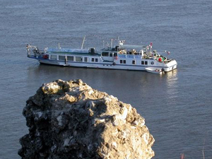
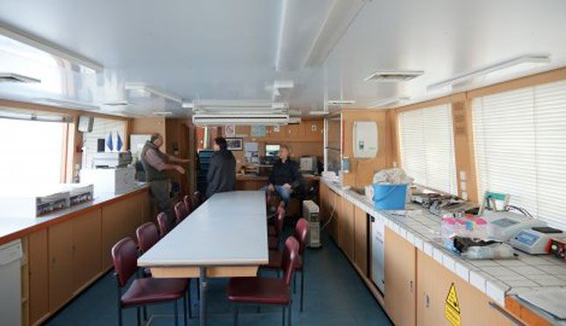
Research Vessel
Laboratory “Argus”
Interior/laboratory
of the “Argus”

Slide 9
Organic pollutants to be analyzed
TPH – Total Petroleum Hydrocarbons
PAHs – Polycyclic Aromatic Hydrocarbons
PFCs – Perfluorinated compounds
PCB – Polychlorinated Biphenyl
PCDD – Polychlorinated dibenzodioxins
PCDF – Polychlorinated dibenzofurans
Pesticides
Antibiotics (chloramphenicol, tetracycline)
Hormones, endocrine disruptors

Slide 11
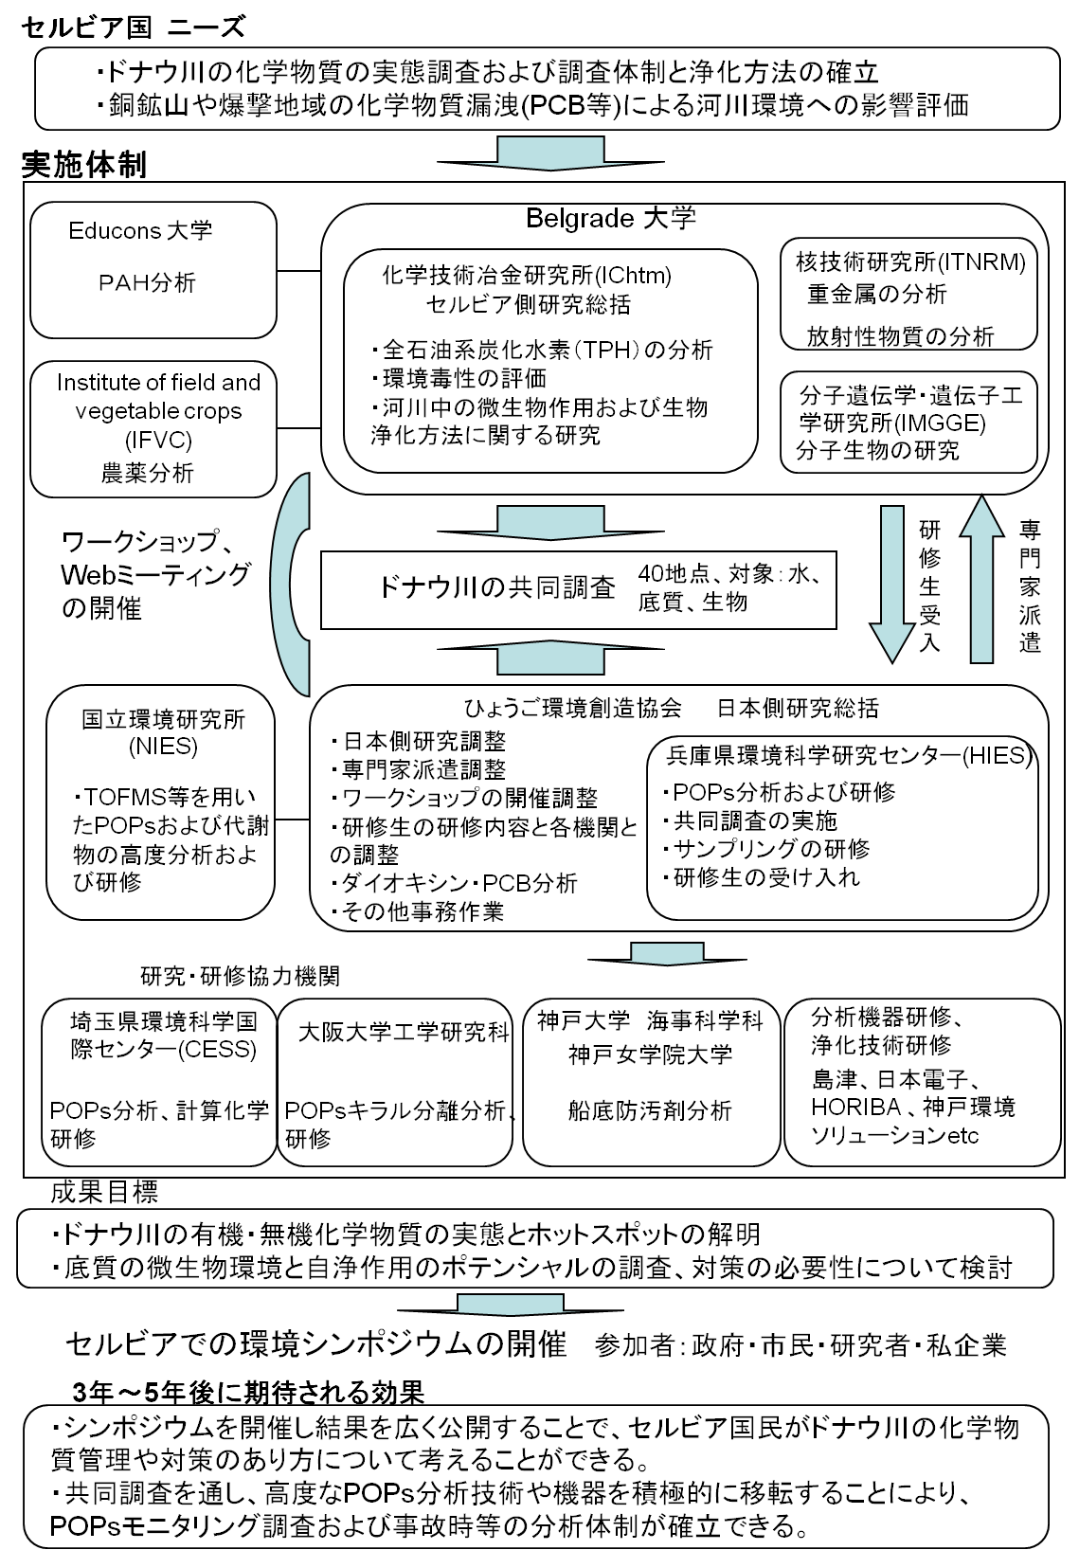

Slide 12
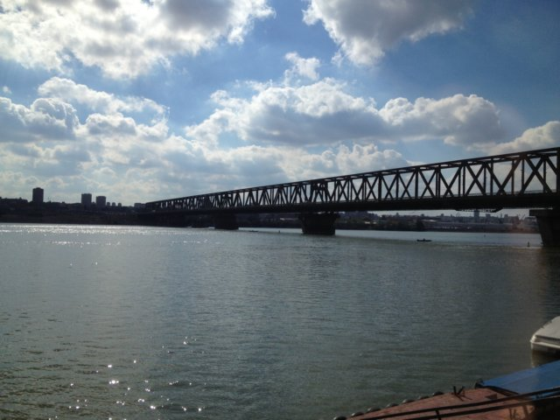
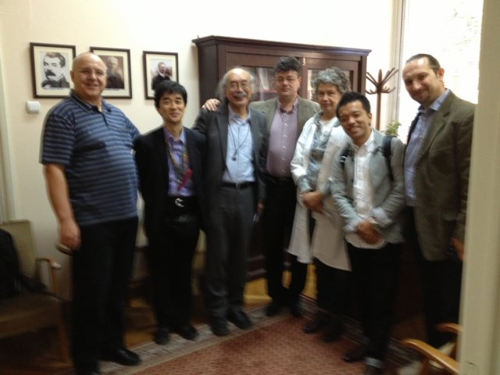

Slide 13
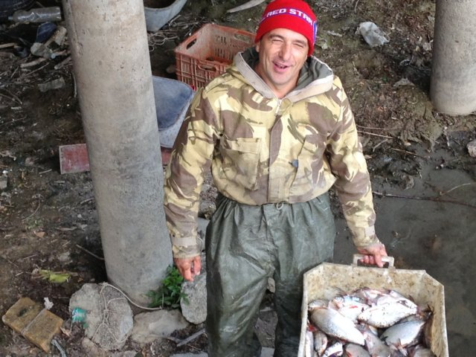
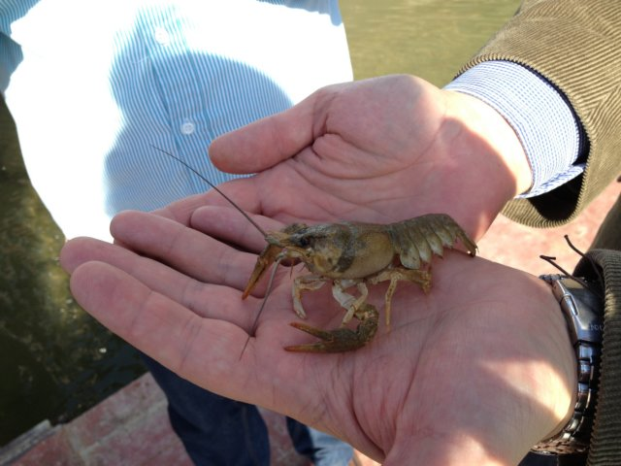

Slide 14

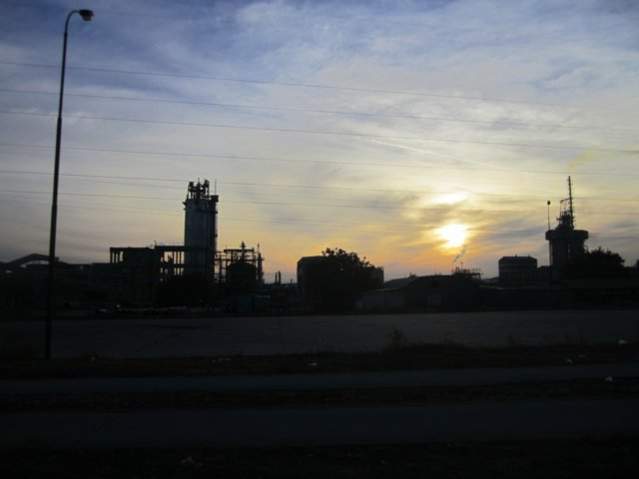

Slide 15
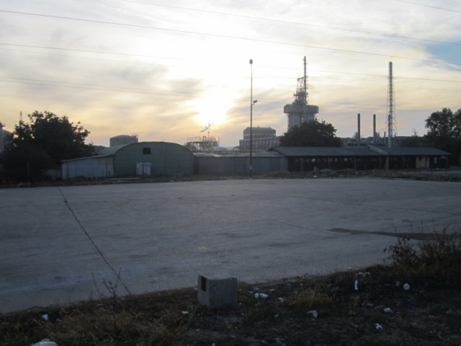
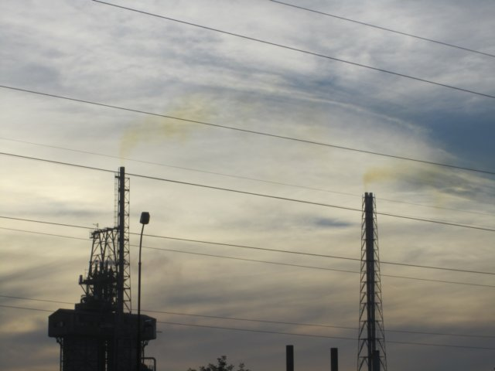

Slide 16
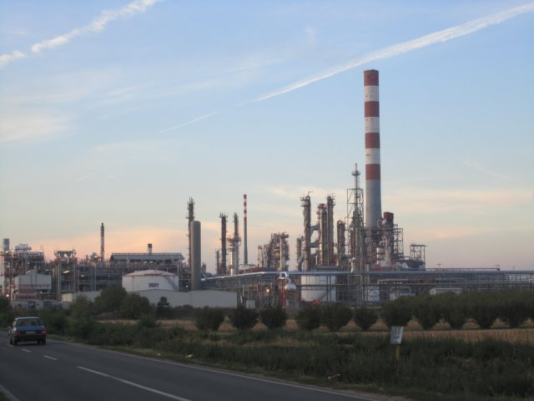
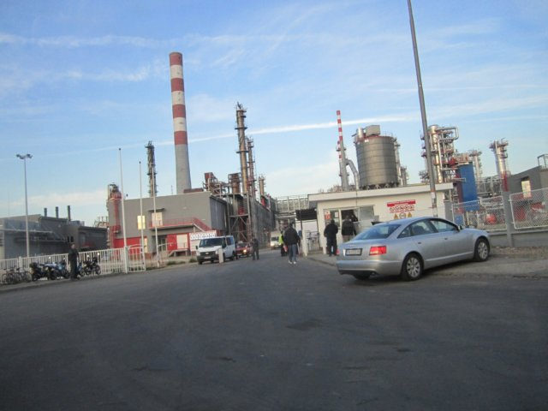
NIS
Gazprom
Notes:
メドヴェージェフ

Slide 17
2012.10.10

Slide 18



Slide 19
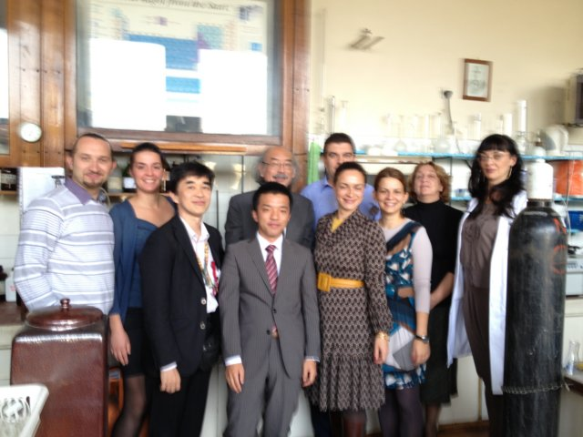
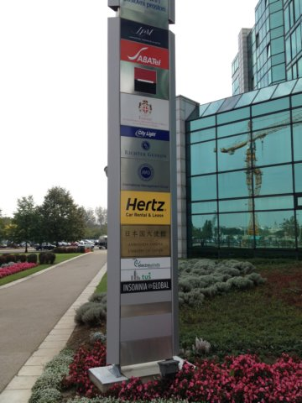

Slide 20



Slide 21
2012.10.11

Slide 22
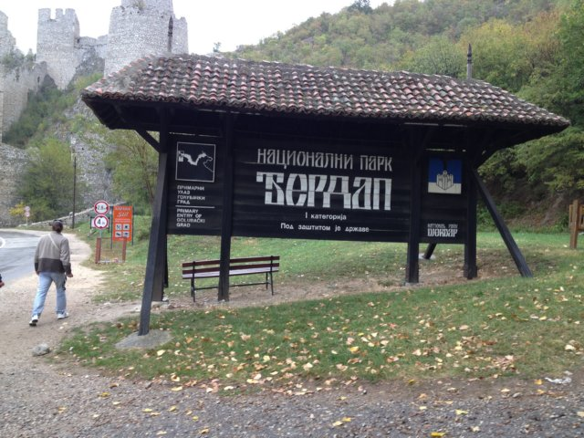
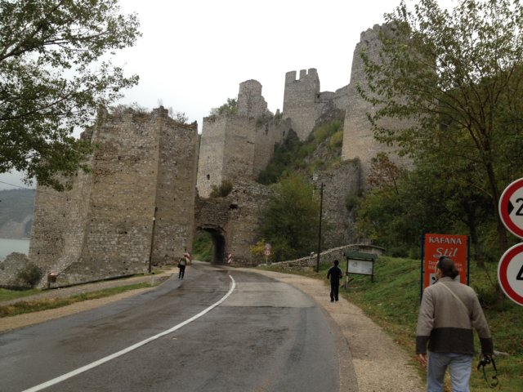

Slide 23
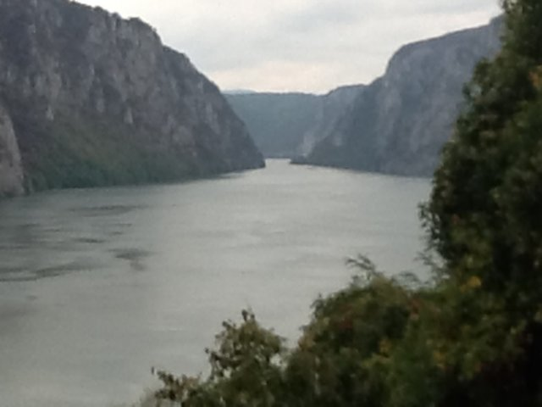
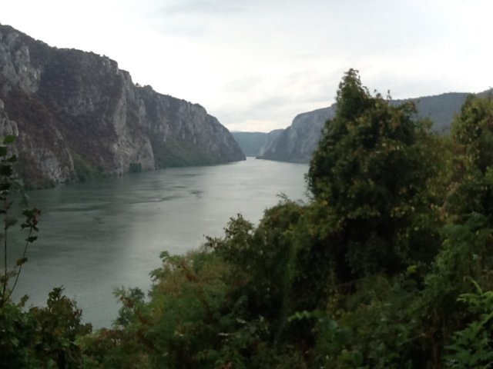

Slide 24
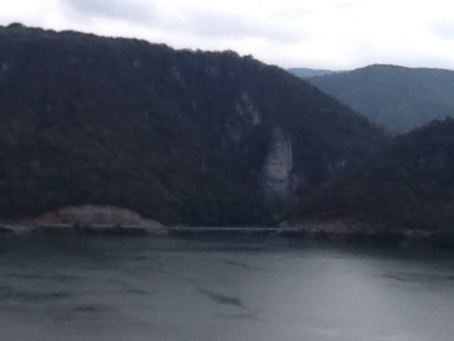
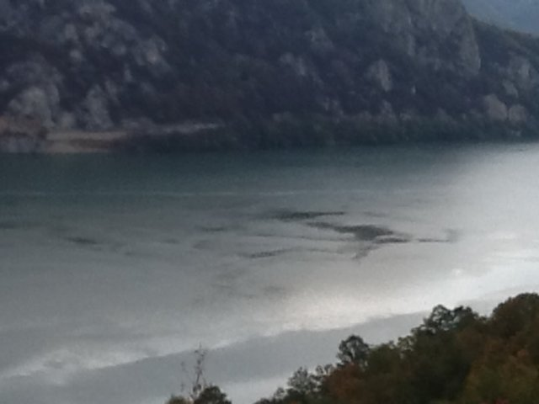

Slide 25
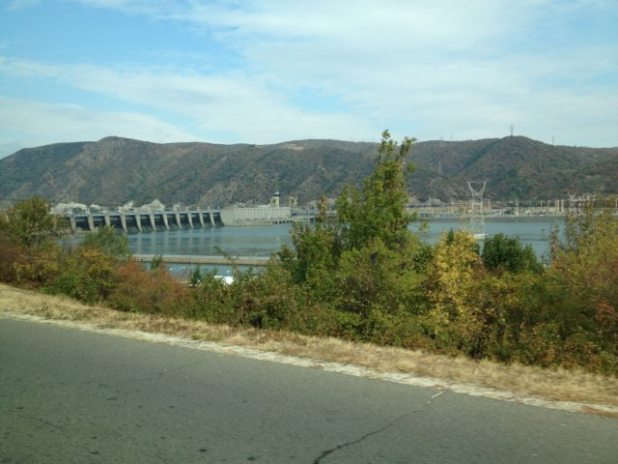
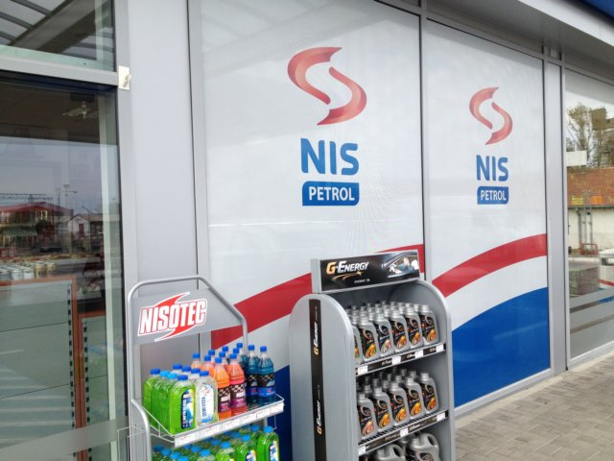

Slide 26
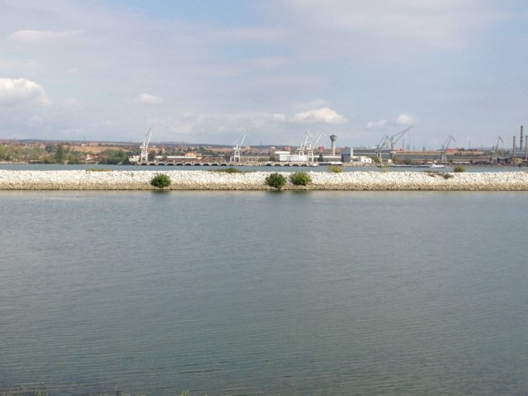
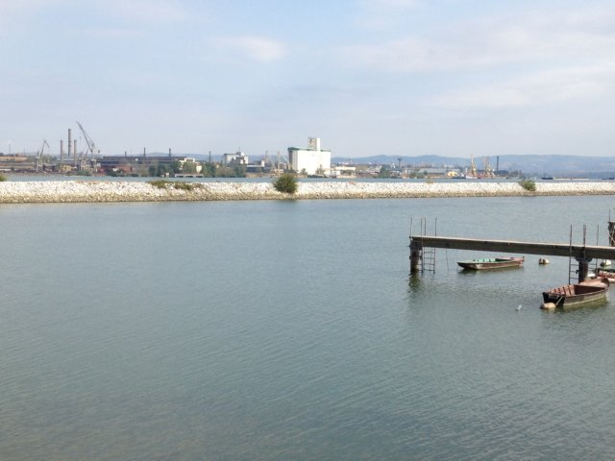

Slide 27
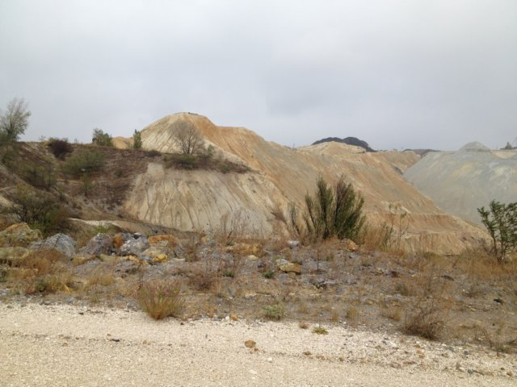
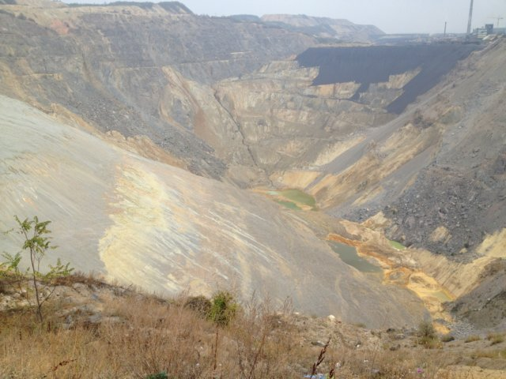
Bor
Cu Ores

Slide 28
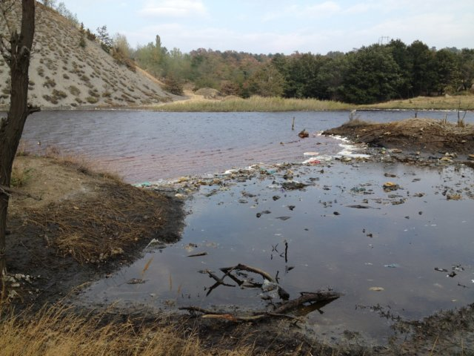
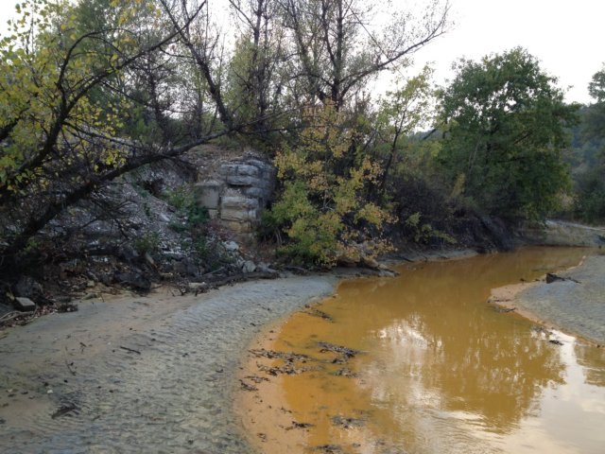

Slide 29
2012.10.12
Illegal dumping site
Frska Gora

Slide 30



Slide 31
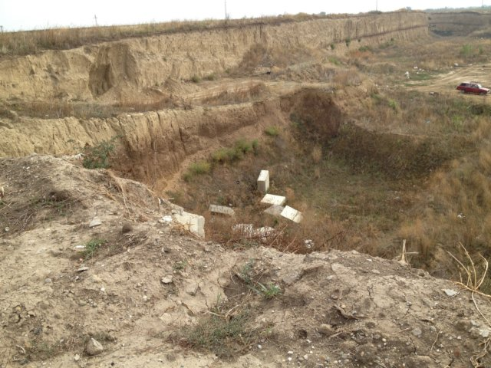
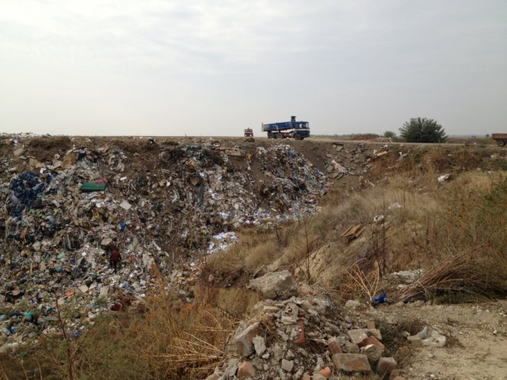

Slide 32



Slide 33
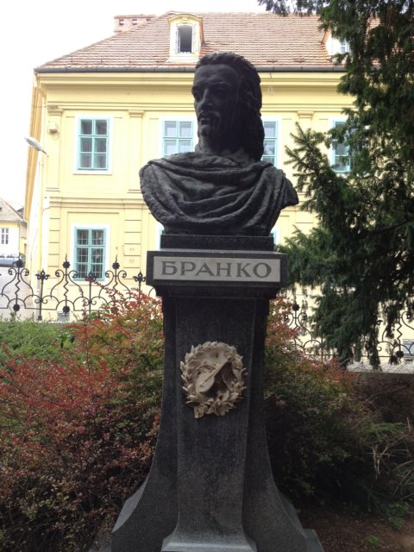


Slide 34
2012.10.13
Studio B

Slide 35




Slide 36



Slide 37
国・自治体 環境研究所 （人材・機器）
HRMS vs ECD
研究紀要 vs EST
同位体希釈分析（IS） vs QA/QC
異性体分析 vs PCB-7異性体
経験・ノウハウ 技術移転
自治体の枠を超えて、連携、協力

