Slide 1
CURRENT REGULATIONS AND RISK MANAGEMENT REGARDING PCBS IN JAPAN
Takeshi Nakano
Osaka University
Graduate School of Engineering

Slide 2
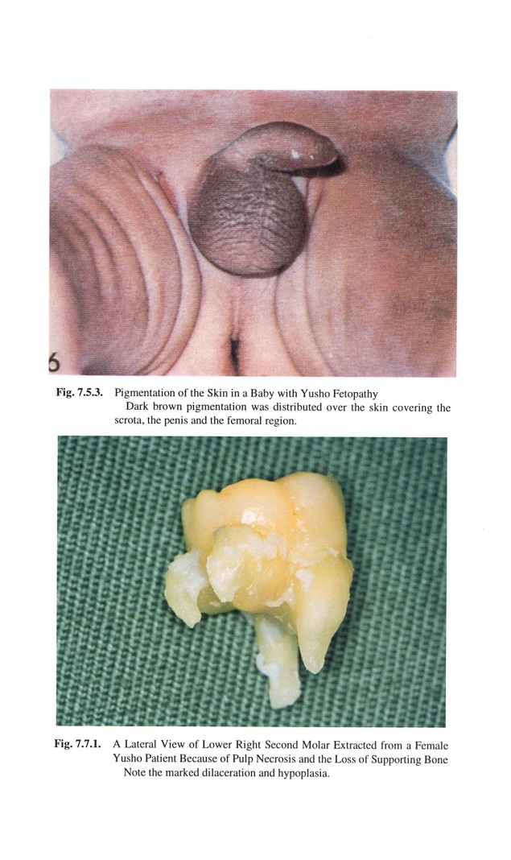
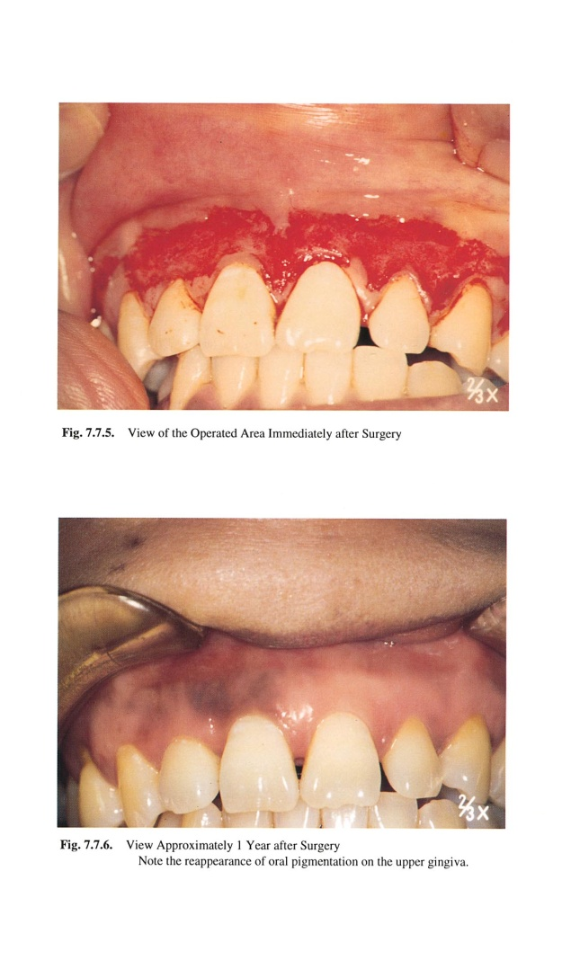
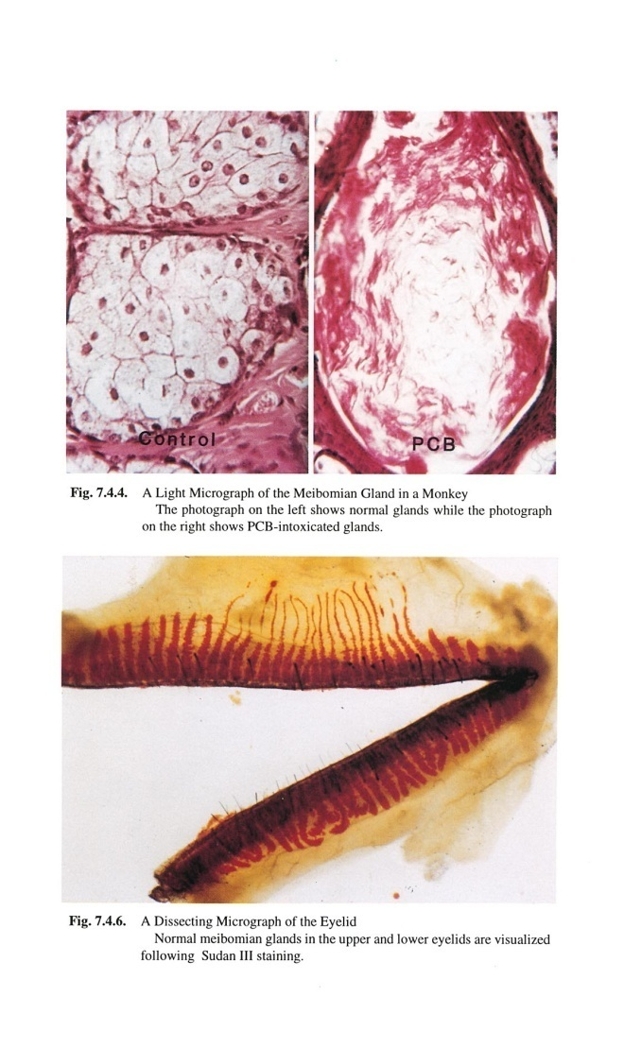
Kanemi Yusho
YUSHO (Kushu University)

Slide 3
Trend of PCB Use in Japan
Total 58,000t
Amount of PCB use (t)

Slide 4
Time trend of Co-PCBs（TEQ）
Matsumura et al, symposium of J.Env.Chem, 2003.6

Slide 5
Time trend of Co-PCBs（TEQ）

Slide 6
Time trend of PCB levels in ambient air (log scale)

Slide 7
(
ng/m
3
)
(
pg/m
3
)
1000
Ambient air
100
10
1
0.1
0.01
1970
1975
1980
1985
1990
1995
2000
2005
Time trend of PCBs concentration in ambient air (ng/m
3
)
Time trend of PCBs concentration in ambient air (pg/m
3
)

Slide 8
Time trend of PCB levels in breast milk

Slide 9
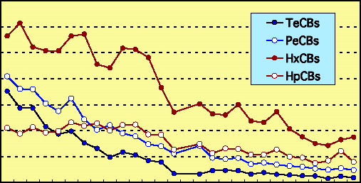
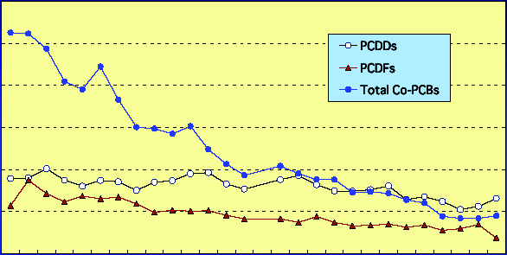
Time trend of breast milk levels
µg / g-fat
0.3
0.2
0.1
0
µg g-fat
PCB
60
40
20
0
60
40
20
0
pg TEQ/g-fat
pg TEQ/g-fat
Dioxins
Year (1973-2000)
Year (1973-2000)
Konishi et al. (2003)
Konishi et al (2003) Organohalogen compds

Slide 10
PCB pollution in Japan almost finished?
1972 banned PCB production & usage
1986-89 liquid PCB was completely destroyed
except transformer, capacitor, …10% of Total
(National project in Takasago, Hyogo pref.)

Slide 11
Unintentional formation
- Organic Pigment
- FeCl3

Slide 12
- Organic Pigment
Pigment-A
Pigment-B
(N.D.)
M1CB
(N.D.)
M1CB
#11(3-3)
D2CB
#11(3-3)
D2CB
#35(34-3)
T3CB
(ﾌﾗｸﾞﾒﾝﾄｲｵﾝ)
T3CB
#77
#52
(34-34)
T4CB
(25-25)
T4CB
#101
(N.D.)
P5CB
(245-25)
P5CB

Slide 13
- Organic Pigment

Slide 14
PCB Treatment at Japan Environmental Safety Corporation (JESCO)
– A National Project of Japan –

Slide 15
Outline of JESCO
- Established in 2004 under the “Japan Environmental Safety Corporation Law (Law No.44 of 2003)
- The only national body (special company wholly owned by the government) in charge of PCB waste treatment
- Is to construct and operate 5 regional PCB waste treatment facilities throughout Japan, under supervision of the central government
- National subsidies granted for construction

Slide 16

Structure of PCB Waste Treatment in Japan
Prefectures and Specified Cities
The local governments are in charge of
gathering PCB waste storage information
from the PCB Waste Holders
and make treatment plans for their regions.
JESCO accepts waste from the waste holders
according to the local governments’ plans.
Ministry of the Environment (MOE)
Report of reported PCB wastes under jurisdiction
Report of PCB wastes
Authorize & Direct
PCB Waste Treatment Plan
PCB Waste Treatment Basic Plan
(Identification of PCB amount, Treatment Plan)
(Identification of PCB amount, Establish Treatment Framework)
Authorize & Direct
Acceptance Plan
・Supervise & Direct
・Approval of Business Plan
PCB Waste Holders (at over 50,000 sites)
PCB Waste
Japan Environmental Safety Corporation ・Construction of Facility ・ Operation of Facilityx
Subsidies for Construction of Facility
Authorize & Direct
Transpor- tation Contract
Approved Transpor- tation
Companies
Industrial Waste Treatment / Recycling Companies
Approve
Regional Facility
Transport
Carry In
Residue
Accep- tance
Chemical Treatment
Material for Recycle
Transpor- tation Fee
Operation
Waste
Waste holders must report
their storage status
to their local government
annually
have approved transportation
companies carry
their wastes to JESCO
Regional Facility
JESCO detoxifies PCB wastes
using chemical treatment,
PCB-free residues and material for recycle
are shipped to decent industrial waste treatment
or recycling companies.
Treatment Contract
：
Local Authority
Treatment Fees
Regional Facility
Acceptance of Facility / Supervise & Direct
Subsidize small & medium-sized enterprises
Environmental Restoration and
Conservation Agency (ERCA)
Explanation Information Disclosure
Residents
PCB Waste Treatment Fund (Consists of subsidies from the government, local governments etc.)

Slide 17
Location of JESCO Facilities
: Area assigned to each facility
: Location of Treatment Facilities
Hokkaido Facility Muroran City, Hokkaido
Operation started: May. 2008
Kitakyushu Facility
Kitakyushu City, Fukuoka
Operation started: Dec. 2004
Osaka Facility
Osaka City, Osaka
Operation started: Oct. 2006
Tokyo Facility Koto-ku, Tokyo
Operation started: Nov. 2005
Toyota Facility
Toyota City, Aichi
Operation started: Sep. 2005
MOE made adjustments with local authorities, and obtained local consent to build
five treatment facilities as shown in this map.
Kita-kyushu , Osaka, Toyota , Tokyo , and Hokkaido Facility
Each facility has assigned prefectures, and although the area size differ
the amount of PCB waste stored in each area is about the same.

Slide 18
Outline of Regional PCB Waste Treatment Facilities
This slide shows the location, region, and the types of
PCB wastes accepted at each facility and capacity..
Facility | Location | Assigned to treat PCB wastes of below area | Types of PCB wastes treated | Capacity (PCB Oil)
Kitakyushu | Kitakyushu City, Fukuoka | 17 prefectures in Chugoku, Shikoku, Kyushu, and Okinawa Regions | 1st Phase: Transformers, capacitors, PCB oil stored in Kitakyushu City 2nd Phase: Transformers, capacitors, PCB oil, and PCB contaminated wastes stored in all assigned areas (Wastes to be treated together with 1st phase facilities) | 1.5 tons / day (Contaminated wastes: 10 tons / day)
Toyota | Toyota City, Aichi | 4 prefectures in Tokai Region | Transformers, capacitors and PCB oil | 1.6 tons / day
Tokyo | Koto-ku, Tokyo | 4 prefectures in South Kanto Region | Transformers, capacitors, fluorescent ballasts and PCB oil | 2.0 tons / day
Osaka | Osaka City, Osaka | 6 prefectures in Kinki Regions | Transformers, capacitors and PCB oil | 2.0 tons / day
Hokkaido | Muroran City, Hokkaido | 16 prefectures in Hokkaido, Tohoku, North Kanto, Koushinetsu, and Hokuriku Regions | 1st Facility: Transformers, capacitors and PCB oil Additional Facility: PCB contaminated wastes | 1.8 tons / day (Contaminated wastes: 4.8 tons / day)

Slide 19
Treatment Method Adopted at Each Facility
Facility | Pre-treatment | PCB Decomposition
Kitakyushu (Phase 1) (Phase 2) | Precise Recovery Cleansing Method*1 Vacuum Thermal Recycling Method (VTR Method) *2 | Dechlorination Method Sodium Dispersion Method (SD Method) *6 Melting Method Plasma Melting Method *3,*7
Toyota | Solvent Extraction Decomposition Method (SED Method) *3 | Dechlorination Method Ontario Hydro Technologies Sodium Dispersion Method (OSD Method) *8
Tokyo | MHI Chemical Cleansing Method*4 | Hydrothermal Oxidation Decomposition Method Hydrothermal Decomposition Method *4
Osaka | Solvent Cleansing Method*5 Vacuum Thermal Recycling Method (VTR Method) *2 | Dechlorination Method Catalyst Hydrogenation Dechlorination Method (Pd/C Method) *9
Hokkaido (1st facility) (Additional facility) | Solvent Extraction Decomposition Method (SED Method)*3 | Dechlorination Method Sodium Dispersion Method (SP Hybrid Method) *3 Melting Method Plasma Melting Method *3,*7
Translated names of above methods are informal Technology owned by following companies:*1 Mitsui & Co. *2 Z.E.R.O. Japan Co., Ltd. *3 Kobelco Eco-Solutions Co. Ltd. *4 Mitsubishi Heavy Industries, Ltd. *5 Toshiba Corporation *6 Nippon Soda Co., Ltd. *7 Nippon Steel Coporation, *8 Nuclear Fuels Industries, Ltd. *9 Kanden Engineering CO., Ltd.

Slide 20
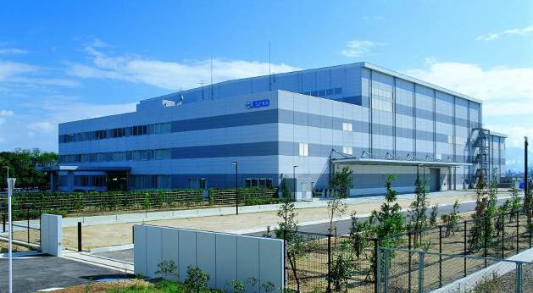
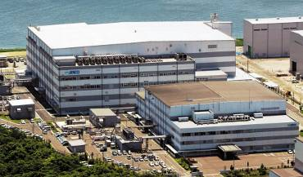
Kitakyushu Facility
↑1st phase facility
←1st phase facility in the front. (dechlorination)
2nd phase facility in the back. (plasma melting)

Slide 21
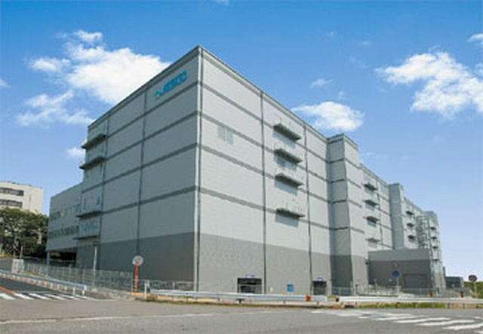
Toyota Facility

Slide 22
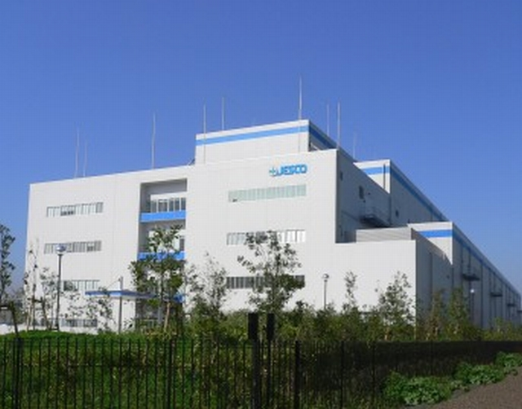
Tokyo Facility

Slide 23
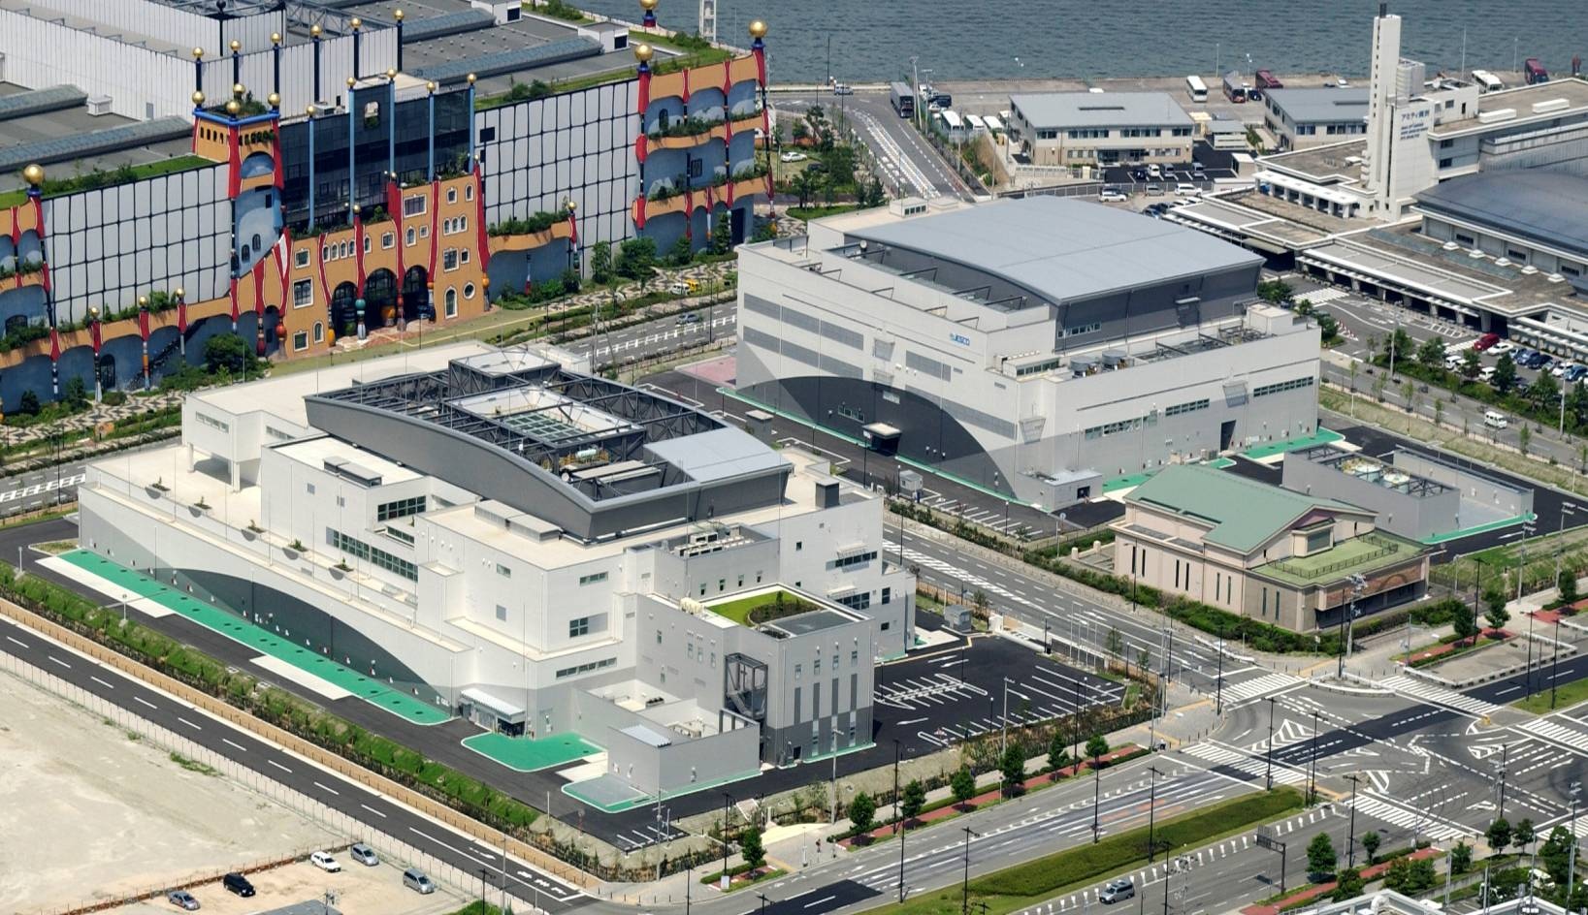
Osaka Facility

Slide 24
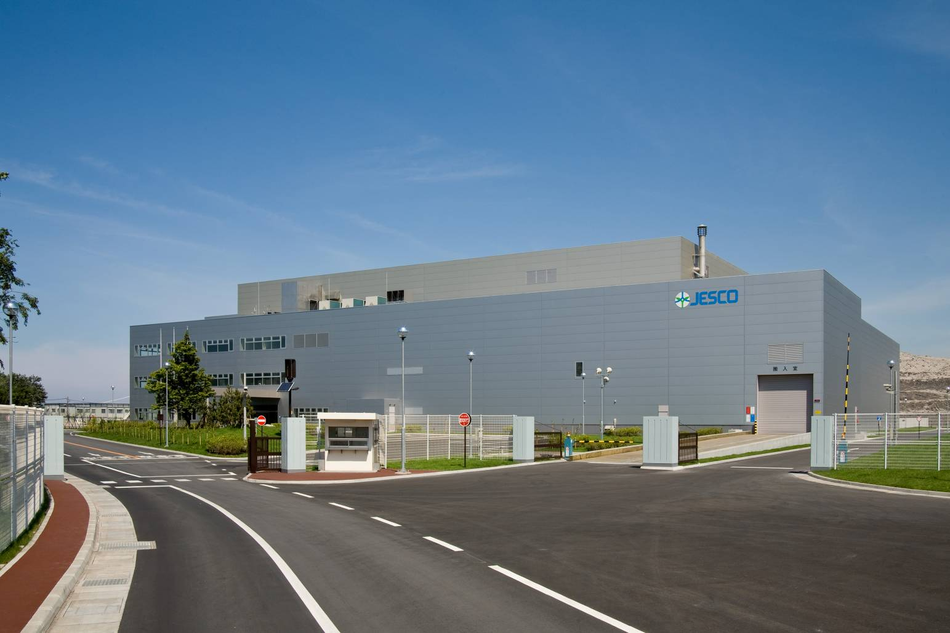
Hokkaido Facility

Slide 25
Basic Concept for Designing of Facilities
Safe & Secure PCB Treatment Method, Risk management,
and Information Disclosure lead to safe treatment.
Multidiscipline Engineering
Adoption of a Safe and Secure PCB Treatment Method
Multiple safety measures based on the concept of Risk Management
Information Disclosure on Treatment Status

Slide 26
Safety Design Concept
1. Safe design of
treatment process
・Cooperation with the location area and related authorities
・Information disclosure
2. Operation Monitoring System
Managing system for operations, maintenance and security
3. Fail-safe Functions
4. Safety Nets
Ensuring safety of the workers

Slide 27
Examples of Safety Nets
PCB Decomposition Facilities
Negative Pressure
Negative Pressure
Control
Multiple Measures to Prevent Underground Infiltration
Exhaust of Nitrogen, etc.
Air pressure of negative pressure rooms are controlled according to specified control level of the rooms
Leak-proof facilities and piping
↓
Oil Pan
↓
Oil Retraining Dike and Impermeable Floor
（Or Shield Floor）
Shield
Negative Pressure
Cleansing Facilities
Exhaust Gas Treatment
Exhaust of Nitrogen, etc
Exhaust Treatment Equipment
Oil Pan
Activated Carbon
Activated Carbon
Exhaust Gas
Exhaust gas is treated in exhaust treatment equipment, and furthermore, filtered through activated carbon as a safety-net
Shield
Negative Pressure
PCB wastes are carried directly inside the treatment building
Shield Floor
（Double structure）
Oil Extracting and Disassembling Facilities
Exhaust from Shield
Carrying in, Acceptance and Inspection
Exhaust Gas Monitoring
Exhaust gas is monitored online and offline, and only released if it meets standards

Slide 28
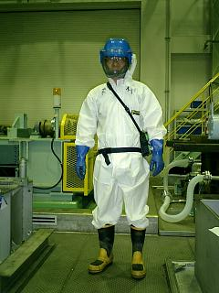
Examples of Ensuring Safety of Workers
Work Management & Health Management
- Workers are required to wear appropriate protective gear when working at atmospheres where dioxin levels are over 2.5pg-TEQ/m3, or where PCB levels are over 0.01mg/m3 (LEVEL 3 ZONES). Below is an example.
Chemical protective clothing*
Chemical protective gloves* + inner gloves
Chemical protective boots*
Respiratory Protective Equipment
with electric fan
(* Permeation resistance to PCB are tested)
- Appropriate protective gear is required according to the work content, at lower level zones too.
- Entrance time is limited to reduce exposure: Example : A worker can enter high level areas Only 2-3 hours per day.
- Blood PCB levels are checked periodically.
Some areas require frequent changing
Example of Protective gear at Kitakyushu Facility
Used gear cannot be carried outside room
Notes:
28

Slide 29
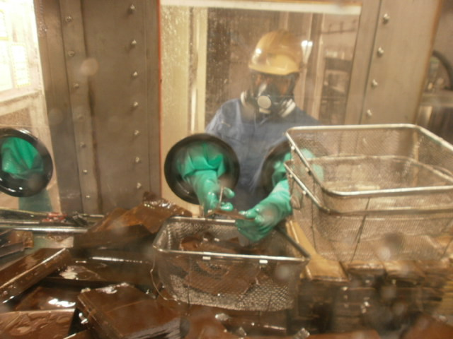
Examples of Ensuring Safety of Workers
Glove box
To reduce workers’ risk of exposure to PCB, processes such as the dismantling of capacitors are done inside a closed “glove box”.
cutting of capacitor elements, which include 100% pure PCB
Notes:
29

Slide 30
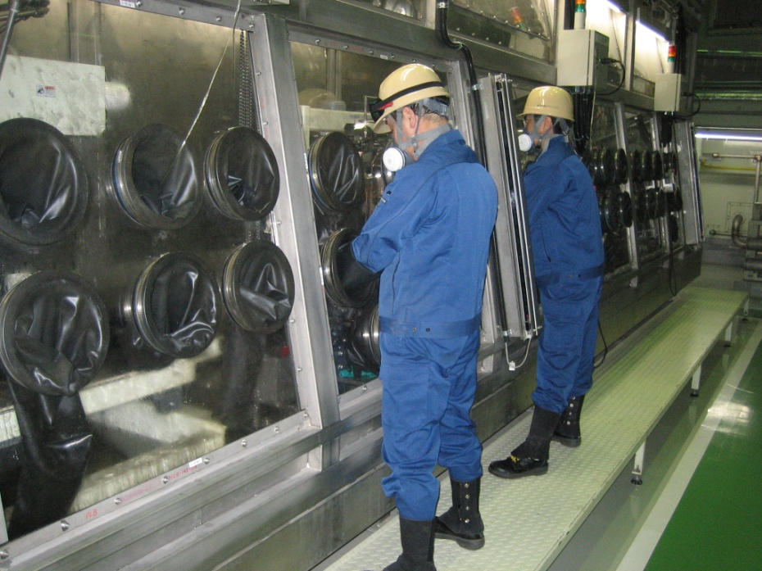
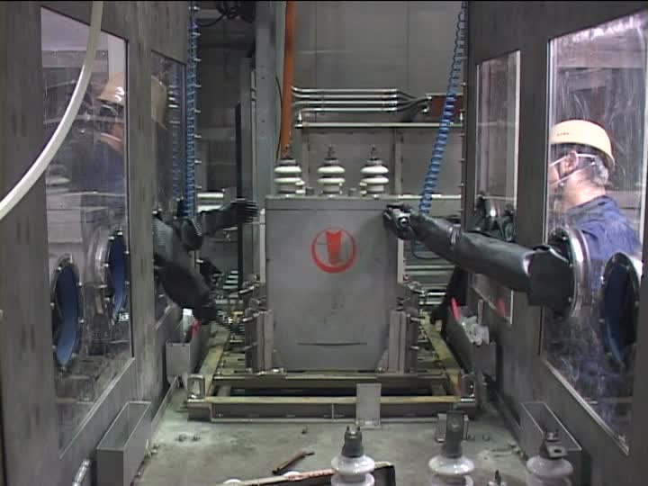
Dismantling of Capacitors (Glove box)
These are other angles of capacitors being dismantled in glove boxes.

Slide 31
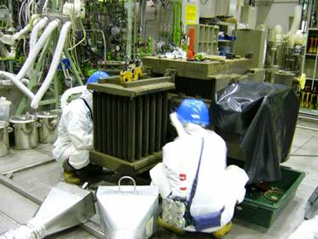
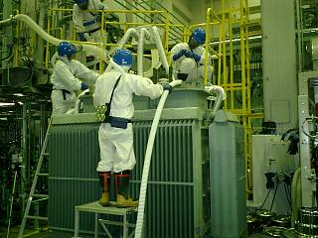
PCB Removal
(Draining and Cleaning Transformers)
PCB oil of transformers are drained from the drain valve on the bottom. Local exhaust ventilations are set to minimize PCB level in the working atmospheres.
After draining, the casings are repeatedly washed with circulating cleaning solvents
until the PCB level are low enough and safe to open up the transformers.

Slide 32
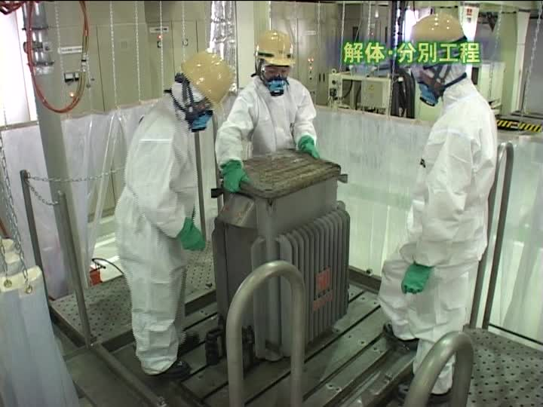
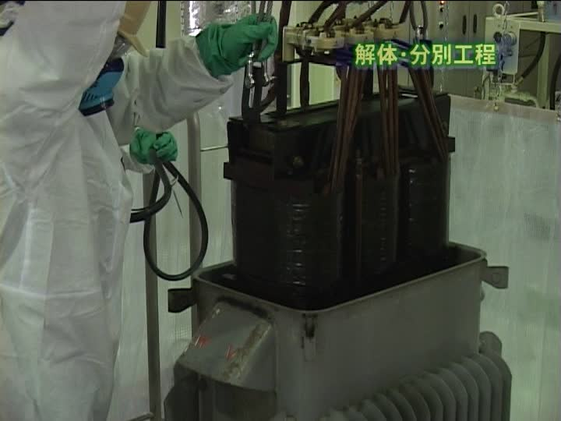
PCB Removal (Dismantling and Removal of Core of Transformers)
Once the PCB levels are low enough the transformer is cut open
and the cores are removed for further treatment.

Slide 33
PCB Level after Treatment
At JESCO, PCB level of transformers are reduced by1/1,200,000, and that of capacitors are reduced by 1/2,000,000 before shipping.
Transformers
1 / 1,200,000
Standard
Liquid treatment
PCB level
0.5mg/kg and below
100％ PCB concentration
（0.6kg/kg）
oil
Dismantling and washing
Washing repeated until
PCB level is
160mg/kg*
PCB level of washing solvent
0.5mg/kg and below
First
Washing
Casings paper wood
PCB level of effluent
0.003mg/L and below
（1 / 3,750）
（1 / 320）
*Example at Kitakyushu Facility
Capacitors
1 / 2,000,000
PCB level
0.5mg/kg and below
100％
PCB concentration (1kg/kg)
Liquid treatment
oil
PCB level of washing solvent
0.5mg/kg and below
Casings paper other
Cleaning**
（1 / 2,000,000）
PCB level of effluent
0.003mg/L and below
**Wiping test methods are applied for the casings of capacitors treated in VTR (Vacuum Thermal Recovery) furnaces at Kitakyushu and Osaka Facilities.

Slide 34
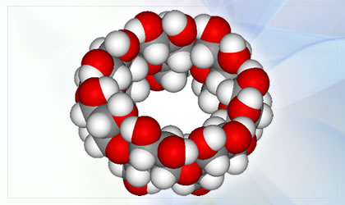
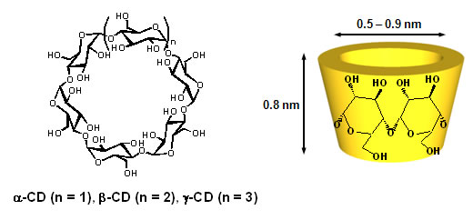
PCB treatment

Slide 35
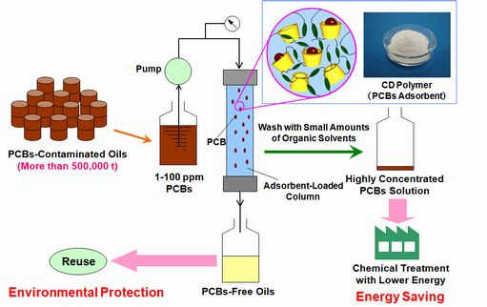
PCB treatment

Slide 36
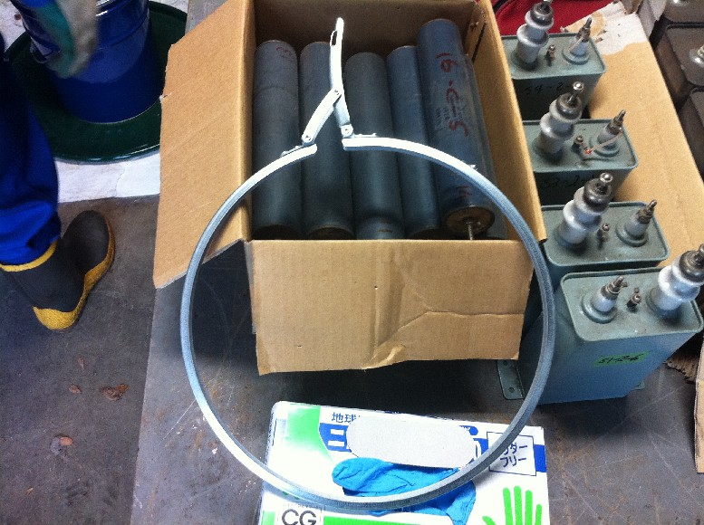
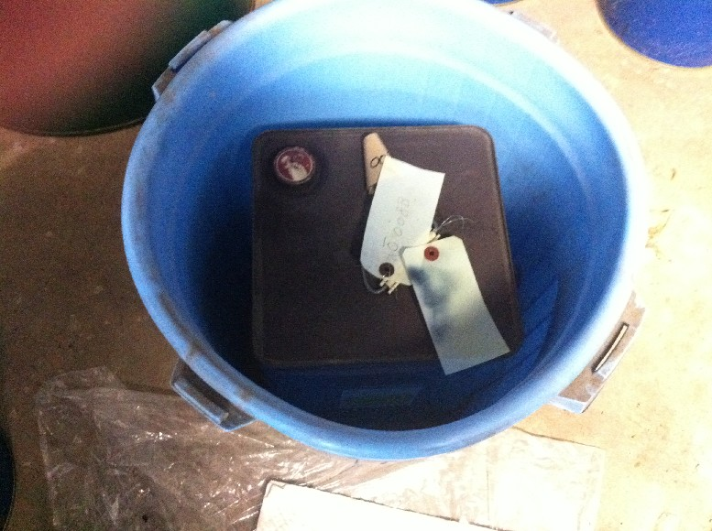
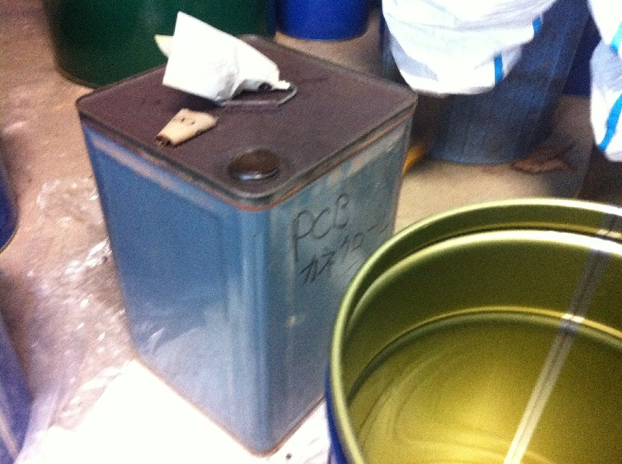
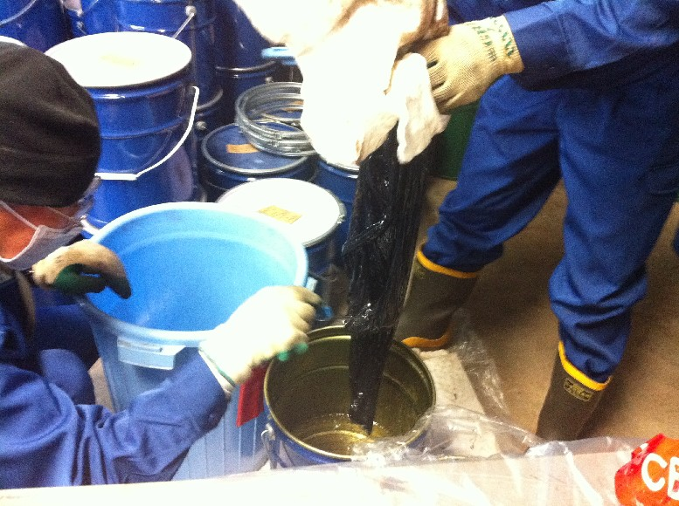
Transportation company

Slide 37
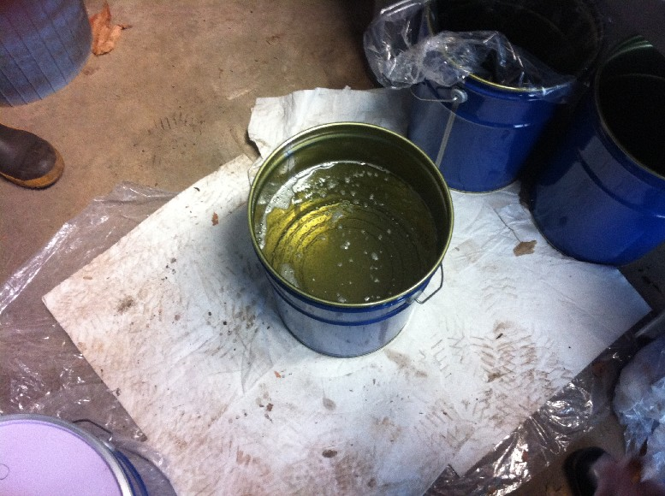
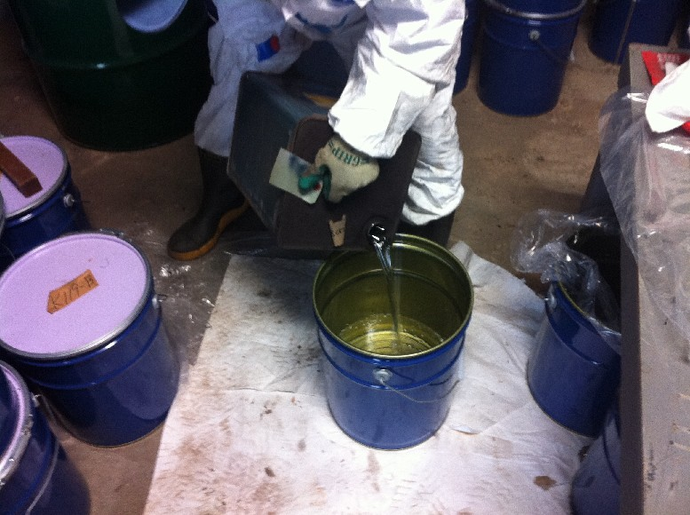
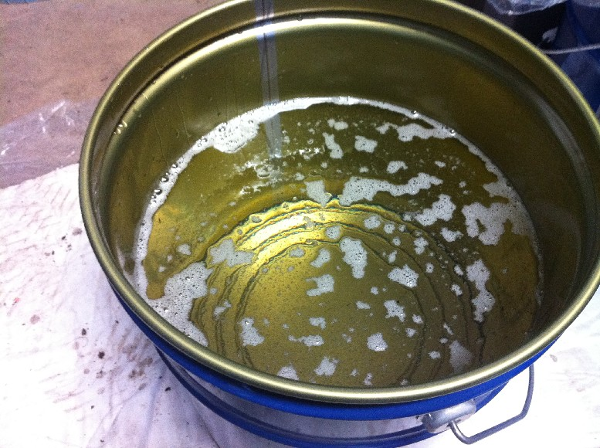
Transportation company

Slide 38
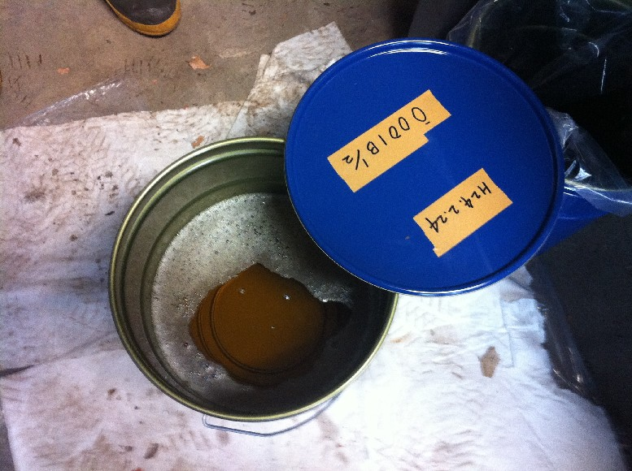
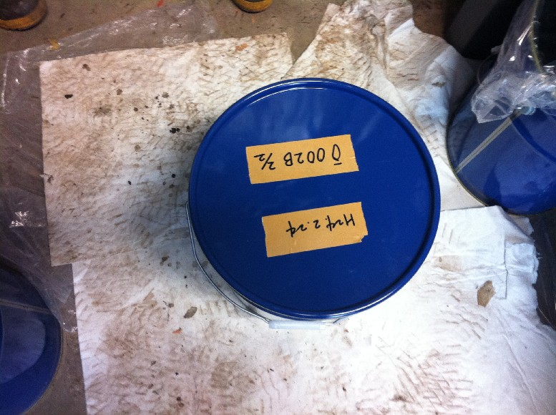
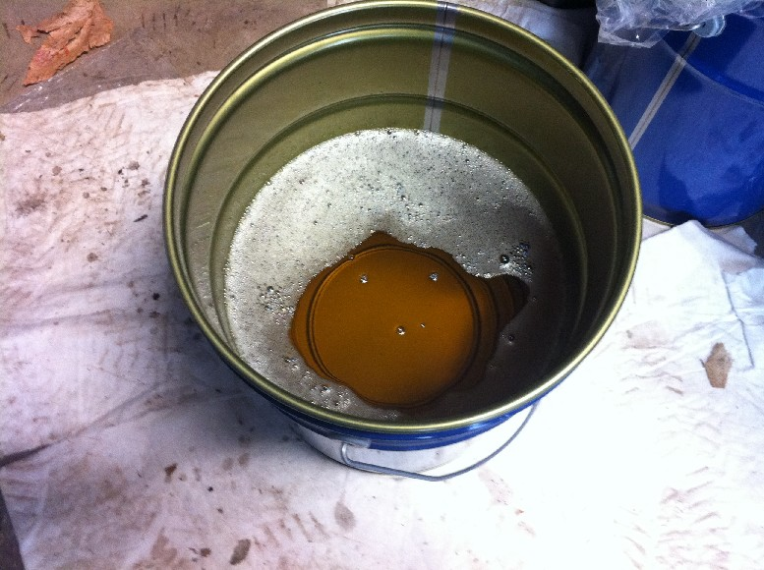
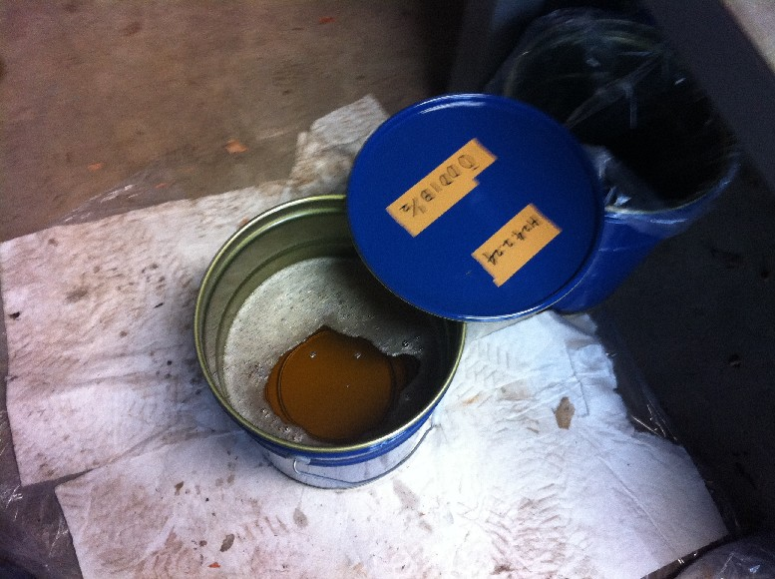
Transportation company

Slide 39
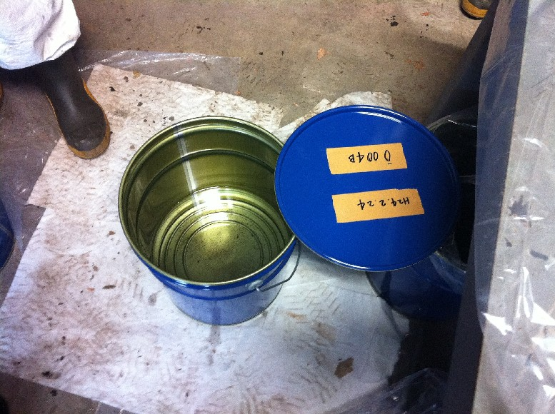
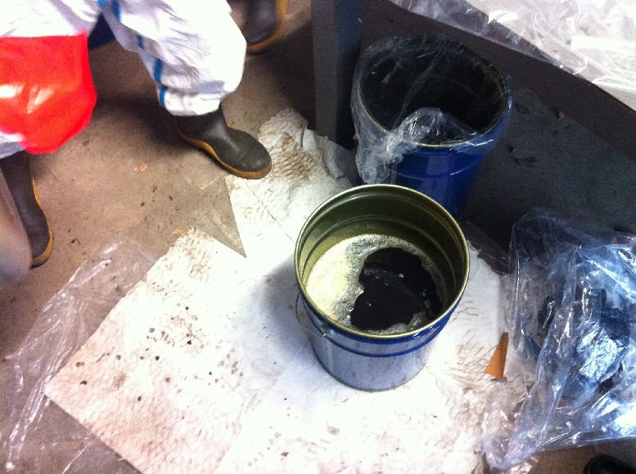
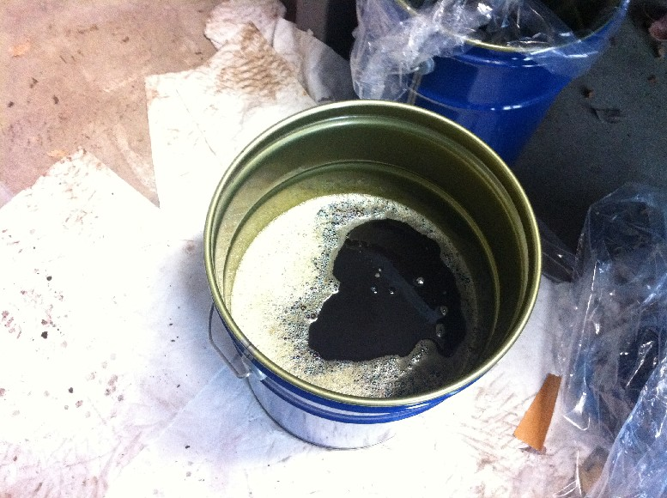
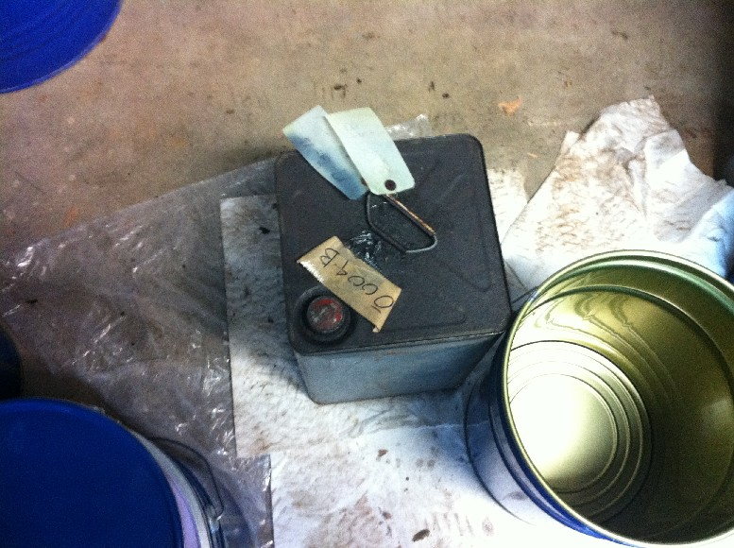
Transportation company

Slide 40
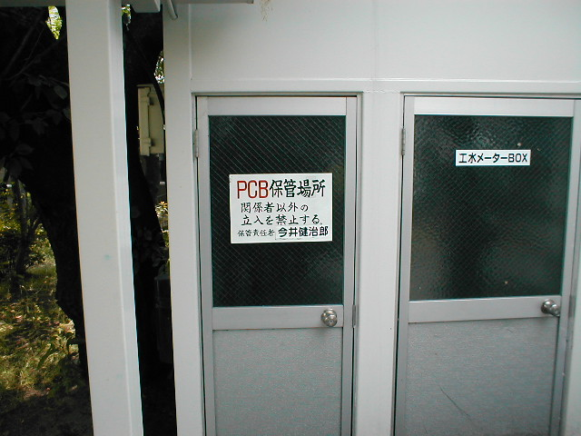
Stored PCB contaminated waste

Slide 41
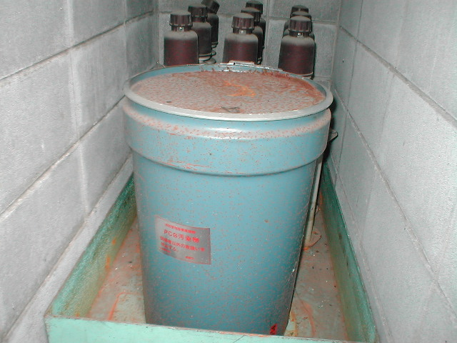
Various type of PCB contaminated waste

Slide 42
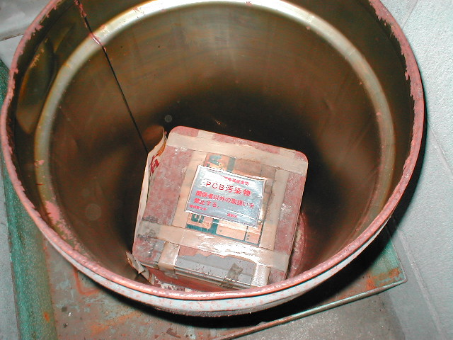
Various type of PCB contaminated waste

Slide 43
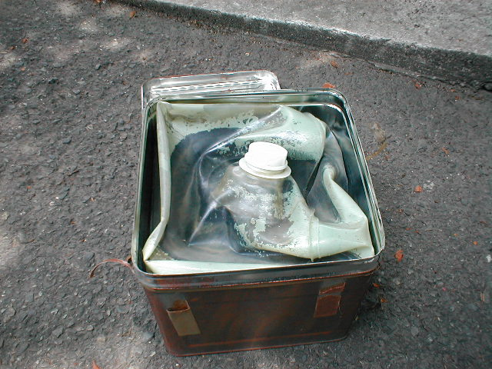
Various type of PCB contaminated waste

Slide 44
Urine Monitoring for risk reduction
Transportation workers

Slide 45
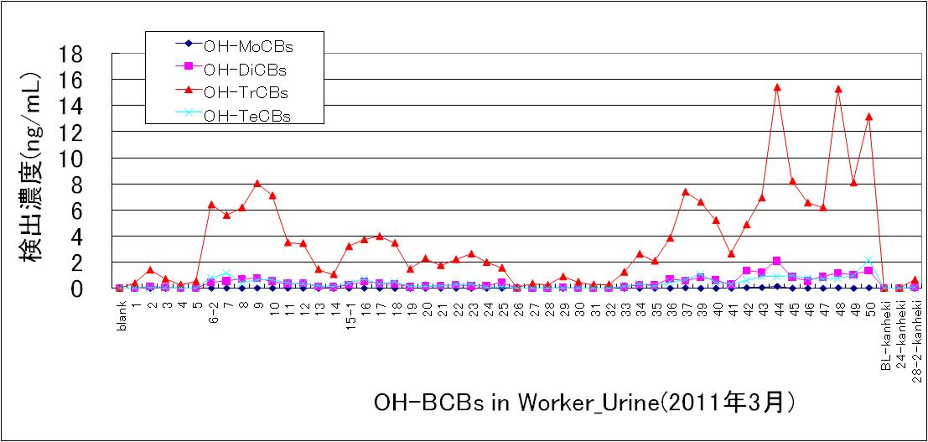
OH-PCBs in Urine (ng/mL)
OH-TrCBs
OH-TrCBs
Urine No for OH-PCBs analysis
OH-PCBs in Urine (Transportation Workers)

Slide 46
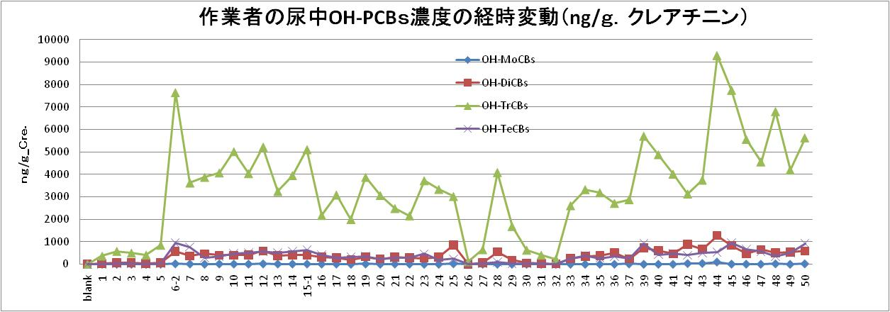
OH-PCBs in Urine (ng/g-creatinin)
OH-PCBs in Urine (Transportation Workers)
OH-TrCBs
OH-TrCB
24hrs
OH-TrCBs
Urine No for OH-PCBs analysis(Mar. 2011)

Slide 47
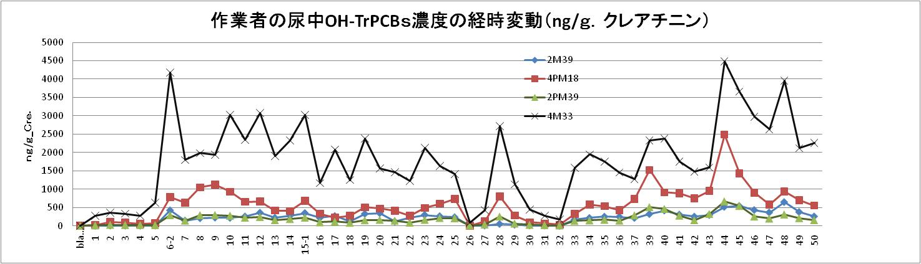
OH-PCBs in Urine (ng/g-creatinin)
OH-PCBs in Urine (Transportation Workers)
4-OH-CB33
4’-OH-CB33
Urine No for OH-TrCBs analysis (Mar. 2011)

Slide 48
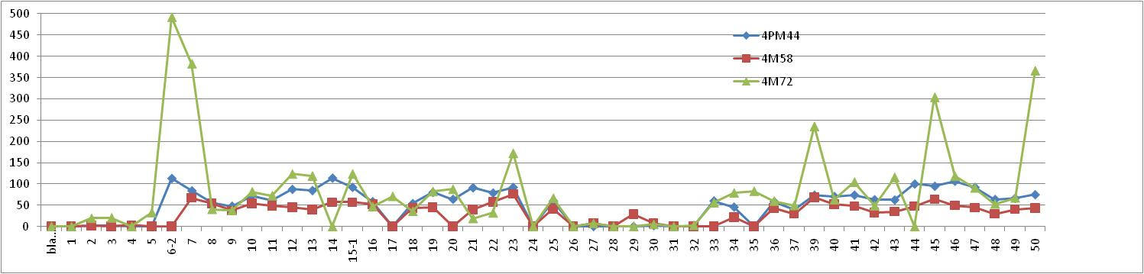
OH-PCBs in Urine (Transportation Workers)
4-OH-CB72
4’-OH-CB44
4-OH-CB58
4-OH-CB72
OH-PCBs in Urine (ng/g-creatinin)
Urine No for OH-TeCBs analysis analysis (Mar. 2011)

Slide 49
Transportation workers
30 years
47 years
62 years
65years
45 years
62 years
Urine No for OH-TeCBs analysis analysis (Jan. 2012)
3 Transportation workers & 3 researchers

Slide 50
Acknowledgements
- Ministry of The Environment, Japan(MOE)
- Japan Environmental Safety Corporation(JESCO)
- Osaka University, Graduate Sachool of Engineering
- Joint Research Chair for PCB separation & Concentration System
- Kobe University, Graduate Sachool of Maritime Science
- Hyogo prefectural Institute of Environmental Sciences
- JESCO Express
- Hokkaido Research Organization
- Chiba Prefectural Environmental Reserch Center
- National Institute for Environmental Studies

Slide 51
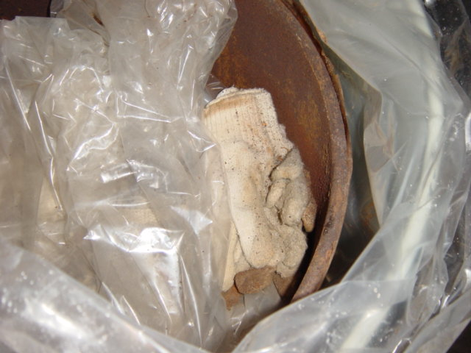
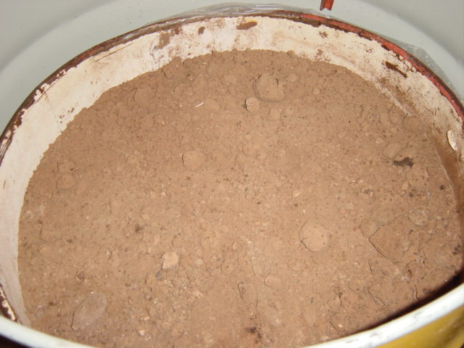
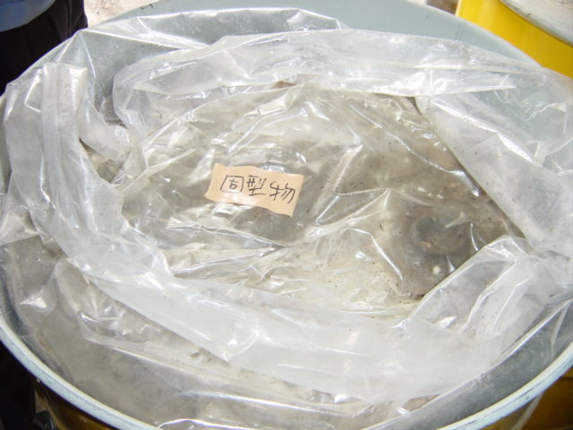
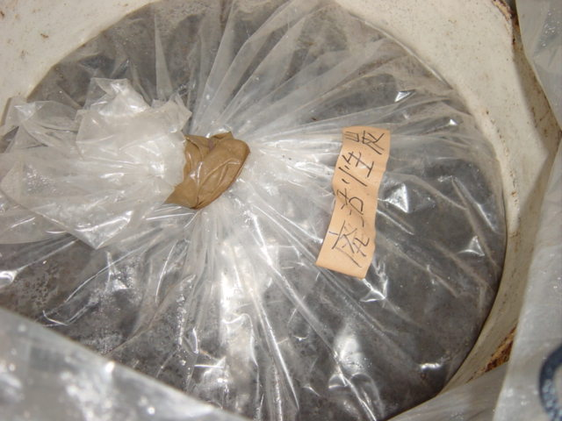
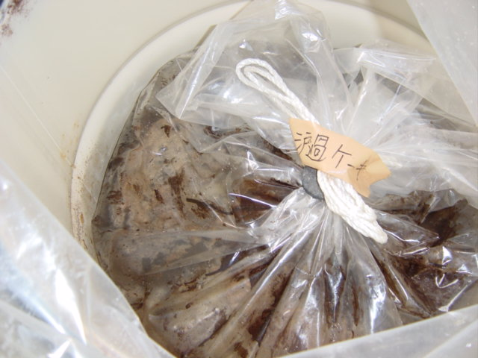




Various type of PCB contaminated waste

Slide 52

Stored drum PCB sediment in underground

Slide 53

Stored drum PCB sediment in underground

Slide 54

Stored drum PCB sediment in underground

Slide 55

Various type of PCB contaminated waste

Slide 56

Various type of PCB contaminated waste

Slide 57

Various type of PCB contaminated waste

Slide 58

Various type of PCB contaminated waste

Slide 59

PCB contaminated waste under the parking

Slide 60

PCB contaminated waste under the parking

Slide 61

PCB contaminated waste in the drum

Slide 62

Sampling of PCB contaminated waste

Slide 63

Sampling of PCB contaminated waste

Slide 64

Sampling of PCB contaminated waste

Slide 65

Various type of PCB contaminated waste

Slide 66

Various type of PCB contaminated waste

Slide 67
Various type of PCB contaminated waste

Slide 68

Various type of PCB (paper condenser)

Slide 69

PCB free (paper condenser)

Slide 70

Various type of PCB waste

Slide 71

Various type of PCB waste

Slide 72

Various type of PCB waste

Slide 73

Various type of PCB waste

Slide 74

Various type of PCB waste

Slide 75

Various type of PCB waste

Slide 76

Stored PCB contaminated waste

