Slide 1
POPsモニタリングと異性体分析 -研究者・技術者の連携と情報の共有
大阪大学大学院工学研究科
中野 武

Slide 2
PCB製品中の異性体

Slide 3
Typical PCB brand name in different country
(ASKAREL : UK / DELOR : Czecho / SOVOL : Russia)
Japan
USA
Germany
France
France
Italy
Kanechlor | Aroclor | Clophen | Pyralene | Phenoclor | Fenclor
KC-200 | 1232 |  | 2000
KC-300 | 1242 | A-30 | 3000 | DP-3 | 42
KC-400 | 1248 | A-40 |  | DP-4
KC-500 | 1254 | A-50 |  | DP-5 | 54
KC-600 | 1260 | A-60 |  | DP-6 | 64
Dominant structure in the PCB product

Slide 4
Dominant structure in the phenyl ring of PCB product

Slide 5
特異なPCB異性体組成

Slide 6
Cement Industry (Stack gas)
meta position substitution : dominant
CB-35
CB-2
CB-13
CB-2 : 90% of total PCB
CB-38

Slide 7
carpet manufacturing plant
ortho position substitution :dominant
CB-4 : 70% of total PCB
CB-4
70%
CB-1
5%
Homologue distribution of PCB (water)
4%
CB-19
Congener profile of PCB (water)
dominant congeners

Slide 8
Thermal oxidization process (stack gas)
TrCB
CB-47
#47
#51
#68
TeCB
CB-68
1,3,6,8-TCDF
CB-51

Slide 9
非意図的POPs生成と特異異性体
- 有機顔料

Slide 10
顔料中のPCB異性体

Slide 11
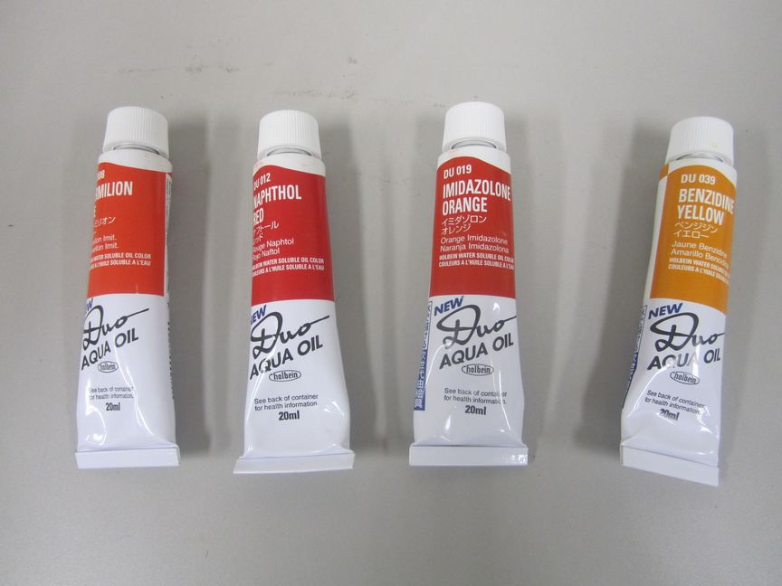
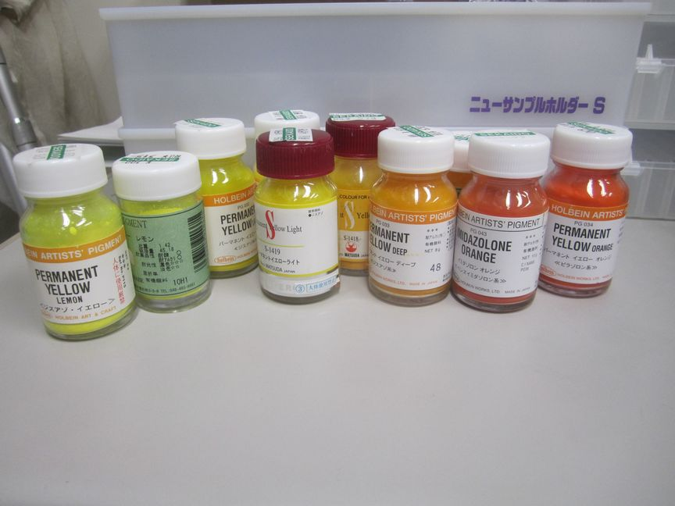

Slide 12

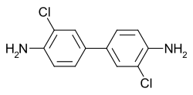
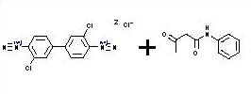
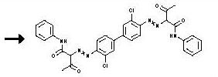
NaNO₂, HCl
顔料の合成過程の例

Slide 13
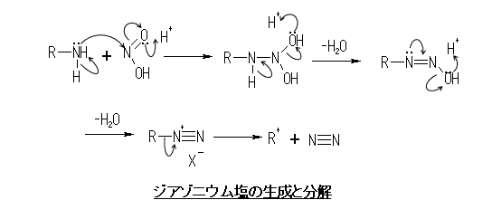
一級アミンを酸性水溶液中で亜硝酸塩に作用させると、
速やかにジアゾニウム塩を生成する。

Slide 14
CB-52(25-25)
NaNO₂, HCl
NaNO₂, HCl
CB-101(245-25)
2,2’,5,5’-テトラクロロベンジジン
(CuCl₂)
ザンドマイヤー反応
Ar-N⁺≡N + CuX → Ar-X + Cu⁺ + N₂↑
芳香族ジアゾニウム塩を塩化銅(存在下に生成させ、加温分解すると、アミノ基が塩素置換されたアリールが生成
CB-153(245-245)
Notes:
ザンドマイヤー反応
芳香族ジアゾニウム塩をフッ素を除くハロゲン化銅(I)あるいはシアン化銅(I)、チオシアン化銅(I)の存在下に生成させ、加温分解すると、元のアミノ基の位置が対応するハロゲンあるいはシアノ基・チオシアノ基で置き換えられた置換アリール体が得られる。この反応は1884年に発見した T. Sandmeyer に因んでザンドマイヤー反応と呼ばれる。この反応は一電子移動を含むラジカル的な機構を経て進行し、中間体としてアリール銅化合物を経由すると考えられている。
Ar-N⁺≡N + CuX → Ar-X + Cu⁺ + N₂↑ (X = Cl, Br, CN, SCN) ハロゲンがフッ素の場合はフッ化銅(II)がフッ化銅(I)に比べて安定なため反応が進行しない（フッ化銅(I) は放置すると不均化を起こしてフッ化銅(II)と金属銅となる）。

Slide 15
顔料中のPCB異性体（ジスアゾ系）
permanent yellow lemon; PY81;

Slide 16
- Organic Pigment
Pigment-A
Pigment-B
(N.D.)
M1CB
(N.D.)
M1CB
#11(3-3)
D2CB
#11(3-3)
D2CB
#35(34-3)
T3CB
(ﾌﾗｸﾞﾒﾝﾄｲｵﾝ)
T3CB
#77
#52
(34-34)
T4CB
(25-25)
T4CB
#101
(N.D.)
P5CB
(245-25)
P5CB

Slide 17
- Organic Pigment

Slide 18
非意図的POPs生成と特異異性体
- FeCl3

Slide 19
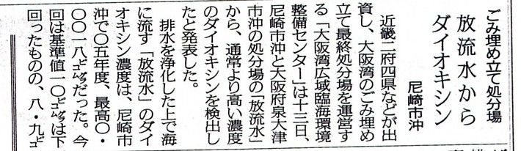

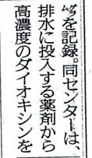
塩化第二鉄液のPCB汚染問題 2006.11.13
放流水 0.002 pgTEQ/L が8.9 pgTEQ/L

Slide 20
塩化鉄(II) （フェロ） 水中 黄緑色
塩化鉄(II) FeCl₂ は緑黄色の結晶である。かつては塩化第一鉄（えんかだいいちてつ）と
も呼ばれた。水に易溶。
塩化鉄(III) （フェリ） 水中 赤褐色
塩化鉄(III) FeCl₃ は緑がかった黒色の葉状結晶である。かつては塩化第二鉄（えんかだ
いにてつ）とも呼ばれた。金属光沢がある。融点は 302 ℃。アルコールやエーテルに可
溶である。水に解かすと赤褐色の溶液となる。
銅箔を腐食するのでプリント基板のエッチング剤としても利用される。
塩化鉄(III) の 2004年度日本国内生産量は 356,472 t、工業消費量は 29,314 tである。

Slide 21
pg-TEQ/L
塩化第二鉄
FeCl₃
PAC(ポリ塩化アルミ)
リン酸 NaOH H₂SO₄
NaOH
MeOH
NaOH H₂SO₄
NaOH H₂SO₄
次亜塩素酸ソーダ NaClO
NaOH
原水ポンプ井
加温槽
分配槽
接触酸化槽
硝化槽
脱窒槽
再ばっき槽
急速攪拌槽
緩速攪拌槽
凝集沈殿槽
中和槽
滅菌槽
放流槽
12.5m³
24m³
224m³

Slide 22
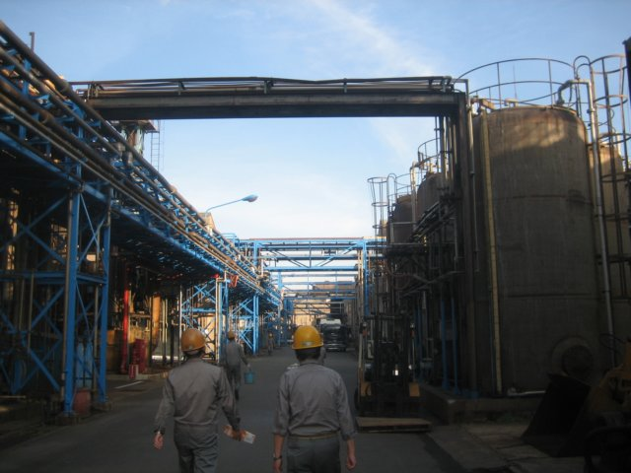
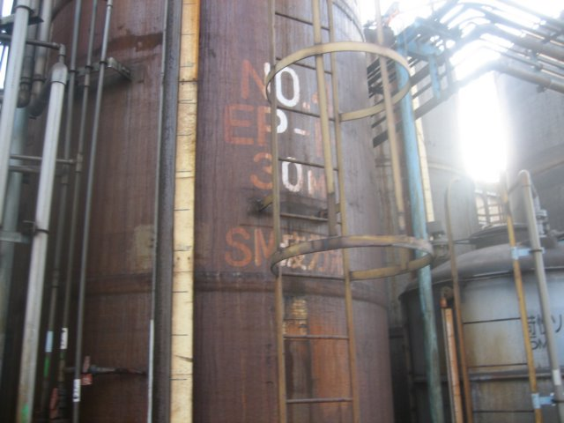
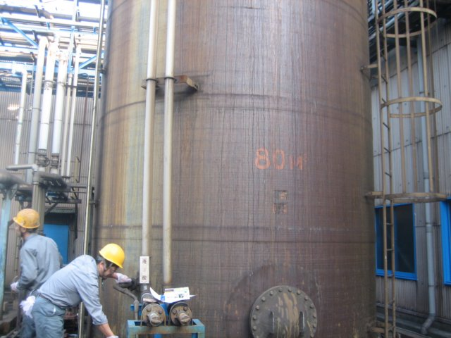
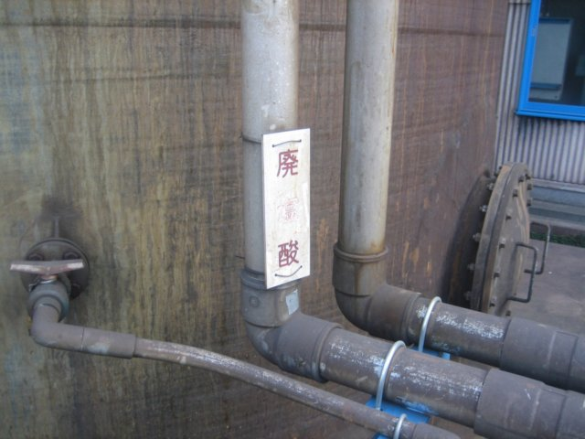
塩化第二鉄液のPCB汚染問題 2007.11.13

Slide 23
塩化第二鉄液製造フロー
鉄スクラップ 薄板端材、プレス屑
廃塩酸 鉄鋼 酸洗液 HCl+FeCl₂
原料タンク
濃度調整
ろ過
塩化第一鉄化 鉄溶解槽 2HCl+Fe FeCl₂+H₂ 2FeCl₃+Fe 3FeCl₂
廃塩化第二鉄液 エッチング使用済液 FeCl₂+FeCl₃
製品タンク
塩素ガス
ろ液タンク
プリント基板
塩素化 2FeCl₂+Cl₂ 2FeCl₃
50-120m³

Slide 24
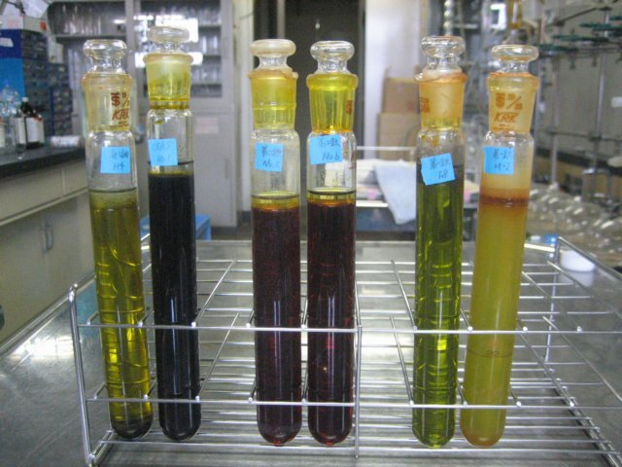
廃塩酸
エッチング液
FeCl₃
FeCl₂

Slide 25
塩化第二鉄不純物による環境汚染の未然防止
高濃度排水の原因を早期に究明
→ 河川水を分析し安全を確認
プリント基板の 酸洗浄液
（臭素系難燃剤を含有）
排水処理 凝集沈殿薬剤 ＦｅＣｌ_{３} 中の高濃度（PCB#126）
Cl
Cl
Cl
Cl
Cl
DL-PCB#126
（3, 3’,4, 4’,5-PeCB）
（ ）
Cl
Cl
Cl
Cl
Cl
Cl
Cl
Cl
Cl
O
O
Cl
１２３７８
２３４７８

Slide 26
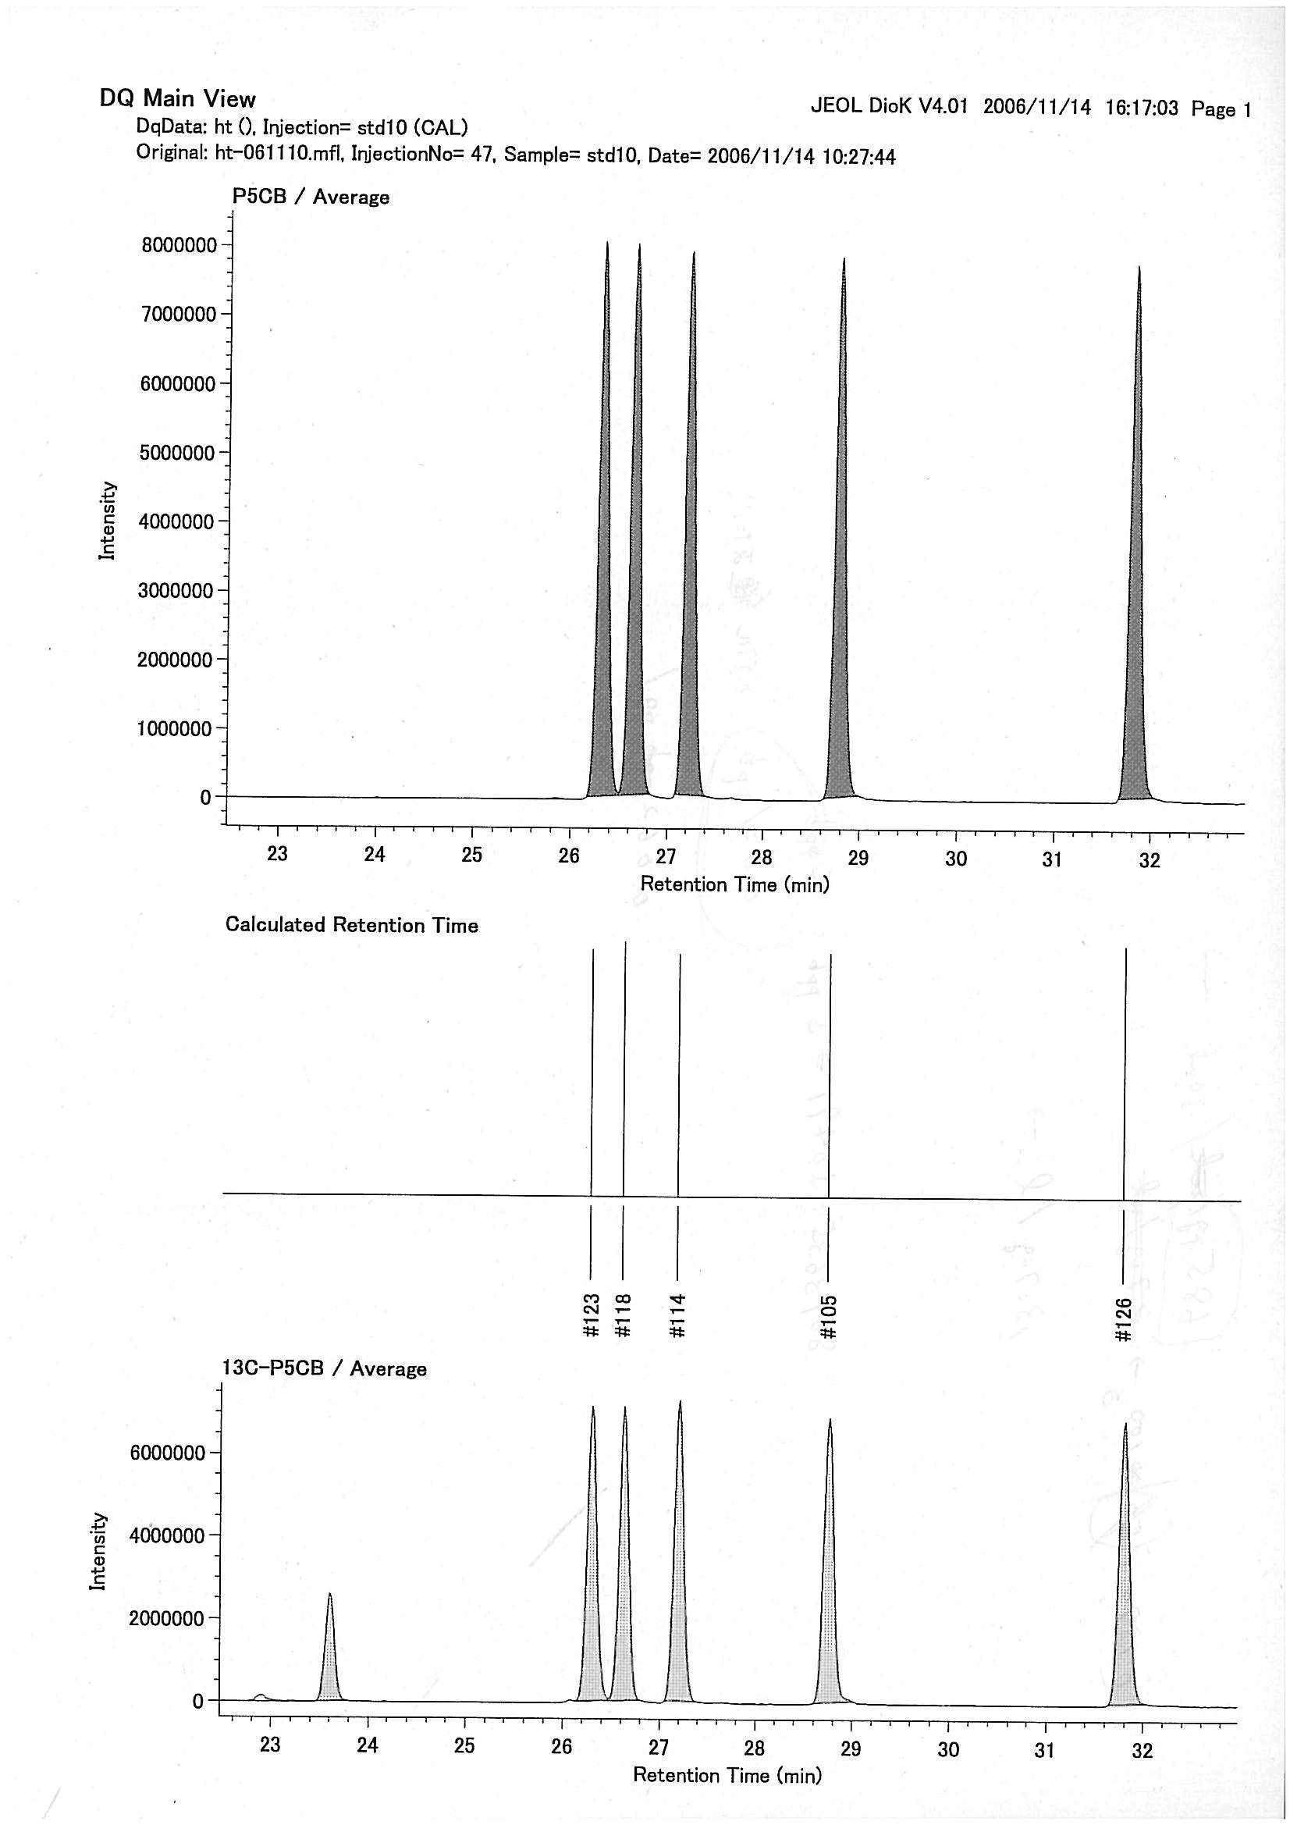
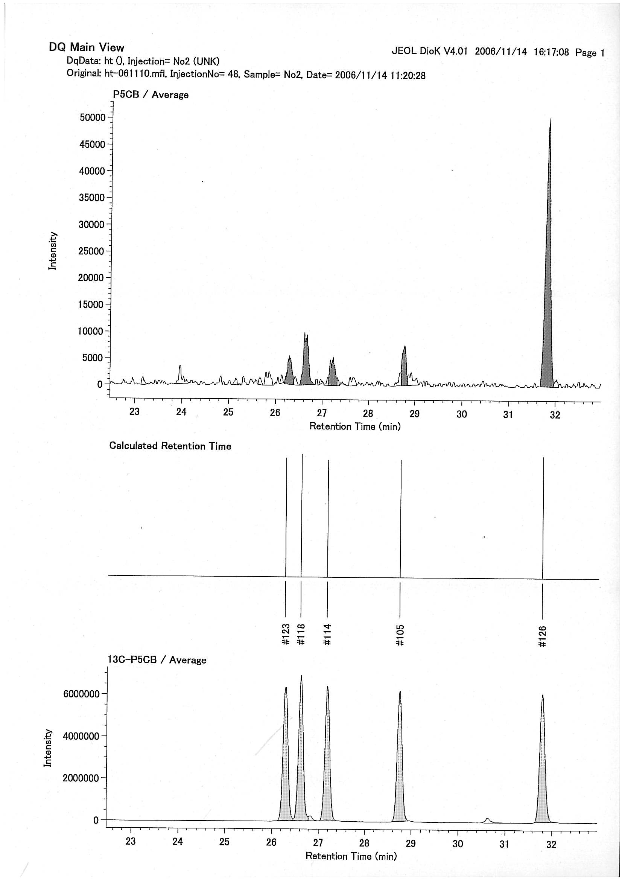

Slide 27
非意図的POPs生成と特異異性体
- クロルピリフォスから2378-TCDD-Nの熱的生成

Slide 28
PRELIMINARY ASSESSMENT OF DIOXIN-LIKE COMPOUNDS IN/FROM CHLORPYRIFOS
A POTENTIAL PRECURSOR OF THE PYRIDINE ANALOGUE OF 2,3,7,8-TCDD-
Sakiyama et al （Organohalogen compounds 2011)

Slide 29
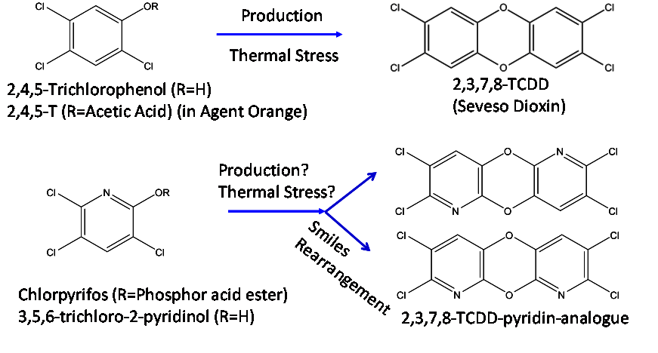

Slide 30

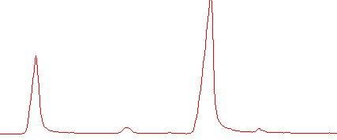
300ºC
3.5.6-trichloro 2-pyridinol
340ºC
380ºC
2,3,7,8-TCDD-N
thermal product
(TCDD-N analogue)
TIC chromatogram of thermal product from 3.5.6-trichloro 2-pyridinol

Slide 31
TCDD- N analogue
thermal product (380C)
2,3,7,8-TCDD

Slide 33
有機フッ素汚染
-連携

Slide 35
Congener profiles of PCBs in environmental samples

Slide 36
Congener profiles of PCBs(Di-, Tri-) in environmental samples

Slide 37
Congener profiles of PCBs in environmental and human samples

Slide 38
Congener profiles of PCBs(Hexa-) in environmental and human samples

Slide 39
Congener profiles of PCBs(Hepta-) in environmental and human samples

Slide 40
Congener profiles of PCBs in human samples (pooled blood)

Slide 41
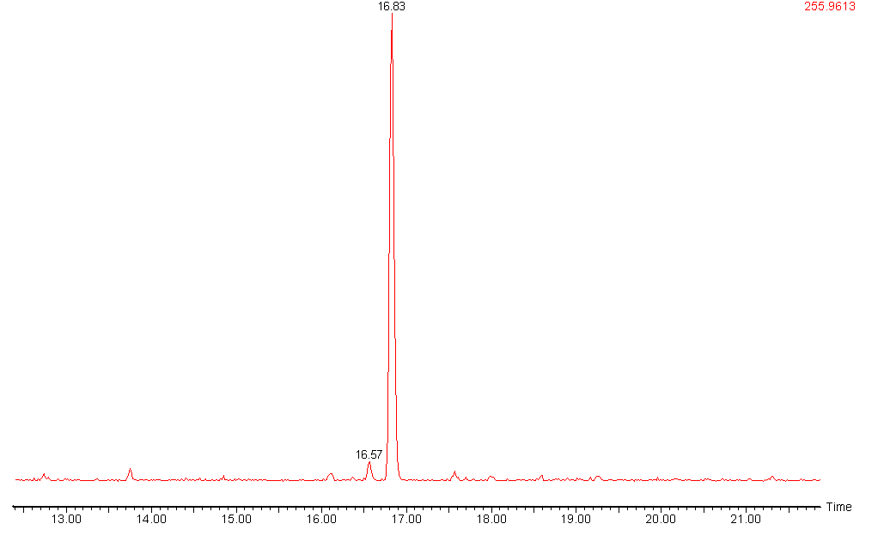
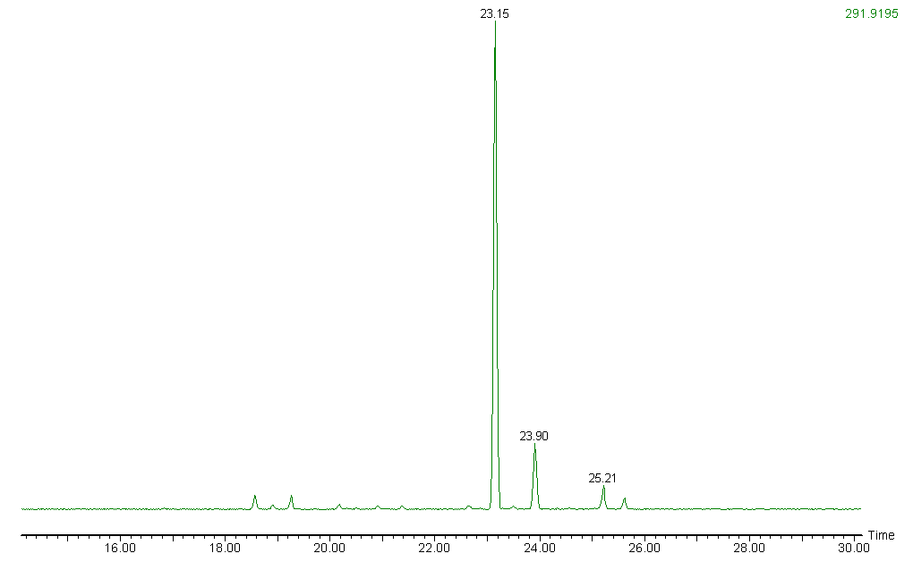
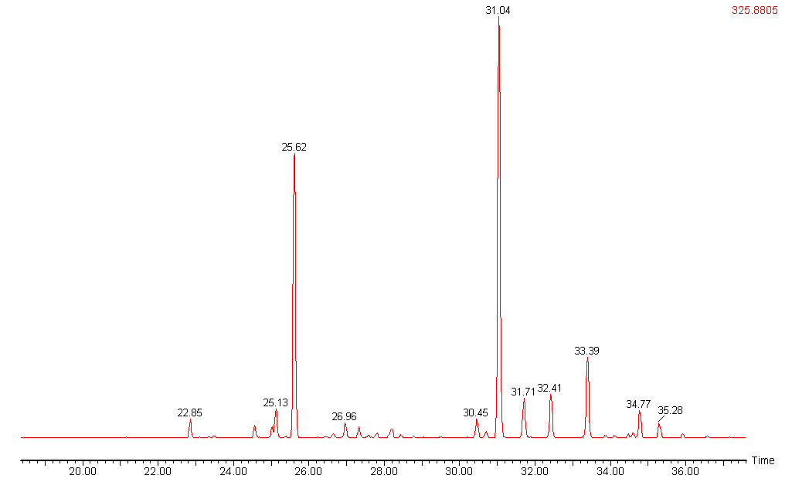
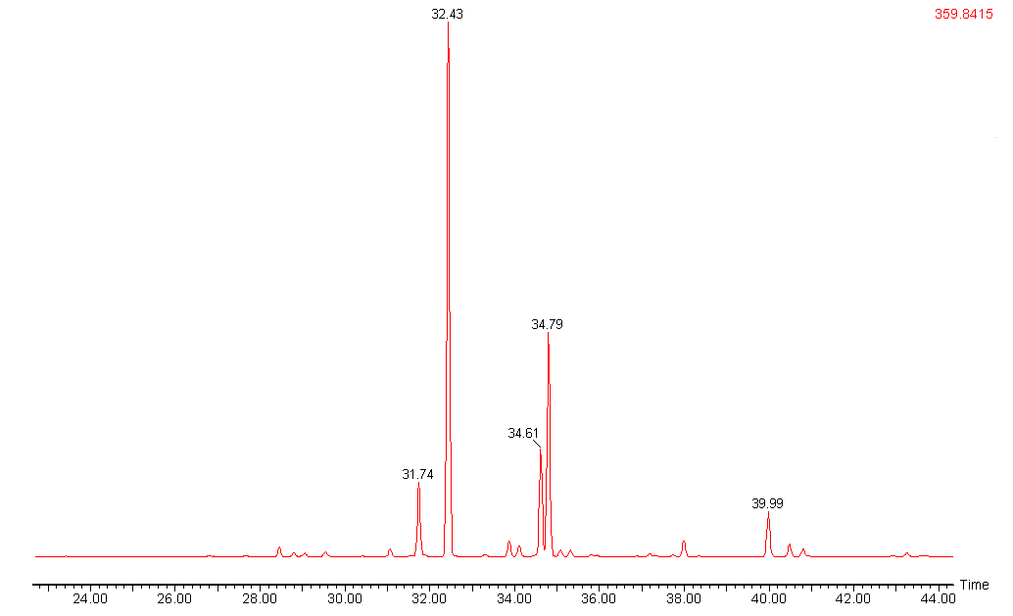
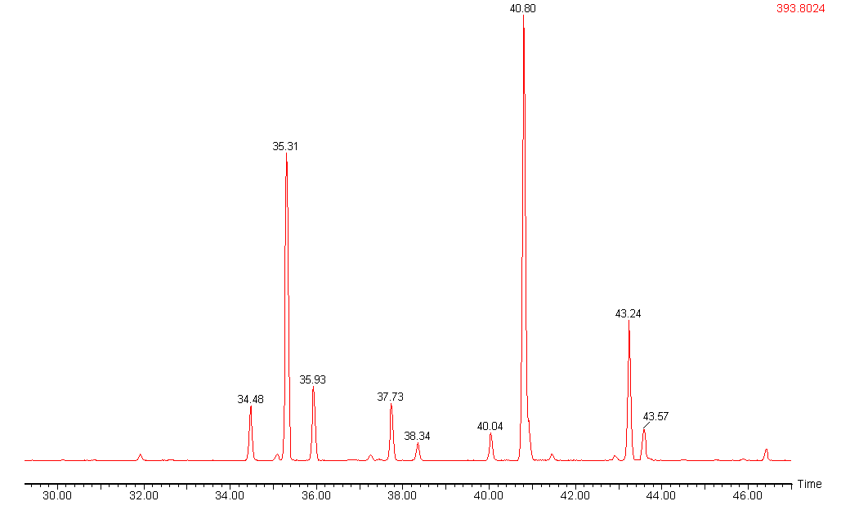
#28
Tri-CBs
＃28
24-4
＃31
Tetra-CBs
#74
245-4
＃74
＃80
Penta-CBs
#99
245-34
#118
＃99
＃118
245-24
Hexa-CBs
＃153
245-234
#153
245-245
＃163/
＃164
#138
＃138
Hepta-CBs
#187
＃180
＃187
245-2345
#180
245-2356
＃170
Chromatogram of PCB in human blood （3~7Cl）
Hirai et al, (2003) Organohalogen compounds

Slide 42
Levels of the predominant PCB congeners in human blood
(n=24)
Congeners
Mean
±
2S.D.
Existence Ratio*
cumulative
(%)
22.3
34.1
42.4
49.0
54.5
59.6
63.4
67.0
70.3
73.3
75.6
(BZ#)
(ng /g-lipid)
(%)
245-245
#153
28.0
±
28.0
22.3
245-2345
#180
14.9
±
16.6
11.8
245-234
#138
10.4
±
9.2
8.3
245-2356
#187
8.3
±
8.5
6.6
245-34
#118
6.9
±
5.9
5.5
#163,164
6.4
±
6.2
5.1
245-24
#99
4.7
±
4.2
3.8
245-4
#74
4.6
±
2.6
3.6
245-235
#146
4.1
±
3.7
3.3
2345-234
#170
3.8
±
4.1
3.0
2345-34
#156
2.8
±
3.0
2.3
Sum
75.6
*
Mean is compare to total PCBs level
Hirai et al, (2003) Organohalogen compounds

Slide 43
human milk/adipose tissue
#153
(2,2',4,4',5,5'-)
#74
(2,4,4',5-)
#138
(2,2',3,4,4',5'-)
#99 (2,2’,4,4',5-)
#187
(2,2',3,4’,5,5’,6-)
#118
(2,3’,4,4',5-)
PCB congeners predominant in human samples

Slide 44
低塩素化ダイオキシン類の
異性体分析

Slide 45
PCDF formation from chlorophenols

Slide 46
4-MCP
1,2,8-TrCDF
2,3,8-TrCDF
3,4-DCP

Slide 47
2-MCP
3-MCP
1,4,9-TrCDF
1,4,6-TrCDF
2,5-DCP
1,4,7-TrCDF
1,4,8-TrCDF
4-MCP
Authentic standard
(1,4,7- : NMR)
Synthesis of 1,4,X-T₃CDF isomers from chlorophenol

Slide 48
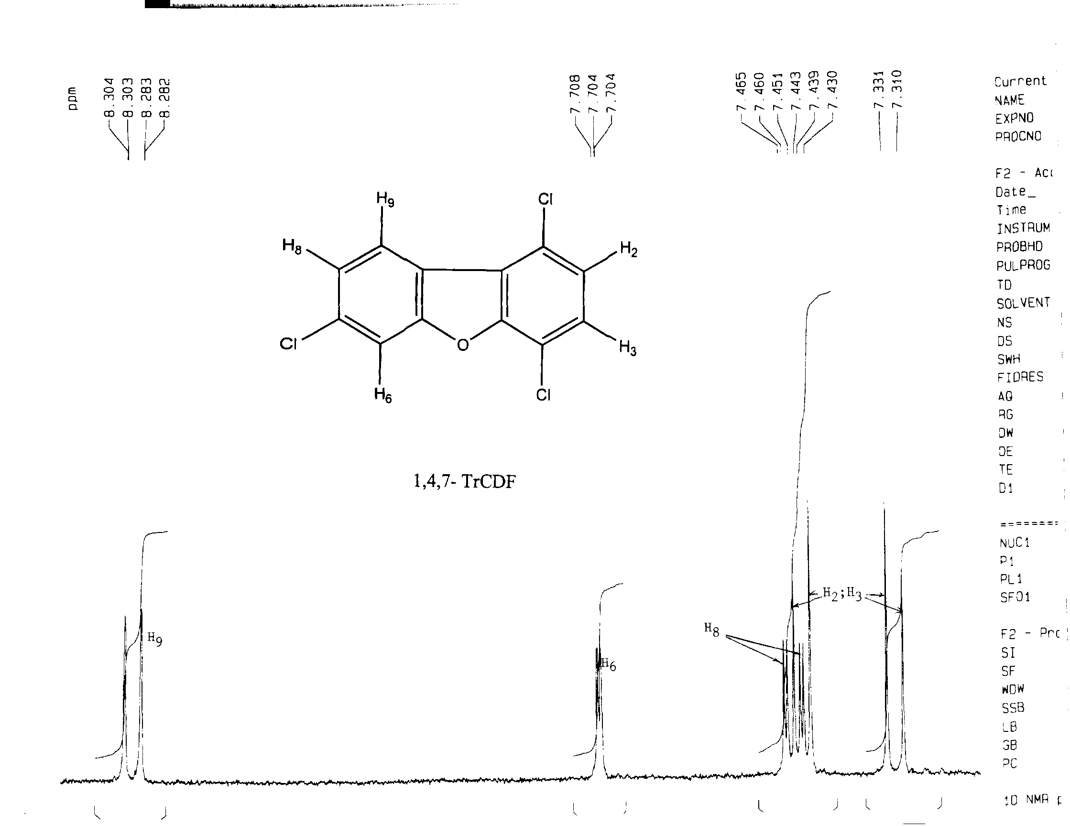
Authentic standard
H₉
Cl₁
H₈
H₂
Cl₇
H₃
H₆
Cl₄
H₂ ; H₃
H₆
H₉
H₈
NMR 1,4,7-TrCDF

Slide 49
Ambient air
SP-2331

Slide 50
Homologue profiles of PCDD/Fs in ambient air

Slide 51
Homologue profiles of PCDD/Fs in ambient air

Slide 52
Homologue profiles of PCDD/Fs in river water

Slide 53


Kako river
Σ
=200pg/L
Kako river
Σ
=20pg/L
Σ
=100pg/L
Σ
=20pg/L
80
80
2,4-D
PCDD
PCDF
PCDD
PCDF
60
60
CNP
pg/L)
PCP
pg/L)
40
40
(
(
20
20
0
0
M1Cl
D2Cl
P5Cl
O8Cl
M1Cl
D2Cl
P5Cl
O8Cl
Tr3Cl
Te4Cl
Hx6Cl
Hp7Cl
Tr3Cl
Te4Cl
Hx6Cl
Hp7Cl
Homologue profiles of PCDD/Fs in river water
Homologue profiles of PCDD/Fs in river water

Slide 54
Homologue profiles of PCDD/Fs in river water (SPM)

Slide 56
Japan
PCDD
CNP
PCDD
TeCDD
PCDD
No CNP
PCDD
USA
PCDD

Slide 57
Congener profiles of PCDD/Fs in ambient air

Slide 59
2,4-DCP related
PCDD
2,4-D, NIP

Slide 60
2-
28-
37-DiCDF
23-
27-DiCDF
27-
37-
23-DiCDF
28-DiCDF
238-
128-TrCDF
128-
237-TrCDF
237-
238-TrCDF
1278-TCDF
2378-TCDF
塩素漂白パターンの異性体分布(MCDF～TrCDF)
Isomer distribution of bleaching process(MCDF-TrCDF)

Slide 61
238-
2-
28-
128-
237-
27-
塩素漂白パターンの異性体分布(MCDF～TrCDF)
Isomer distribution of bleaching process(MCDF-TrCDF)
Ambient air
24-
124-
Isomer distribution of ambient air(MCDF-TrCDF)
環境大気の異性体分布(MCDF～TrCDF)

Slide 62
農薬CNP中の異性体分布(MCDF～TrCDF)
Isomer distribution of pesticide CNP (MCDF-TrCDF)
24-
248-
246-
pesticide CNP
Ambient air
24-
124-
環境大気の異性体分布(MCDF～TrCDF)
Isomer distribution of ambient air(MCDF-TrCDF)

Slide 63
PCB建築用シーリング材

Slide 64
ＰＣＢ含有シーリング材
異性体分析をダイオキシン・環境ホルモン調査での精度管理や
起源推定に活用
ＰＣＢ高濃度地点 →
シーラント中にＰＣＢが高濃度で含有されていることを究明
シーラント調査法の開発
→ 全国で採用
県の建物一斉調査実施
→ 安全性を確認

Slide 65
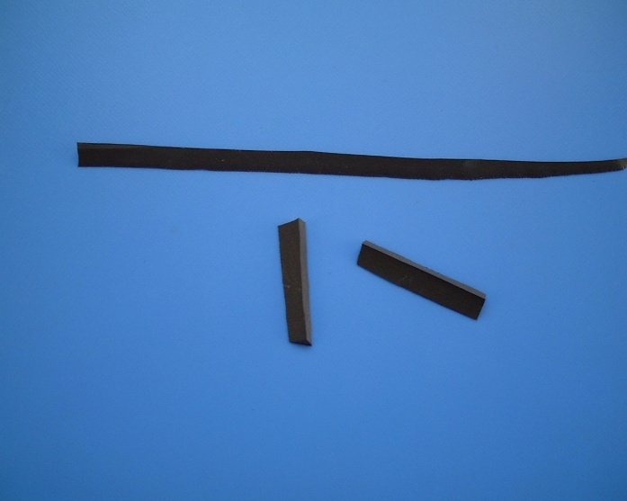
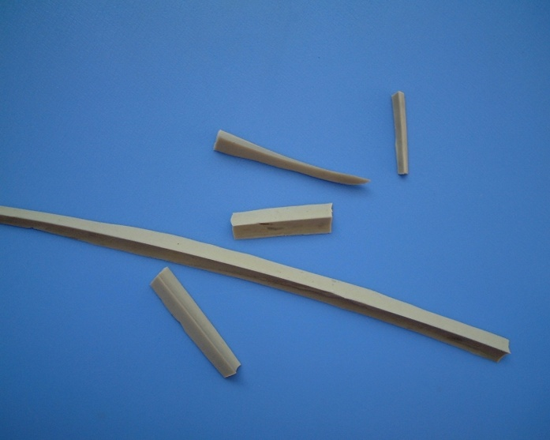
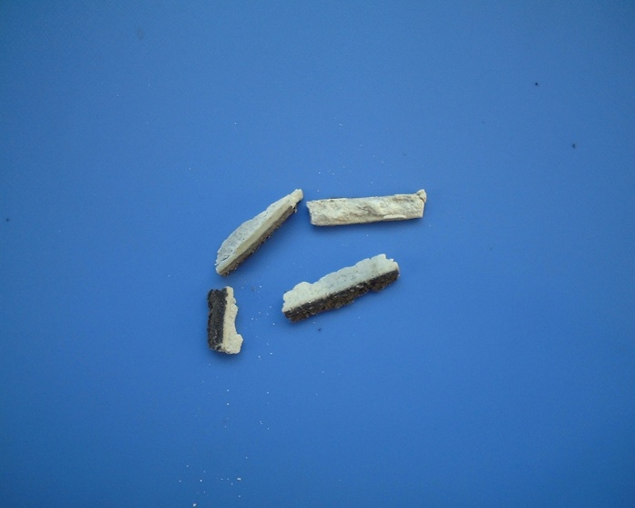
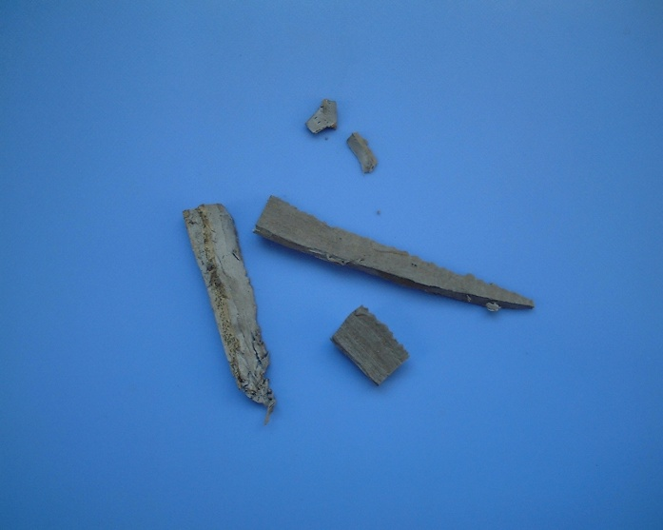
結果
・外観の観察：
ポリサルファイド系
シリコーン系
油 系
変性シリコーン系

Slide 66
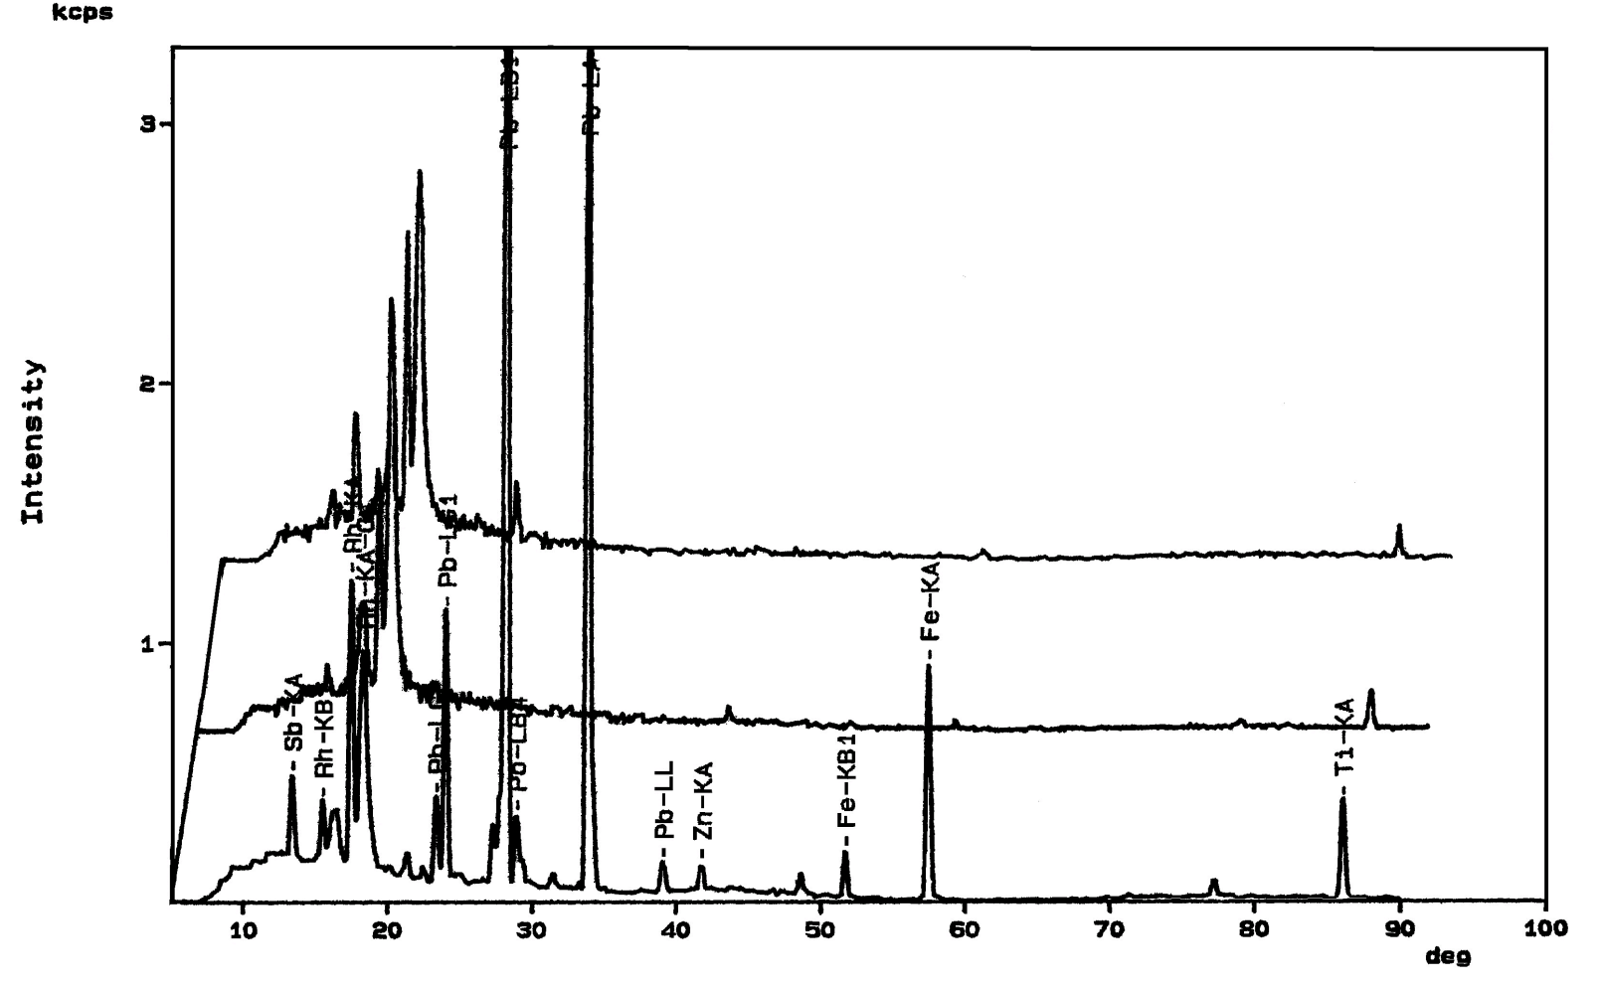
結果
・蛍光Ｘ線による含有元素分析
S元素
Si元素
（ R:－C₂H₄OCH₂OC₂H₄－）
（一般的に、R,R’:－CH₃）
ポリサルファイド系
シリコーン系
油性コーキング材
シリコーン系
ポリサルファイド系
各種シーリング材に含まれる重金属類

Slide 67
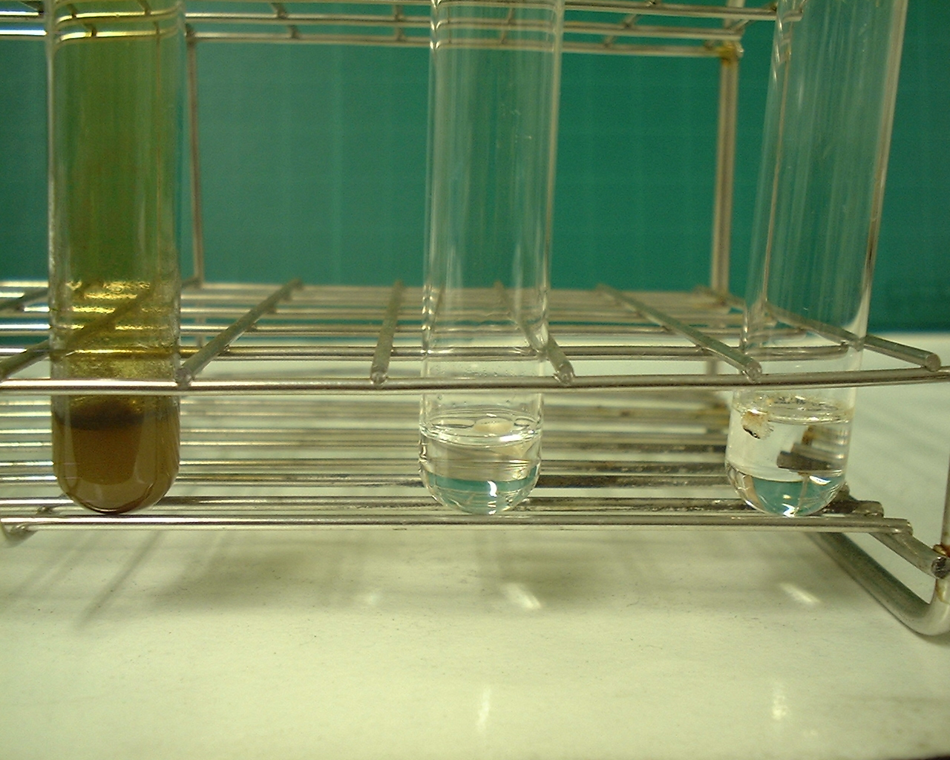
結果
・硝酸への溶解：
溶解の特徴
ポリサルファイド系
シリコーン系
油系
NO₂ガスを発生、瞬時に溶解
全く溶解しない
一部のみ溶解

Slide 68
光学異性体分析
-PCB atropisomer

Slide 69
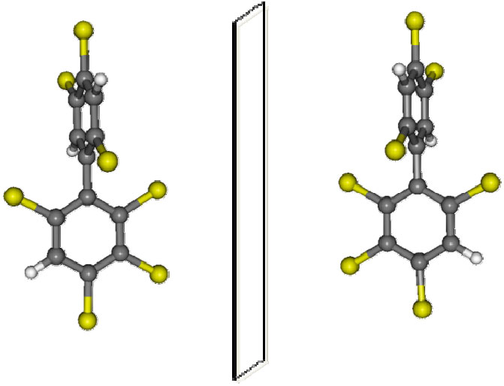
aR/M
aS/P
aR/M and aS/P enantiomers of atropisomeric PCB-183 (2346-245)

Slide 70
GC/MS chromatogram for enantioselective analysis (HpCB)

Slide 71
HPLC traces for the optical resolution of PCB-135

Slide 72
微量PCB処理

Slide 73
PCB Level after Treatment
At JESCO, PCB level of transformers are reduced by1/1,200,000, and that of capacitors are reduced by 1/2,000,000 before shipping.
Transformers
1 / 1,200,000
Standard
Liquid treatment
PCB level
0.5mg/kg and below
100％ PCB concentration
（0.6kg/kg）
oil
Dismantling and washing
Washing repeated until
PCB level is
160mg/kg*
PCB level of washing solvent
0.5mg/kg and below
First
Washing
Casings paper wood
PCB level of effluent
0.003mg/L and below
（1 / 3,750）
（1 / 320）
*Example at Kitakyushu Facility
Capacitors
1 / 2,000,000
PCB level
0.5mg/kg and below
100％
PCB concentration (1kg/kg)
Liquid treatment
oil
PCB level of washing solvent
0.5mg/kg and below
Casings paper other
Cleaning**
（1 / 2,000,000）
PCB level of effluent
0.003mg/L and below
**Wiping test methods are applied for the casings of capacitors treated in VTR (Vacuum Thermal Recovery) furnaces at Kitakyushu and Osaka Facilities.

Slide 74
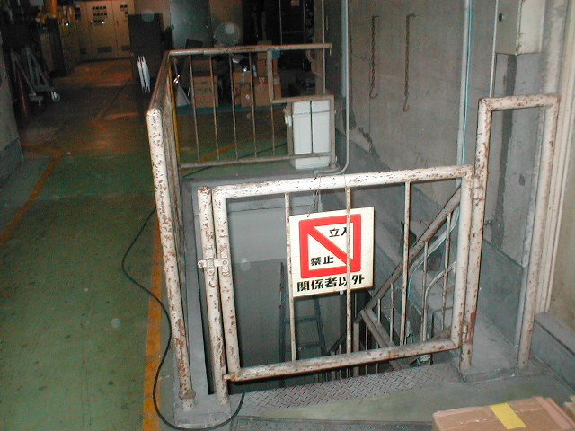
Stored drum PCB sediment in underground

Slide 75
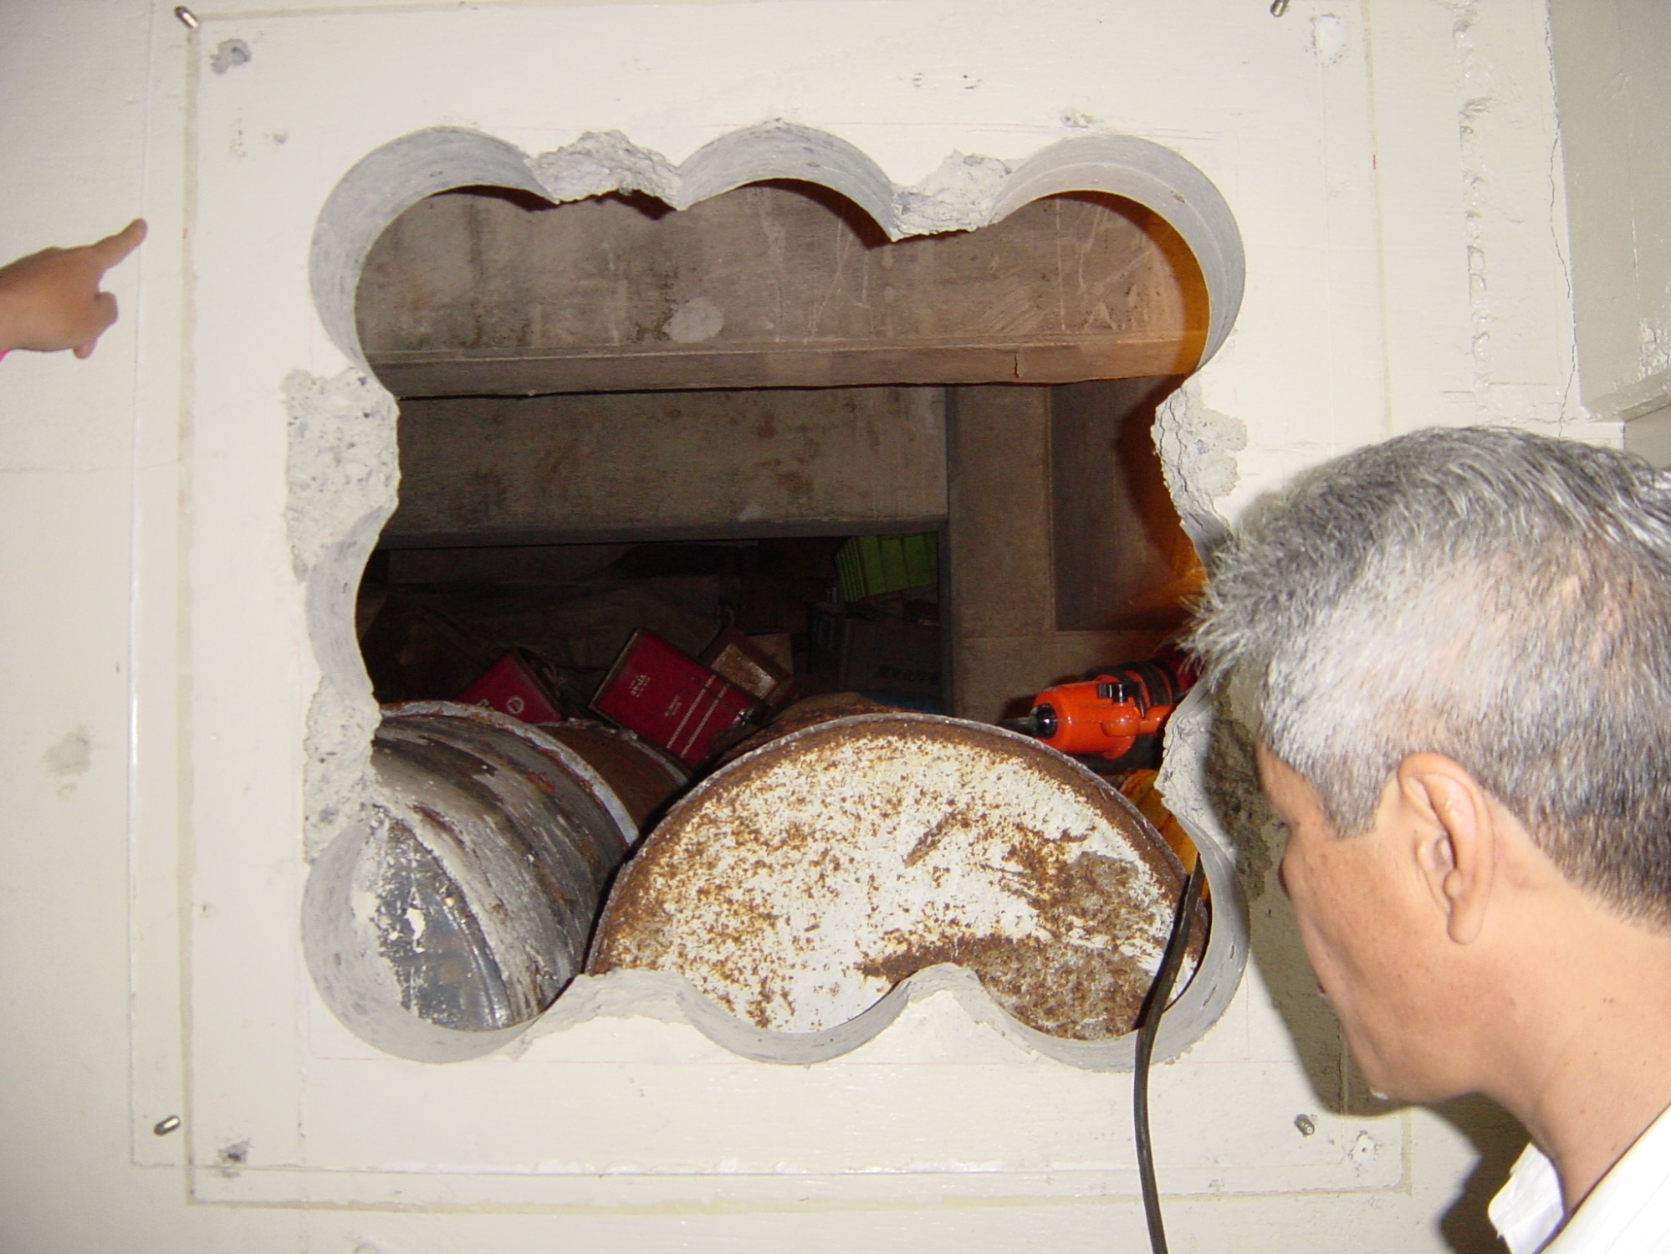
Stored drum PCB sediment in underground

Slide 76
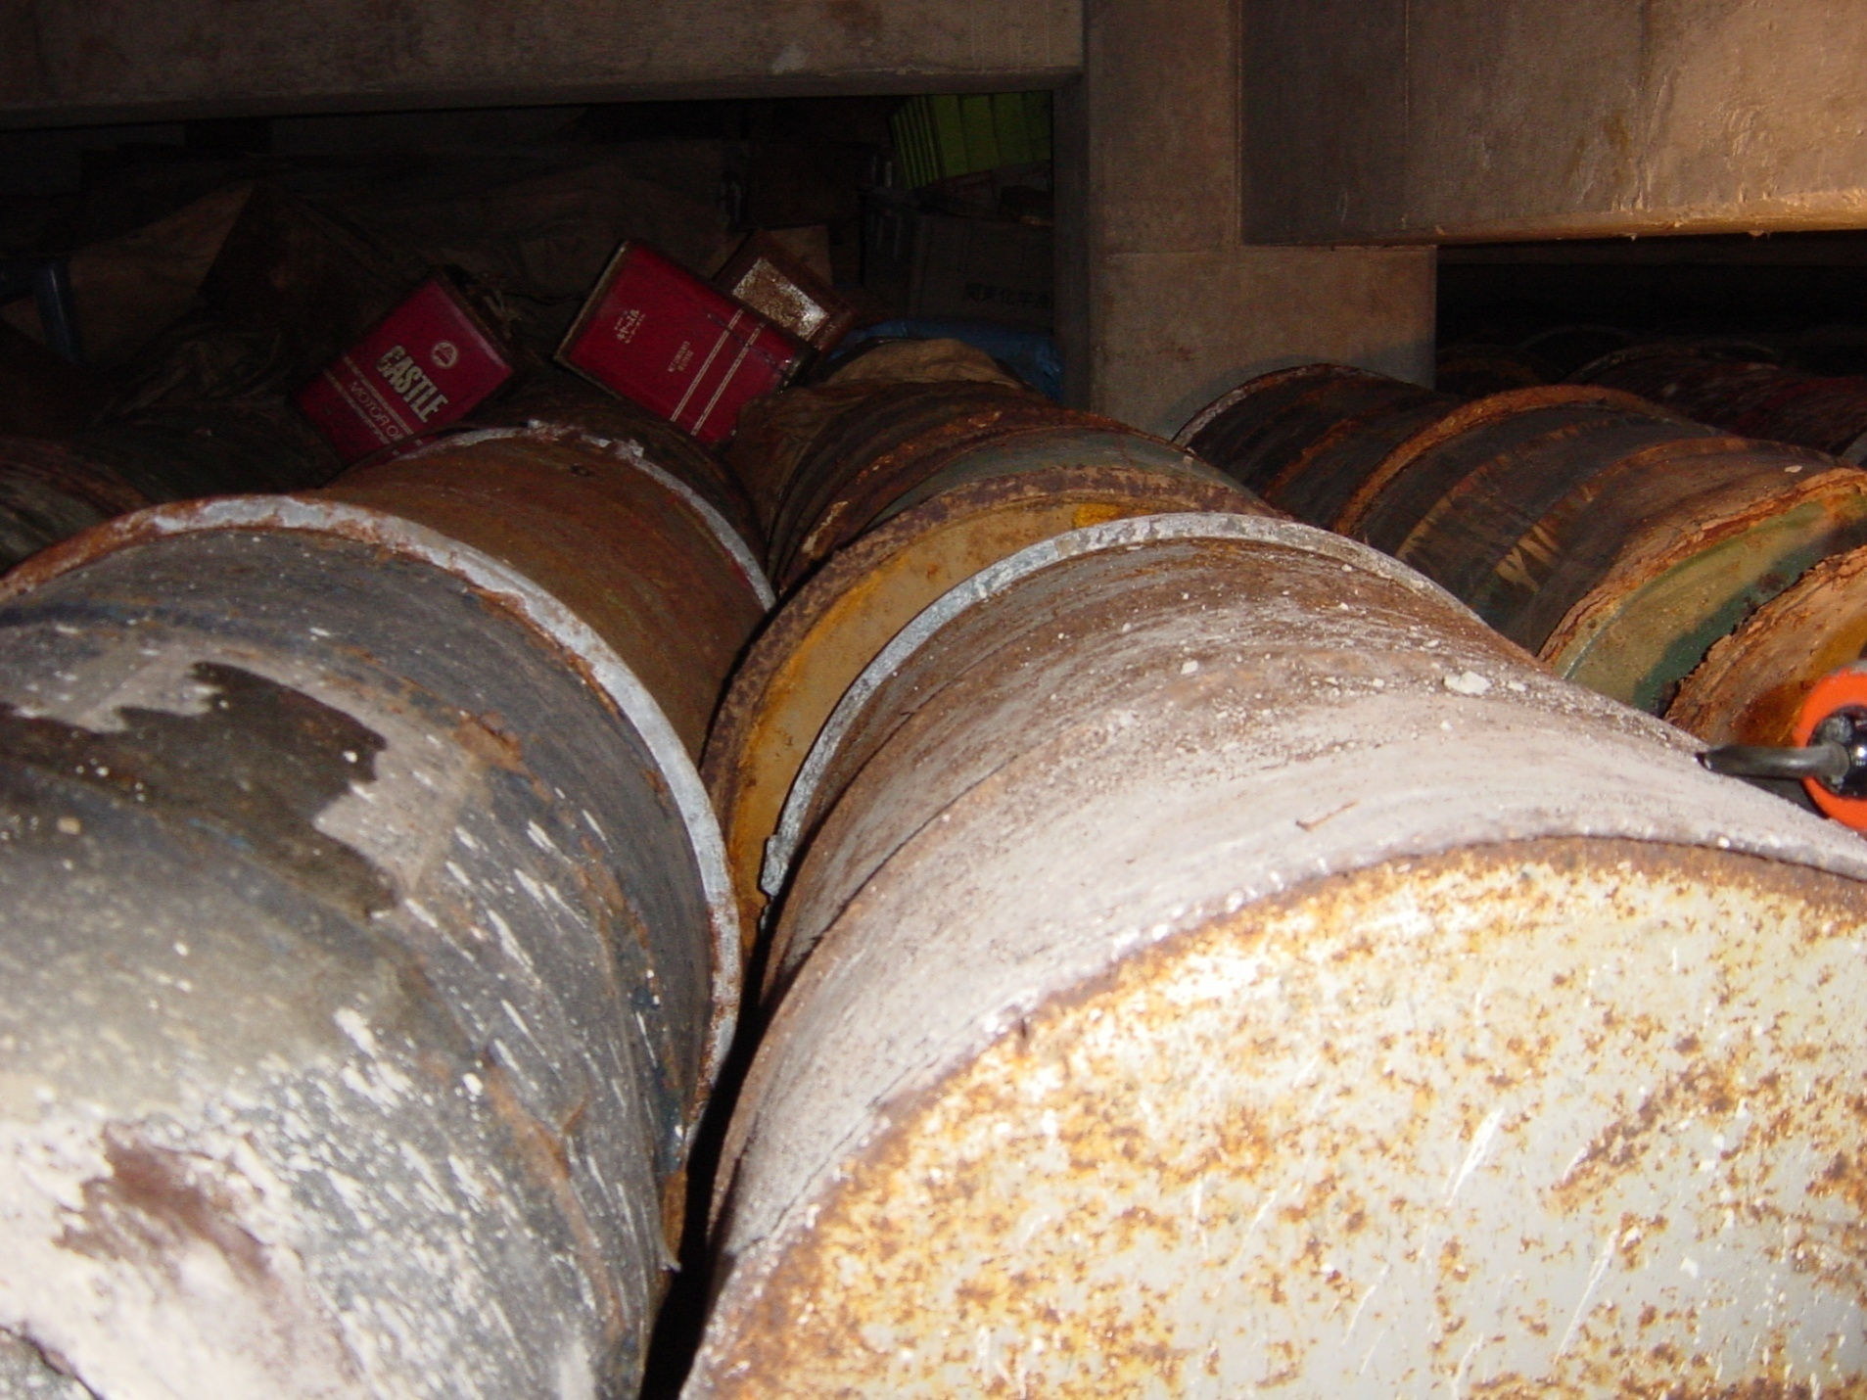
Stored drum PCB sediment in underground

Slide 77
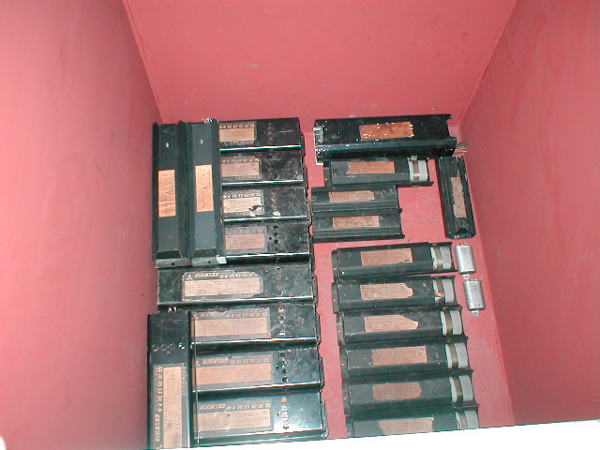
Various type of PCB contaminated waste

Slide 78
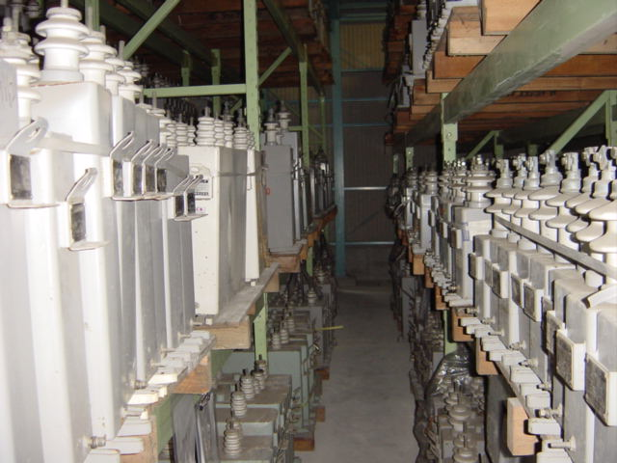
Various type of PCB contaminated waste

Slide 79
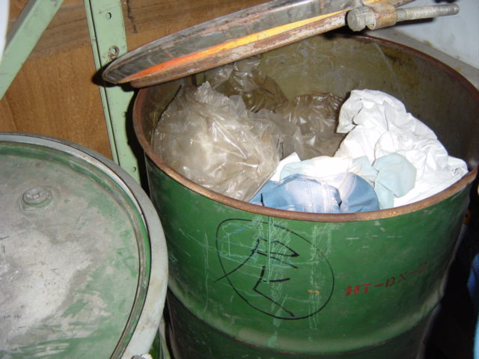
Various type of PCB contaminated waste

Slide 80
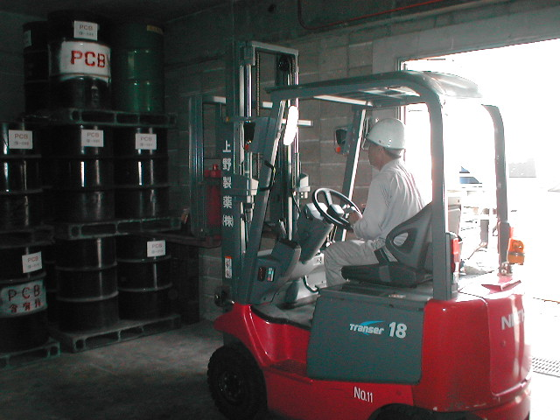
Sampling of PCB contaminated waste

Slide 81
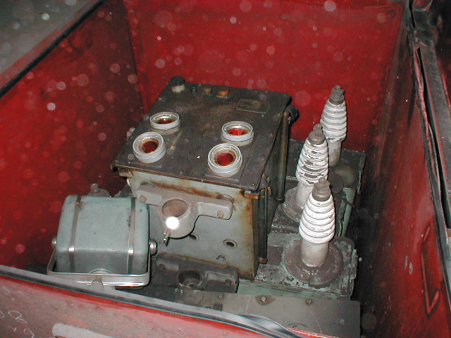
Various type of PCB contaminated waste

Slide 82
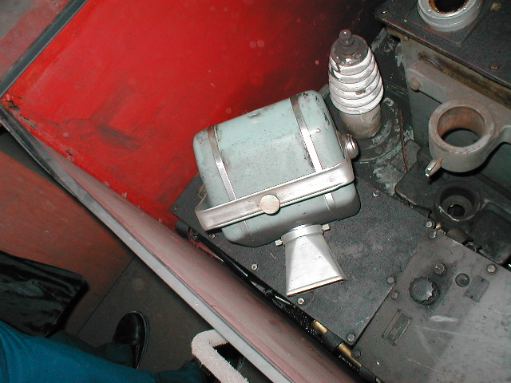
Various type of PCB contaminated waste

Slide 83
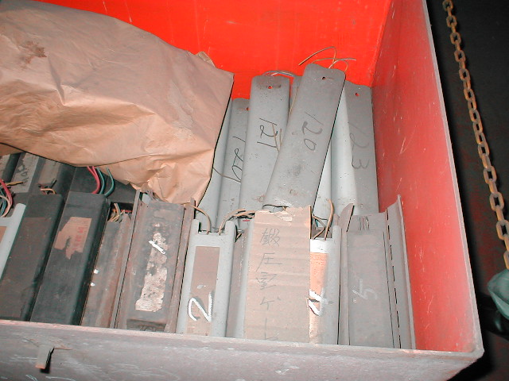
Various type of PCB contaminated waste

Slide 84
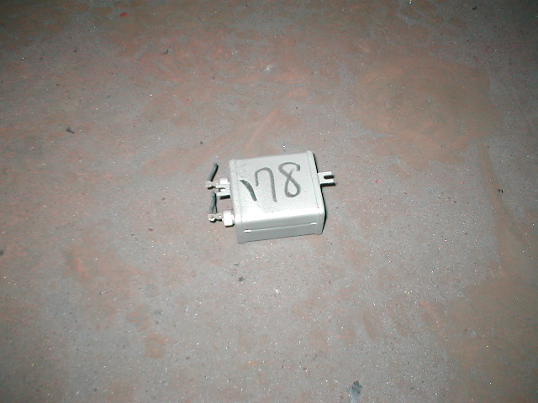
Various type of PCB (paper condenser)

Slide 85
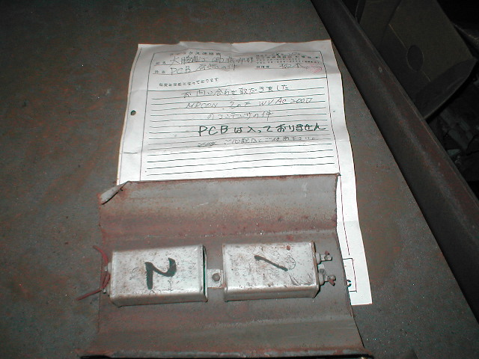
PCB free (paper condenser)

Slide 86
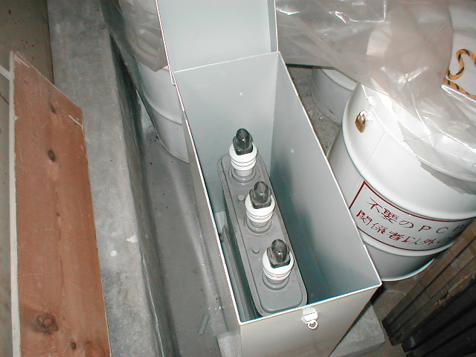
Various type of PCB waste

Slide 87
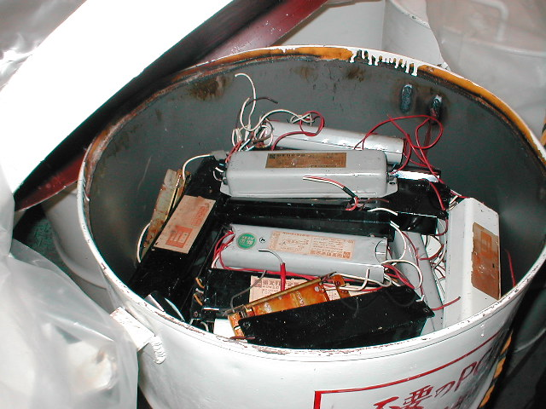
Various type of PCB waste

Slide 88
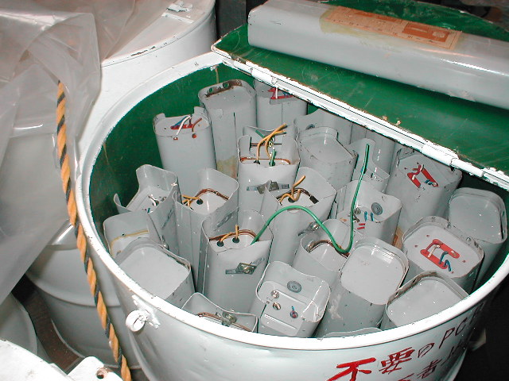
Various type of PCB waste

Slide 89
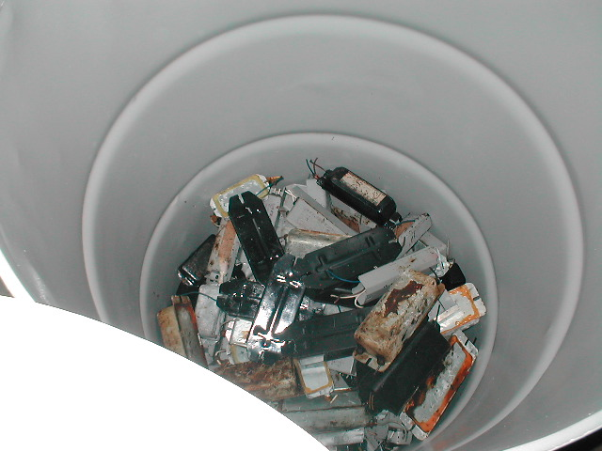
Various type of PCB waste

Slide 90
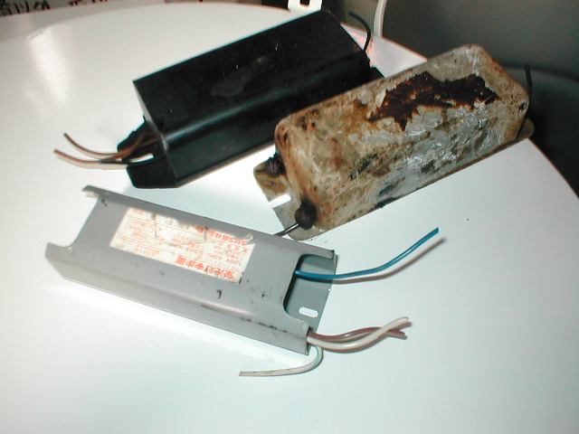
Various type of PCB waste

Slide 91
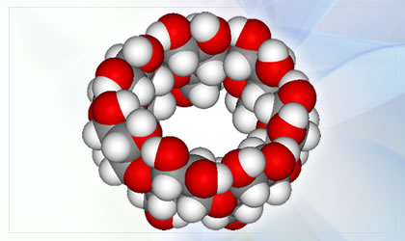
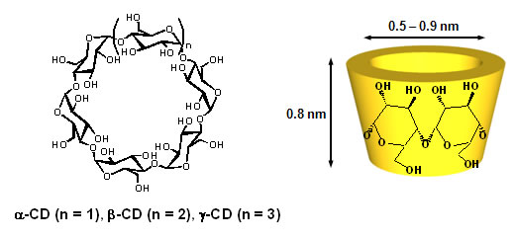
PCB treatment

Slide 92
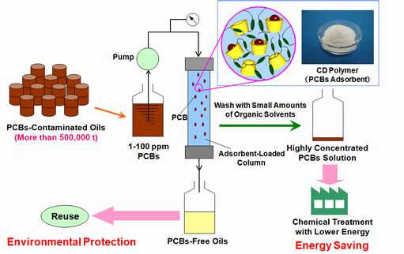
PCB treatment

Slide 93
Urine Monitoring for risk reduction
Transportation workers

Slide 94




Transportation company

Slide 95



Transportation company

Slide 96




Transportation company

Slide 97




Transportation company

Slide 98

OH-PCBs in Urine (ng/mL)
OH-TrCBs
OH-TrCBs
Urine No for OH-PCBs analysis
OH-PCBs in Urine (Transportation Workers)

Slide 99

OH-PCBs in Urine (ng/g-creatinin)
OH-PCBs in Urine (Transportation Workers)
OH-TrCBs
OH-TrCB
24hrs
OH-TrCBs
Urine No for OH-PCBs analysis(Mar. 2011)

Slide 100

OH-PCBs in Urine (ng/g-creatinin)
OH-PCBs in Urine (Transportation Workers)
4-OH-CB33
4’-OH-CB33
Urine No for OH-TrCBs analysis (Mar. 2011)

Slide 101

OH-PCBs in Urine (Transportation Workers)
4-OH-CB72
4’-OH-CB44
4-OH-CB58
4-OH-CB72
OH-PCBs in Urine (ng/g-creatinin)
Urine No for OH-TeCBs analysis analysis (Mar. 2011)

Slide 102
Transportation workers
30 years
47 years
62 years
65years
45 years
62 years
Urine No for OH-TeCBs analysis analysis (Jan. 2012)
3 Transportation workers & 3 researchers

Slide 103
生体試料中のPCB代謝物

Slide 104
Material
Major 6 components of OH-PCBs in human blood
purchased from Wellington Laboratories Inc.(Guelph, On, Canada)
Penta-chloro/OH-CB 4-OH-CB 107
Hexa-chloro/OH-CB 3-OH-CB 153 4-OH-CB 146 3’-OH-CB 138
Hepta-chloro/OH-CB 4-OH-CB 187 4-OH-CB 172
4-OH-CB 187
4-OH-CB 172
3-OH-CB 153
4-OH-CB 146
3’-OH-CB 138
4-OH-CB 107
Another OH-PCBs
Hexa-chloro/OH-CB 4’-OH-CB 165
4’-OH-CB 165
Notes:
Material
We purchased standard solutions from Wellington Laboratories Inc. located in Canada
Target compounds of this study is 7 compound.
These are major 6 OH-PCBs in human blood.
One penta-chlorinated, three hexa-chlorinated and two hepta-clorinated OH-CB
Another one, bottom in slide, hexa-chlorinated, this #165 is difficult to be separated with #153 in GC-HRMS with derivertization.

Slide 105
Sample preparation
Urine(100～200 mL)
Add X1, 20mM Phosphate buffer (pH 4.0)
Extraction
2 mL of CH₂Cl₂ X 2 times
Adjust pH at 4.0 with
10%-HCOOH aq.
Centrifugation
2600 rpm. for 10 min
Solid Phase Extraction
(RP-WAX:240 mg)
Elute with 8 mL
of 0.1%-NH3 in methanol
Concentration
1 mL by N₂ gas
Concentration
Less than 1 mL by N₂ gas
Add. X 9 CH₃CN
Add. 5mL of 20mM-
Phosphate buffer (pH 7.0 )
Add. 20 μL β-Glucuronidase
/ Aryl sulfatase,
Concentration
1 mL by N₂ gas
Enzyme reaction
at 37 degree for 1.5 hr
LC/MS analysis

Slide 106
Analytical Condition
LC condition
Notes:
This is LC condition.
In this analytical method, separation is one of the most important element, because each OH-PCBs congener has many isomers and they are same MW and provide same precursor ions. So LC separation is fundamental.
Instrument is ACQUITY UPLC, Waters
Column which we used is ACQUITY UPLC BEH column from Waters. This is ODS column, but particle size is very small, 1.7 um.
As the particle size is small, this column gives large number of theoretical plates. This column gives same number of theoretical plates as 45cm with 5um column
Flow rate is 0.5 mL/min, this is one of the characteristic of column with small particle that it can be used under high linear velocity without losing resolution (separation).
Column temperature is 60 deg.
Mobile phase is 5mM-ammonium acetate and acetonitrile including 20%-THF
Gradient is linier.

Slide 107
Analytical Condition
MS condition
Notes:
This is Q-Tof condition.
Ionization mode is ESI negative.
Desolvation temperature is 600 deg.
Resolving power is more than 20000.
As acquired data with Tof is scan data with high resolution, we need to extract ion for integration peak area for quantity.
Selected ion of three congeners is 340.868 for penta-chlorinated, 374.829 for hexa-chlorinated, 408.790 for hepta-chlorinated.

Slide 108
Result
- Mass Spectra of OH-PCBs
- Selectivity by high resolution MS
- LC separation of 6 major OH-PCBs in human blood
- Calibration curve
- Repeatability
- Matrix effect
- Applying method to urine sample
- Level and ratio of OH-PCB congeners

Slide 109
Mass Spectra of OH-PCBs
m/z=340.8675
m/z=374.8286
³⁵Cl₄³⁷Cl₁
³⁵Cl₅³⁷Cl₁
³⁵Cl₅³⁷Cl₀
³⁵Cl₄³⁷Cl₂
³⁵Cl₃³⁷Cl₂
³⁵Cl₆³⁷Cl₀
³⁵Cl₃³⁷Cl₃
³⁵Cl₂³⁷Cl₃
Penta-Chloro/OH-CB
Hexa-Chloro/OH-CB
m/z=408.7896
³⁵Cl₆³⁷Cl₁
³⁵Cl₅³⁷Cl₂
³⁵Cl₇³⁷Cl₀
³⁵Cl₄³⁷Cl₃
Hepta-Chloro/OH-CB
Notes:
These are each spectrum of OH-PCBs standard solution.
Each congener of OH-PCBs has different number of chlorines.
For quantitative analysis, we need to chose the most sensitive ion for each congeners.
As we know, there are chlorine 35 and 37 in nature and abundance ratio of chlorine 35 and 37 is three to one.
So, on each congener from penta to hexa chlorinated OH-PCBs, compound including one chlorine 37 isotope gives the highest sensitivity.
Then we chose these compound for quantitative analysis.

Slide 110
High Resolution MS Chromatogram
２ pg/uL Standard solution
500 mDa
4-OH-CB 187
50 mDa
4-OH-CB 187
5 mDa
4-OH-CB 187
Notes:
As Tof MS can acquire MS scan with high resolution, more than twenty thousands of resolving power, we can extract mass chromatogram with accurate mass
These are comparison chromatogram of different range of mass extraction.
The scale of each chromatogram is same range, even in very narrow extraction range like 5 mDa, intensity does not change, moreover the more narrow mass extraction range, the lower background noise it gives.
So determination with high selectivity is possible by using Tof MS.
Selectivity is much higher than that of Quadro pole MS.

Slide 111
LC Separation of OH-PCBs
4-OH-CB 107
4-OH-CB 146
3’-OH-CB 138
4-OH-CB 187
3-OH-CB 153
4-OH-CB 172
4’-OH-CB 165
Notes:
This figure show that the separation of OH-PCBs standard solution without derivatization.
This method is performable to separate into 6 major OH-PCBs in human blood.
Moreover, this method enabled the separation of 3-OH-PCB 153 and 4’-OH-PCB 165 which are difficult to be separated in GC-HRMS with methoxy-derivatization method.
So with this method, we can measure individual isomers and congeners of major compound in human blood.
It is very useful and sufficient for evaluating concentration level and pattern of OH-PCBs in biological sample.

Slide 112
Comparison blood and urine
Blood sample
Japanese 4HO-CB 107 > 4HO-CB 187 > 4HO-CB 146
Belgian 4HO-CB 107 > 4HO-CB 146 > 4HO-CB 187
Romanian 4HO-CB 187 > 4HO-CB 146 > 3'HO-CB 138
Urine sample
Urine 1 3HO-CB 153 > 3’HO-CB 138 > 4HO-CB 107
Urine 2 3HO-CB 153 > 3’HO-CB 138 > 4HO-CB 107
Japanese sample
Blood 4HO-CB 146 > 4HO-CB 107 > 3'HO-CB 138 > 4HO-CB 187
Urine 3HO-CB 153 > 3’HO-CB 138 > 4HO-CB 107
Notes:
This is the pattern of concentration of OH-PCBs in biological sample.
This blood data is from papers.
Urine sample pattern is from this study.
Even though pattern of detected OH-PCBs concentration in human blood depends on race(ethnic group),
Main detected compounds is 107, 187, 146.
On the other hands, in Urine sample, 107 is the lowest concentration which is the highest in human blood.
And 146 which is detected in human blood in all races was not detected in urine sample.
Also 153 is the highest in human urine which is not detected in human blood and even determining 153 and 165 together in GCMS derivatization method
Then, we determined human blood from one person who kindly provided urine sample for this study, so we can compare the human blood and urine sample from same person.
In this case, the highest concentration in blood is 146, but not detected in urine.
Oppositely, the highest in urine is 153, but 153 and also 165 are not detected in blood.
This might indicate that each isomer has characteristic to metabolic and transport pathway then pattern of detected OH-PCBs is different between blood and urine.

Slide 113
Conclusion
Analytical method
6 major OH-PCBs in human blood is separated by UPLC without derivatization
Moreover, separation of 3-OH-CB 153 and 4’-OH-CB 165 that is difficult in GC-HRMS with derivatization is enable
Total analytical time is less than 20 min
Urine sample
Developed analytical method is able to be applied to human urine sample
Three of major 6 OH-PCBs in human blood is detected(#107, #138 and #153) and #146, #182 and #172 are not detected in human urine
Concentration of detected three OH-PCBs in urine sample is
#107 > #138 > #153, pattern of detected compound might be different from it in blood sample.

Slide 114
Acknowledgements
- Ministry of The Environment, Japan(MOE)
- Japan Environmental Safety Corporation(JESCO)
- Osaka University, Graduate Sachool of Engineering
- Joint Research Chair for PCB separation & Concentration System
- Kobe University, Graduate Sachool of Maritime Science
- Hyogo prefectural Institute of Environmental Sciences
- JESCO Express
- Hokkaido Research Organization
- Chiba Prefectural Environmental Reserch Center
- National Institute for Environmental Studies

