Slide 1
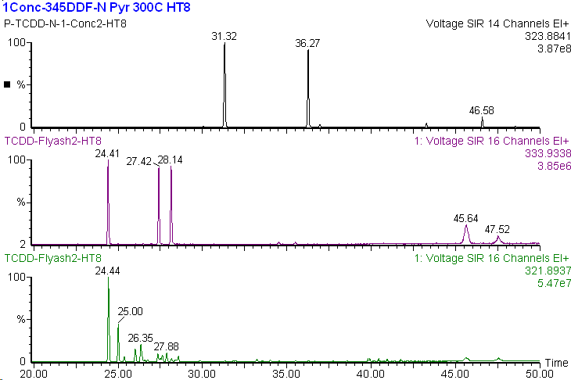
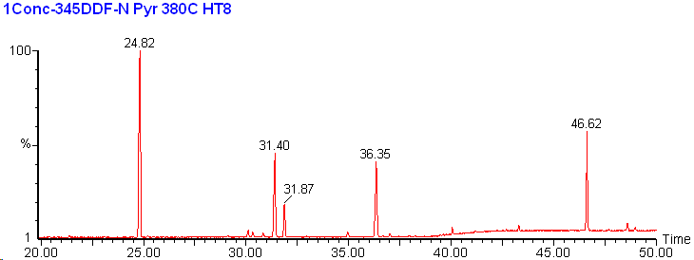
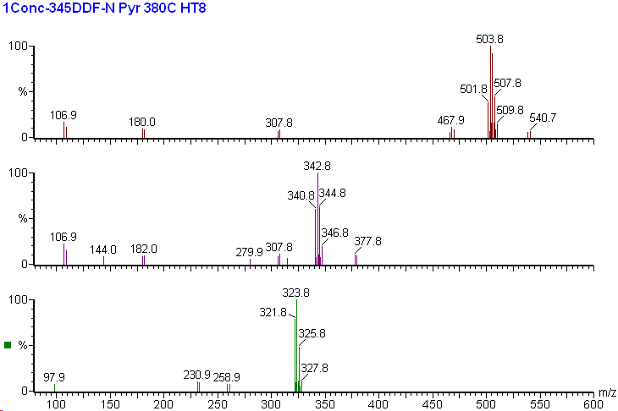
TeCDD-N Analogus in Pyridinol pyrolysis
(m/z:323.8841)
1,3,6,8-
1,2,7,8-
2,3,7,8-
¹³C₁₂ labeled TeCDDs
(m/z:333.9338)
TeCDDs in Flyash
(m/z:321.8937)
Middle Resolution TIC Chromatogram (m/z: 80-600)
①
⑤
High Resolution SIM Chromatogram
Resolution >10,000 (5% valley)
②
④
③
GC/MS: Micromass Autospec Ultima
Column:HT-8PCB(60mx0.25mm)
Oven Temp.
130℃(1min)-30℃/min
-200℃-20℃/min-310℃(hold)
He, 1.0ml/min(constant flow)
Peak ⑤
Peak ①
＆ Peak ③
Peak ②
＆ Peak ④

