Slide 1
Rapid Identification of Synthetic Anti-diabetic Drugs Adulterated in Herbal Dietary Supplement Using Direct Analysis in Real Time (DART)-Mass Spectrometry
Reporter: Zhigui Zhou
Supervisor: Prof. Huiwei Liu
2010.10.13

Slide 2
Outline
Introduction
Experimental
Results and discussion
Conclusion
Acknowledgement

Slide 3

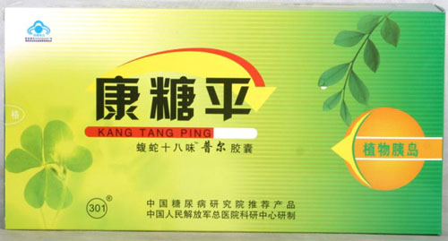
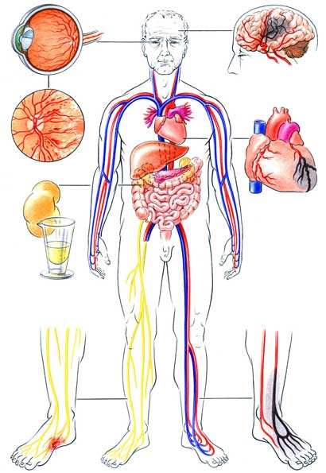

Introduction
Diabetic mellitus Herbal dietary supplement
Adulterated with synthetic drugs

Slide 4
Introduction
Analytical methods for synthetic anti-diabetic drugs
Synthetic drugs in
Chromatography
Preparation
CE
Plasma
LC
Mass Spectrometry
Urine
Spectrometry
Herbal products
Medicine
Electrochemistry
Dietary supplement

Slide 5
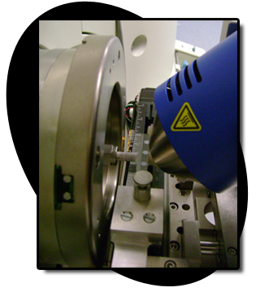
Introduction
DART source: ambient ionization source
Application
Cuticular hydrocarbon of an awake fly
Counterfeit drug
Melamine in milk power
Cocaine and its metabolites in urine
Reaction monitoring in drug discovery
Stabilisers in polypropylene
Nonpolar compounds
Chemical warfare agents
Sulfur materials in drywall
Volatile organic compounds of eucalypts
Olive oil quality and authenticity assessment
…

Slide 6
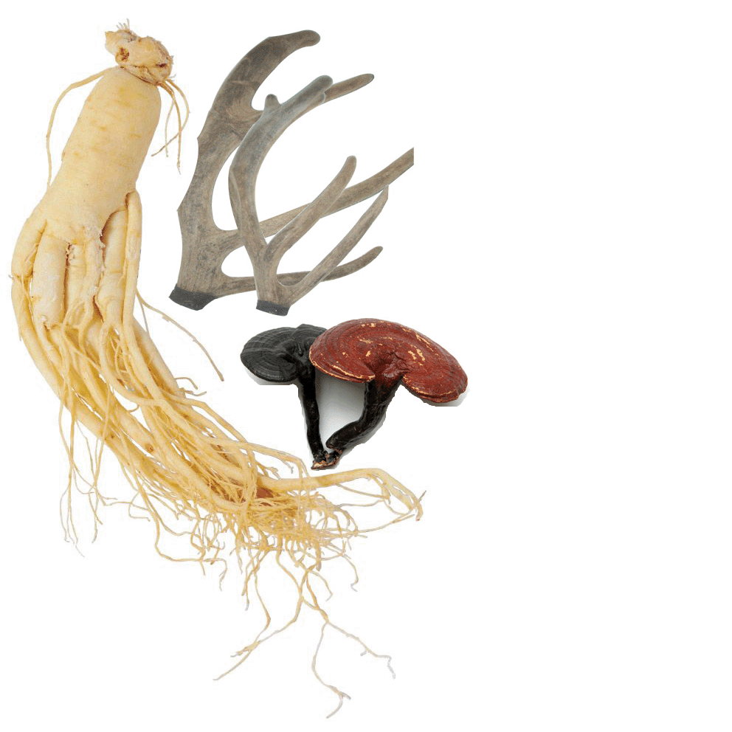
Introduction
DART source: ambient ionization source

Slide 7
Experimental
Chemicals and Reagents
Seven synthetic anti-diabetic drugs
Glibenclamide
Gliclazide
Glipizide
Gliquidone
Metformin
Nateglinide
Rosiglitazone
Five herbal dietary supplement samples
Four: capsule
One: tablet

Slide 8
Experimental
Instruments
Sample introduction
DART®-SVP source
Helium
(> 99.999%)
Agilent 6530 Accurate-Mass QToF MS
15mm
Discharge needle voltage: 6000 V
Capillary entrance voltage: 3500 V
Fragmentor: 175 V
Skimmer1: 65 V

Slide 9
Experimental
Optimization of DART Parameters
250
300
Gas temperature
(^{O}C)
350
Glibenclamide
400
450
Gliclazide
0.06
Glipizide
0.08
E
I
C
DART Parameters
Gas flow rate
(m³/h)
0.10
Sensitivity
Gliquidone
0.12
0.14
Metformin
0.16
Nateglinide
Grid electrode
Voltage
(V)
0
100
Rosiglitazone
200
300
400

Slide 10
Experimental
Optimization of Collision Energy for MS/MS
Molecular ion
Collision energy
Product ions
Abundance
1
3
2
m/z

Slide 11

Experimental
Analysis of Herbal Dietary Supplement samples
Sample preparation and detection by DART-MS
MS
MeOH/H₂O
(50/50, V/V)
DART®-SVP source
Helium

Slide 12
Experimental
Analysis of Herbal Dietary Supplement samples
Matrix Effect and Limit of Detection
MeOH/H₂O
(50/50, V/V)
Spiked with synthetic drugs
MeOH/H₂O (50/50, V/V)
LOD
the accurate mass of molecular ion of synthetic drug was detected;
at least three product ions with accordant accurate mass were observed in MS/MS spectra and the abundance of all ions were in the range of 10² to 10³;
the relative abundance of product ions in sample MS/MS data were in accord with that in drug standard.

Slide 13
Results and discussion
Optimization of DART Parameters
Optimized DART parameters:
Gas temperature: 350 ºC
Gas flow rate: 0.12 m³/h (2L/min)
Grid electrode voltage: 100 V

Slide 14
Results and discussion
Optimization of Collision Energy for MS/MS
Counts vs. Mass-to-Charge (m/z)
Counts vs. Mass-to-Charge (m/z)
Counts vs. Mass-to-Charge (m/z)
Counts vs. Mass-to-Charge (m/z)

Slide 15
Results and discussion
Optimization of Collision Energy for MS/MS
Counts vs. Mass-to-Charge (m/z)
Counts vs. Mass-to-Charge (m/z)
Counts vs. Mass-to-Charge (m/z)

Slide 16
Results and discussion
Analysis of Herbal Dietary Supplement samples
MS/MS
MS/MS

Slide 17
Results and discussion
Matrix Effect and Limit of Detection
 | MeOH/H₂O (50/50 v/v) ng/ml | Matrix 1 ng/ml (μg/g) | Matrix 2 ng/ml (μg/g) | Matrix 3 ng/ml (μg/g)
Metformin | 100 | 200 （20） | 400 （40） | 800 （80）
Nateglinide | 100 | 200 （20） | 200 （20） | 400 （40）
Gliclazide | 20 | 20 （2） | 40 （4） | 40 （4）
Rosiglitazone | 20 | 40 （4） | 40 （4） | 40 （4）
Glipizide | 500 | 2000 （200） | 2000 （200） | 30000 （3000）
Glibenclamide | 1000 | 1000 （100） | 1000 （100） | 2000 （200）
Gliquidone | 200 | 400 （40） | 1000 （100） | 4000 （400）

Slide 18
Conclusion
DART source was coupled to QToF MS for rapid identification of synthetic anti-diabetic drugs adulterated in herbal dietary supplements.
A simple shake extraction manually in several seconds was only required for supplement sample preparation, and the extract was directly analyzed by DART-MS without any further treatment.
The adulteration of synthetic drugs was confirmed by the accurate mass of molecular ions as well as the accurate mass and relative abundances of product ions.
The developed method was successfully applied to examine five herbal dietary supplement products, and two products proved to be adulterated with metformin.
The LOD in herbal supplement matrices indicated that the method was adequate for identification of synthetic drug adulterated in herbal supplements usually at the level of several milligrams per gram.
The proposed DART-MS method provided an opportunity for rapid and reliable screening of similar synthetic adulterants in numerous herbal products with various effects declared, such as anti-obesity, anti-hypertension, sexual enhancement and so on.

Slide 19
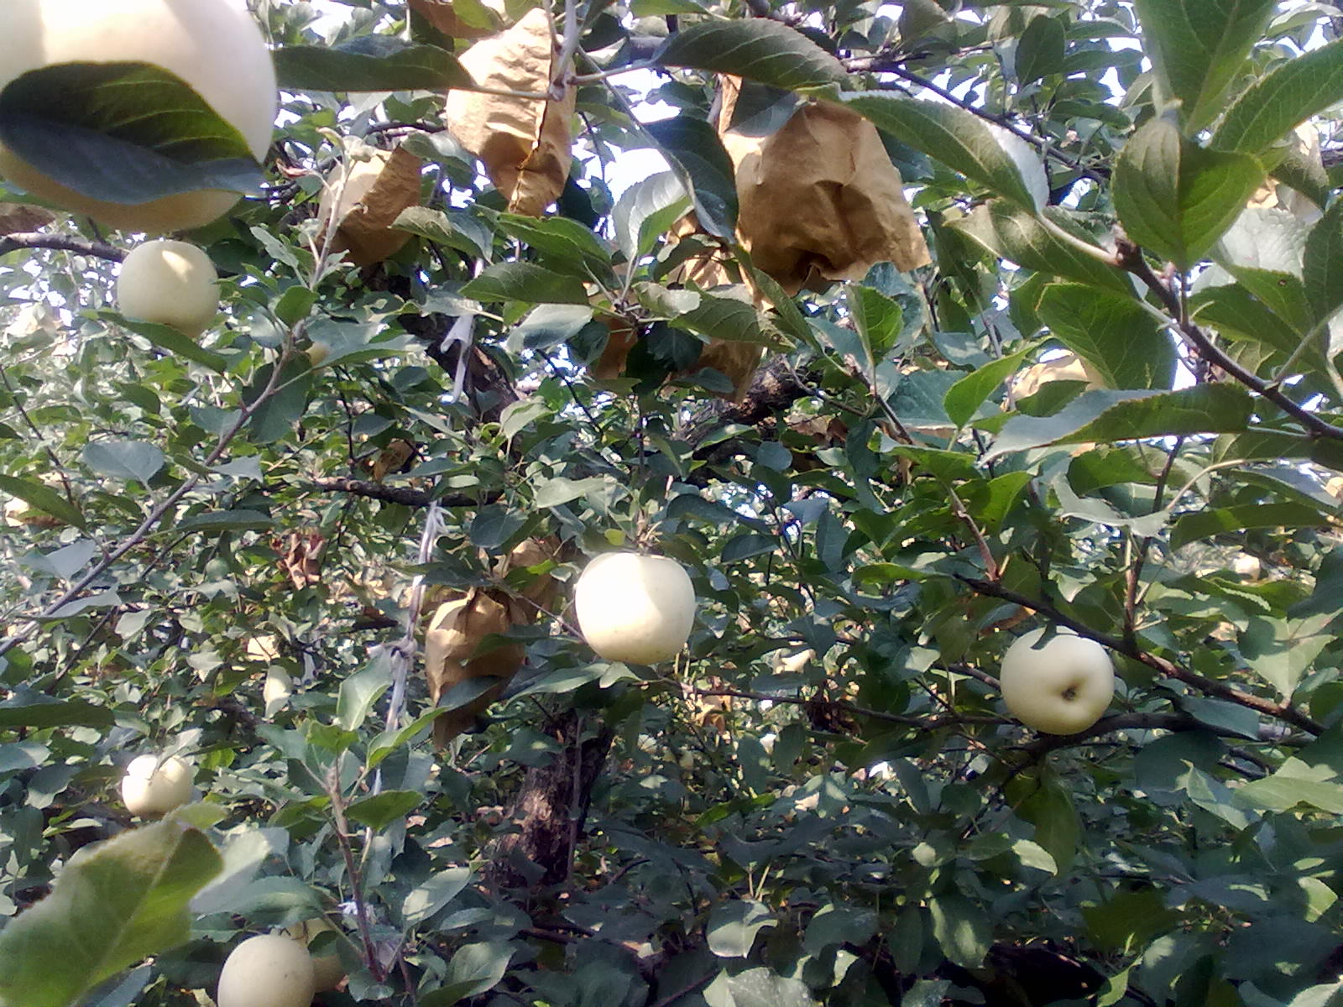
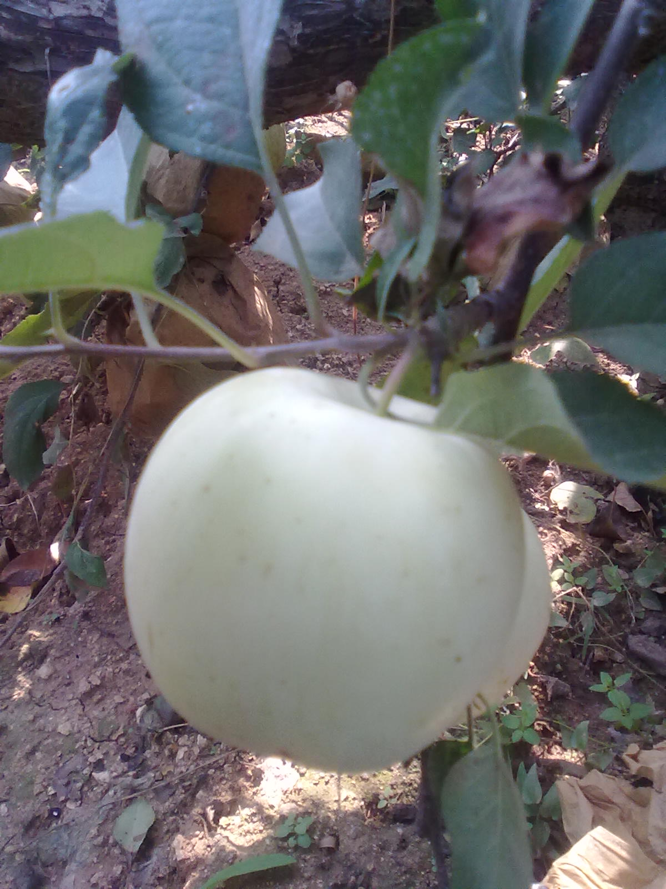
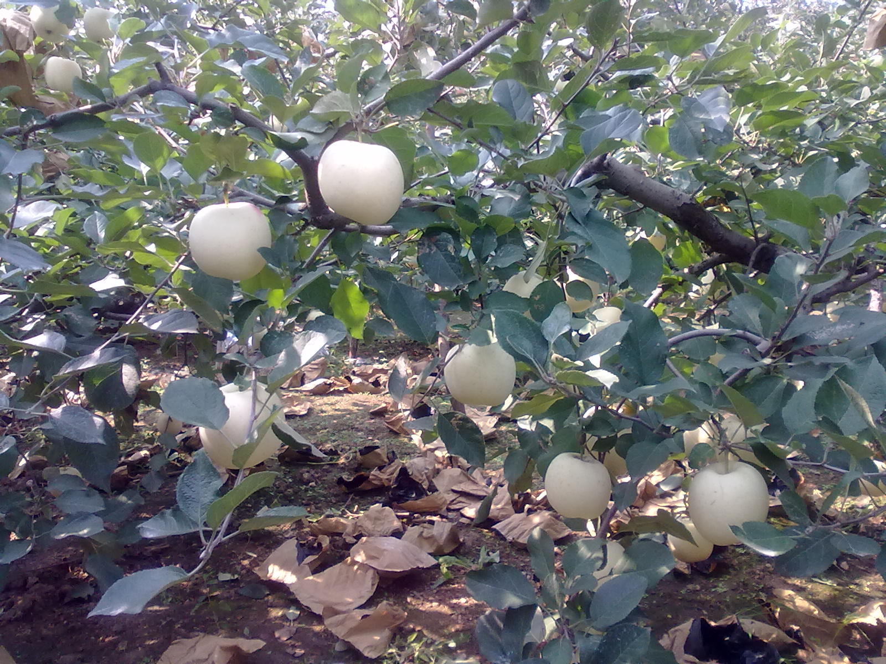
YAN TAI BIG APPLE!

