Slide 1
PRELIMINARY ASSESSMENT OF DIOXIN-LIKE COMPOUNDS IN/FROM CHLORPYRIFOS - A POTENTIAL PRECURSOR OF THE PYRIDINE ANALOGUE OF 2,3,7,8-TCDD
Sakiyama T¹, Weber R², Behnisch P³, Nakano T⁴
1 Osaka City Institute of Public Health and Env. Sciences, Osaka, Japan; 2 POPs Environmental, Göppingen, Germany,
3 BioDetection Systems BV (BDS), Amsterdam, The Netherlands, 4 Osaka University, Suita, Osaka, Japan
Introduction
Pesticide production, use and disposal have contributed significantly to polychlorinated dibenzo-p-dioxins and dibenzofuran (PCDD/F) emissions in the past1-4. However also in a recent monitoring of current used pesticides in Australia in all assessed formulations PCDD/PCDF were detected with high concentrations in some pesticide formulation (in particular pentachloronitrobenzene /Quintozene)4. From historic perspective the two pesticides with the highest Dioxin levels and release were 2,4,5-trichlorophenoxy acetic acid (2,4,5-T) and pentachlorophenol (PCP)1,5. The production and use of 2,4,5-T and 2,4,5-Trichlorophenol - the precursor of 2,3,7,8-TCDD - resulted in large contamination during the Vietnam War (366 kg TEQ release from Agent Orange spray)6 and had a long series of dioxin contamination in the factories3 with a last accident in Seveso where about 30 kg TEQ have been released7.
While today 2,4,5-T seems not be available on the market and the use of 2,4,5-trichlorphenol seems to be largely restricted to the synthesis of the still available hexachlorophen (e.g. skin cleanser PhisoHex) a major pesticide used today - Chlorpyriphos - has as chlorinated aromatic moiety the pyridine-analogue of 2,4,5-trichlorophenol (3,5,6-trichloro-2-pyridinol) (Figure 1). Therefore the pesticide is a potential direct precursor of the pyridine-analogue of 2,3,7,8-TCDD (Figure 1). While in the recent study of Holt et al some PCDF have been detected in a Chlorpyrifos sample4, the presence of this 2,3,7,8-TCDD analogue has to our knowledge not been assessed yet.
Therefore we analysed in a preliminary study the presence of these potentially dioxin-like compound in a Chlorpyrifos formulation. In addition we performed thermal treatments of Chlorpyrifos at moderate temperatures to assess it’s precursor potential and the first condensation steps.
Chlorpyrifos (O,O-diethyl O-3,5,6-trichloropyridin-2-yl phosphorothioate) is a organophosphate insecticide that inhibits acetylcholinesterase and is used to control insect pests. Chlorpyrifos is moderately toxic and chronic exposure has been linked to neurological effects, developmental disorders, and autoimmune disorders. (http://en.wikipedia.org/wiki/Chlorpyrifos)
Figure 1: Formation of 2,3,7,8-TCDD from 2,4,5-T/2,4,5-TCP and potential formation of the 2,3,7,8-TCDD pyridine analogue from Chlorpyrifos or 3,5,6-trichloro-2-pyridinol

Slide 2
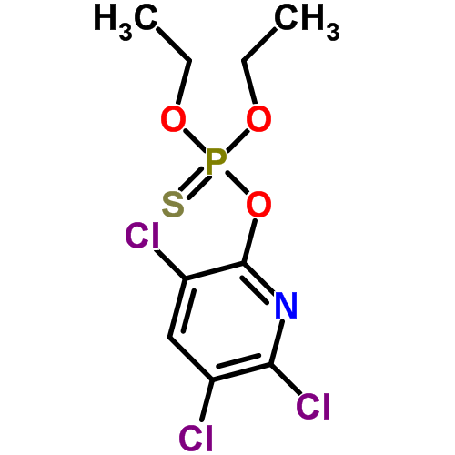
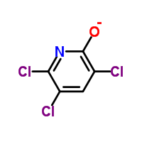
Materials and methods
Thermal treatment
Chlorpyrifos was bought as chemical standard (Wako Pure Chemicals, Osaka Japan).
All pyrolysis experiments were carried out in sealed brown glass ampoules (10 ml) with about 2 mg of Chlorpyrifos at temperature between 200ºC and 300ºC in a GC-oven (Agilent). After cooling to room temperature the ampoules were opened carefully. The reaction products were extracted with toluene (pesticide grade; Wako Pure Chemicals, Osaka, Japan). The toluene was concentrated to 1 ml under gentle nitrogen stream.
GC/MS analysis
For the analysis a GC-TOF-MS:7890A (Agilent) and a JMS-T100GC (JEOL) GC-MS/MS : 450-GC/320-MS (Bruker). The TOF-MS was used with a 30 m DB-5MS (ID: 0.25 mm df:0.25um).for accurate mass analysis and unidentified substance assessment. GC settings were: Oven Temp: 130ºC (1 min); 10ºC/min to -320ºC (10 min hold) ; Injector Temperature: 280ºCAs scan range 50-800 Amu was selected with a scan cycle of 0.4s/scan.As carrier gas Helium was used with constant flow (1.0 ml/min).The MS was operated at a resolution: >5,000 (50% valley)The 320-MS was used with a 10 m Rapid-MS column (ID: 0.25 mm; df: 0.25um) for MS spectra analysis and for rapid screening.
Chlorpyrifos
DR CALUX↓ bioanalysis
The procedure for the DR CALUX↓ by BDS bioassay is described in detail previously8. Briefly, the bioassay is performed using a rat hepatoma H4IIE cell line stably transfected with an AhR-controlled luciferase reporter gene construct. Cells were cultured in α-MEM culture medium supplemented with 10% (v/v) FCS under standard conditions (37oC, 5% CO2, 100% humidity). Cells were exposed in triplicate on 96-well microtiterplates containing the standard 2,3,7,8-TCDD calibration range, the additional 2,3,7,8-TCDD calibration concentrations, a DMSO blank, an internal reference material and various samples extracts at multiple dilutions (e.g. sediment, foodstuffs, feeding stuffs). Following a 24 hour incubation period, cells were lysed, a luciferine containing solution was added and the luciferase activity was measured using a luminometer equipped with 2 dispensers.
For this procedure the samples were transferred from the toluene fraction to DMSO and applied in the assay without further clean-up.
3,5,6-trichloro 2-pyridinol
PRELIMINARY ASSESSMENT OF DIOXIN-LIKE COMPOUNDS IN/FROM CHLORPYRIFOS
- A POTENTIAL PRECURSOR OF THE PYRIDINE ANALOGUE OF 2,3,7,8-TCDD

Slide 3
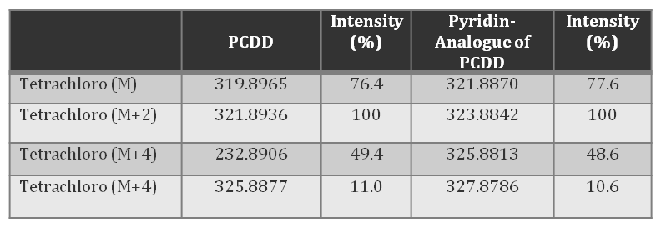
Results & Discussion: Formation of PCDD/Fs N-analogue
Substantial formation observed during thermal process of each chemicals
In the scanning of the raw Chlorpyrifos sample by GC/MS the pyridine analogue of 2,3,7,8-TCDD has not been detected. However the detection limit of this screening method might roughly be estimated in the ng/g range. This indicate that no 2,3,7,8-TCDD analogue was present in the crude samples at ppb levels. For trace analysis in the ppt and sub ppt level a trace analysis for this compound class need to be developed.
In the scanning of the 3,5,6-trichloro 2-pyridinol by GC/MS the pyridine analogue of 2,3,7,8-TCDD has been detected. This indicate that no 2,3,7,8-TCDD analogue was present in the crude samples at ppb levels. For trace analysis in the ppt and sub ppt level a trace analysis for this compound class need to be developed.
The nitrogen analogues of TCDD might behave quite differently on the various clean-up columns compared to PCDD/PCDF and therefore can not be used for trace analysis for these compounds without further detailed assessment.
Table 1: Accurate mass and related intensity of isotope cluster of TCDD and the pyridine analogue of TCDD
Figure 2: Mass spectra of condensation products of Chlorpyrifos at 300ºC. The accurate mass was in agreement with pentachloro hydroxybiphenyl derivative of pyridine and the pentachloro hydroxydiphenyl ether derivative of pyridine.
PRELIMINARY ASSESSMENT OF DIOXIN-LIKE COMPOUNDS IN/FROM CHLORPYRIFOS
- A POTENTIAL PRECURSOR OF THE PYRIDINE ANALOGUE OF 2,3,7,8-TCDD

Slide 4
Thermal treatment of Chlorpyrifos and 3,5,6-trichloro 2-pyridinol
Chlorpyrifos was thermally treated in closed glass ampoules at 200ºC (30 minutes and 15 hours), 250ºC (45 minutes) and 300ºC (5 minutes) in glass ampoule sealed under atmosphere. At these temperatures the phosphorester was expected to degrade and Under these relatively mild conditions for phenol condensation the intermediate of the first condensation steps should be detected as has been found for pyrolysis of chlorophenols⁹.
Results & Discussion: DR-Calux evaluation
Chlorpyrifos and 3,5,6-trichloro 2-pyridinol were thermally treated in closed glass ampoules at 300ºC (10 minutes), 340ºC (10 minutes) and 380ºC (10 minutes) in glass ampoule sealed under atmosphere.
GC/MS screening of formed compounds
The crude toluene extracts (from 1 mL) were injected into the GC/MS without further clean-up step. The samples were analysed in SCAN mode and in Select Ion Monitoring (SIM mode). Table 1 shows the accurate mass of the pyridine analogue of TCDD and the native TCDD with the relative intensities. In this first experimental series relative low pyrolysis temperature were chosen to detect the first condensation products and assess the potential reaction pathway9. As major condensation product a dimer with a mass of either the pyridine analogue of hydroxyl-biphenyl or the diphenyl ether was detected (see mass spectra in Figure 2). In these preliminary low temperatures experiments we did not detect the 2378-TCDD pyridine analogue however the potential precursor 3,5,6-trichloro-2-pyridinol.was detected in the experiment as degradation product of Chlorpyrifos.
PRELIMINARY ASSESSMENT OF DIOXIN-LIKE COMPOUNDS IN/FROM CHLORPYRIFOS
- A POTENTIAL PRECURSOR OF THE PYRIDINE ANALOGUE OF 2,3,7,8-TCDD

Slide 5
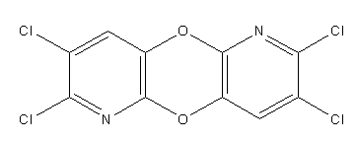

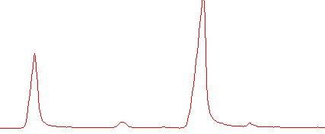
TCDD- N analogue
3.5.6-trichloro 2-pyridinol
300C
340C
2,3,7,8-TCDD
380C
thermal product
(TCDD-N analogue)
TIC chromatogram of thermal product from 3.5.6-trichloro 2-pyridinol

Slide 6
Evaluation of TCDD toxicity in thermal products using DR-Calux
Potential PCDD/Fs toxicity from chlorpyrifos is lower than 3,5,6-trichloro 2-pyridinol
3,5,6-trichloro 2-pyridinol
chlorpyrifos
Future work
Investigate and quantify the formation of PCDD/F N-analogue
Investigate and evaluate the toxicity of PCDD/F N-analogue
chlorpyrifos
estimated possible thermal product
3,5,6-trichloro 2-pyridinol
high toxicity of thermal product
References:
1. Weber R, Gaus C, Tysklind M, Johnston P, Forter M, Hollert H, Heinisch E, Holoubek I, Lloyd-Smith M, Masunaga S, Moccarelli P, Santillo D, Seike N, Symons R, Torres J, Verta M, Varbelow G, Vijgen J, Watson A, Costner P, Woelz J; Wycisk P; Zennegg M. (2008); Environ. Sci. Pollut. Res., 15 (5) 363-393
2. Masunaga S, Takasuga T, Nakanishi J. (2001); Chemosphere 44 (4), 873-885,;
3. Weber R, Tysklind M, Gaus C. (2008); Env Sci Pollut Res 15 (2): 96-100
4. Holt E, Weber R, Stevenson G, Gaus C. (2010) Environ. Sci. Technol. 44, 5409-5415
5. Hagenmaier H, Berchtold A. (1986) Chemosphere 15, 1991-1994
6. Stellman, J. M, Stellman, S. D, Christian, R, Weber, T, Tomasallo, C (2003); Nature 422 (6933): 681-687
7. Mocarelli P (2001): Seveso: A Teaching story. Chemosphere 43, 391-402
8 . Besselink, H.T., Schipper, C., Klamer, H., Leonards, P., Verhaar, H., Felzel, E., Murk, A.J.,Thain, J., Hosoe, K., Schoeters, G., Legler, J. and Brouwer, B. (2004);. Environm. Toxicol. Chem., 23:2781-2789.
9. Weber R, Hagenmaier H (1999); Chemosphere 38 (3):529-549
10. Huwe JK, Clark GC, Chu AC, Garry V (2003); Organohalogen Compounds, 60: 227-230
11. Grant S, Mortimer M, Stevenson G, Malcolm D, Gaus C (2011) Environ. Sci. Technol., 2011, 45: 406-411
12 Giger W (2007) UWSF, 19(1), 11-23
13. Forter M (2010) Falsches Spiel - Die Umweltsünden der Basler Chemie vor und nach «Schweizerhalle. Chronos Verlag, ISBN 978-3-0340-1007-8
14. Tingting Z; Jun H; Shubo D; Gang Y (2011) Environmental, 159(6):1744-1748.

Slide 7
DCDD- N analogue
DCDD- N analogue
TrCDD- N analogue
TrCDD- N analogue
TCDD- N analogue
TCDD- N analogue
C
l
C
l
C
l
N
O
C
l
N
H
O
C
l
Thermal product from 3.5.6-trichloro 2-pyridinol (30m capillary)

