Slide 1
PRELIMINARY ASSESSMENTOF DIOXIN-LIKE COMPOUNDS IN/FROM CHLORPYRIFOS
– A POTENTIAL PRECURSOR OF THE PYRIDINE ANALOGUE OF 2,3,7,8-TCDD
Takanori Sakiyama¹, Roland Weber², Peter Behnisch³, Takeshi Nakano⁴
¹Osaka City Institute of Public Health and Env. Sciences, Osaka 543-0026, Japan; ²POPs Environmental Consulting, 73035 Göppingen, Germany ³BioDetection Systems BV (BDS), Amsterdam, The Netherlands, ⁴Osaka University, Research Center for Environm. Preservation; Osaka 565-0871, Japan
BACKGROUND: Pesticide production, use and disposal have contributed significantly to polychlorinated dibenzo-p-dioxins and dibenzofuran (PCDD/F) emissions in the past. Also in a recent monitoring of current use pesticides in Australia PCDD/PCDF were detected in all formulations assessed (Holt et al 2010). From an historic perspective the two pesticides with the highest dioxin levels and release were 2,4,5-trichlorophenoxy acetic acid (2,4,5-T) and pentachlorophenol (PCP) (Masunaga et al 2001, Weber et al 2008a). The production of 2,4,5-T and 2,4,5-Trichlorophenol (the precursors of 2,3,7,8-TCDD) resulted in a series of incidents involving widespread dioxin contamination near production facilities (Weber et al 2008b), with the most recent in Seveso, Italy (Moccarelli et al 2001). During the Vietnam War, widespread spraying of these two pesticides by the U.S. resulted in extensive contamination in Vietnam (366 kg TEQ released in Agent Orange spray) (Stellmann et al 2003).
C
C
l
l
O
O
R
R
Production
Production
OBJECTIVE: Chlorpyrifos- a major current use pesticide - has as a chlorinated aromatic moiety the pyridine-analogue (N-analogue) of 2,4,5-trichlorophenol (3,5,6-trichloro-2-pyridinol) (Figure 1). Therefore the pesticide is a potential direct precursor of the pyridine-analogue (N-analogue) of 2,3,7,8-TCDD (Figure 1). We performed thermal treatments of Chlorpyrifos and the related pyridinol and assessed their potential as precursors for formation of the 2,3,7,8-TCDD N-analogue and tested the dioxin-like toxicity of the product mixtures.
Thermal Stress
C
Thermal Stress
C
l
l
C
C
l
l
2,3,7,8
2,3,7,8
-
-
TCDD
2,4,5
TCDD
2,4,5
-
-
Trichlorophenol (R=H)
Trichlorophenol (R=H)
(
(
Seveso
Seveso
Dioxin)
2,4,5
Dioxin)
2,4,5
-
-
T
T
(
(
R=Acetic Acid) (Agent Orange)
R=Acetic Acid) (Agent Orange)
Production?
Production?
C
C
l
l
O
O
N
N
C
C
l
N
l
C
N
C
l
l
O
O
R
R
Thermal Stress?
Thermal Stress?
C
C
l
l
N
N
O
O
C
C
l
C
l
C
l
l
C
C
l
l
Chlorpyrifos
Chlorpyrifos
(R=Phosphoric acid ester)
2,3,7,8
2,3,7,8
-
-
TCDD N
TCDD N
-
-
Analogue?
3,5,6
Analogue?
3,5,6
-
-
trichloro
trichloro
-
-
2
2
-
-
pyridinol
pyridinol
(R=H)
(R=H)
Figure 1: Formation of 2,3,7,8-TCDD from 2,4,5-T/2,4,5-TCP and potential formation of the 2,3,7,8-TCDD pyridine analogue from Chlorpyrifos or 3,5,6-trichloro-2-pyridinol

Slide 2
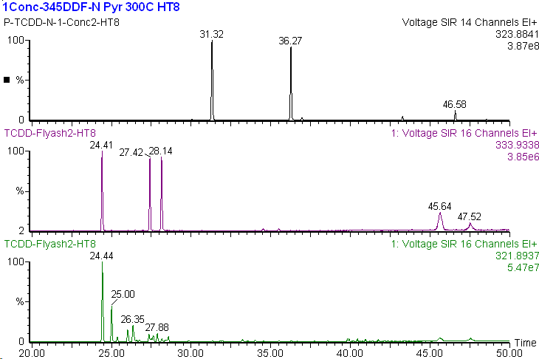
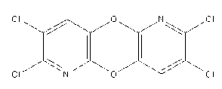
MATERIALS AND METHODS
Thermal treatment: Experiments were carried out in sealed brown glass ampoules (10 ml) with about 2 mg of Chlorpyrifos or 3,5,6-trichloro-2-pyridinol at temperature between 200ºC and 380ºC. Reaction products were extracted with toluene and analysed.
GC/MS analysis: A GC-TOF-MS:7890A (Agilent) and a JMS-T100GC (JEOL) GC-MS/MS : 450-GC/320-MS (Bruker) was used for analysis. The TOF-MS was used with a 30 m DB-5MS (ID: 0.25 mm) or 60 m HT-8PCB (ID: 0.25 mm) for accurate mass analysis and unidentified substance assessment. The MS was operated at a resolution: >5,000 (50% valley). The 320-MS was used with a 10 m Rapid-MS column for MS spectra and screening.
DR CALUX® bioanalysis: The DR CALUX® by BDS bioassay was performed using a rat hepatoma H4IIE cell line stably transfected with an AhR-controlled luciferase reporter gene construct. Cells were exposed in triplicate on 96-well microtiterplates containing the standard 2,3,7,8-TCDD calibration range, the additional 2,3,7,8-TCDD calibration concentrations, a DMSO blank, an internal reference material and various samples extracts at multiple dilutions (e.g. sediment, foodstuffs, feeding stuffs). Following a 24-hour incubation period, cells were lysed, a luciferine containing solution was added and the luciferase activity was measured using a luminometer equipped with 2 dispensers.
TeCDD-N Analogues from Pyridinol pyrolysis
(m/z:323.8841)
1,3,6,8-
1,2,3,4-
2,3,7,8-
¹³C₁₂ labeled TeCDDs
(m/z:333.9338)
TeCDDs in Flyash
(m/z:321.8937)
Figure 2: Retention time of N-analogues of 2,3,7,8-TCDD compared to 2,3,7,8-TCDD and TCDD isomers. the two
(Column:HT-8PCB (60mx0.25mm) Oven Temp:130℃ (1min)-30℃/min to 200℃; 20℃/min to 310℃(hold).
The 2,3,7,8-TCDD N-analogues had a longer retention time compared to 2,3,7,8-TCDD and other TCDD isomers and did not elute within the time window of TCDDs (Figure 2). The reason for the longer retention time is their higher polarity and their interaction of with the column surface. This may explain why these compounds have not been discovered up to now. Also the pyridine-N may have a different elution behaviour on clean-up columns.
Notes:
2

Slide 3

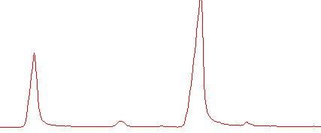

RESULTS AND DISCUSSION
In the commercial Chlorpyrifos standard the N-analogue of 2,3,7,8-TCDD was not detected (ppb detection limit).
Thermal treatment of Chlorpyrifos
Chlorpyrifos and 3,5,6-trichloro 2-pyridinol were individually thermally treated in closed glass ampoules between 200ºC and 380ºC at different reaction times (Table 1 and 2). Under the relatively mild conditions for phenol condensation the intermediate of the first condensation steps could be detected (figure 3) as has been found for pyrolysis of chlorophenols (Weber and Hagenmaier 1999). Higher yields of N-analogue from 2,3,7,8-TCDD were obtained with increasing temperature during the thermal treatment of 3,5,6-trichloro-2-pyridinol and Chlorpyrifos (Figure 5; Table 1, 2). In the reaction the trans-N-analogueof 2,3,7,8-TCDD and, via Smiles rearrangement the cis-N-analogue of 2,3,7,8-TCDD isomers were formed in similar concentrations (Figures 2, 3, 4, 5).
The yield of the 2,3,7,8-TCDD N-analogue was considerably higher from 3,5,6-trichloro-2-pyridinol than from Chlorpyrifos (see table 1 and 2).
300ºC
3.5.6-trichloro 2-pyridinol
340ºC
380ºC
N-analogue 2,3,7,8-TCDD
Figure 3: Chromatogram of reaction mixture of thermal treatment of 3.5.6-trichloro 2-pyridinol

Slide 4
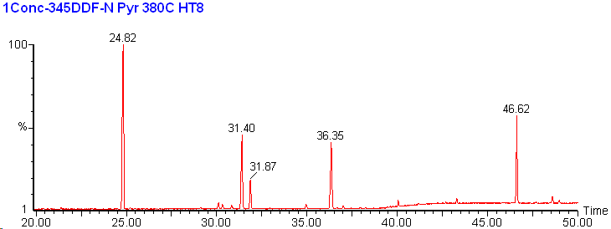
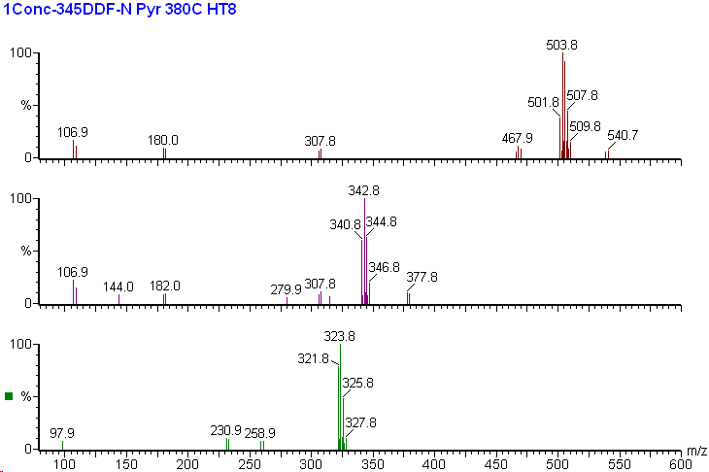
In the experiments intermediates of the first condensation step where also detected (Figure 4; peak No 1 & 3) which, despite their higher degree of chlorination had a shorter average retention time compared to the planar TCDD N-analogues (Fig.4, peak No 2 & 4). Also trimers with longer retention times where formed (peak No 5). Mass spectra of the respective products are shown in Figure 4.
In the thermal treatment of Chlorpyrifos dechlorination was also observed. This might be explained by the presence of alkyl substitutents. Therefore the first chromatograms of N-analogues of DCDD to TCDD (and minor PeCDD) are shown (in Figure 5).
Middle Resolution TIC Chromatogram (m/z: 80-600)
DCDD N-analogue
①
⑤
②
④
DCDD N-analogue
③
TrCDD N-analogue
Peak ⑤
TrCDD N-analogues
2,3,7,8-TCDD- N-analogues
Peak ①
＆ Peak ③
2,3,7,8-TCDD N-analogues
Peak ②
＆ Peak ④
PeCDD N-analogues
Figure 4: Chromatogram and mass spectra of a reaction mixture from thermal treatment of 3,5,6-trichloro-2-pyridinol
Figure 5: Chromatogram of N-analogues of DCDD, TrCDD, TeCDD and PeCDD from thermal treatment of Chlorpyrifos.

Slide 5
Table 1: Dioxin-like toxicities of reaction mixtures from thermal treatment of Chlorpyrifos (in pg 2378-TCDD TEQ/ mg chlorpyrifos; ppb)
Experiment Chlorpyrifos | 2,3,7,8-TCDD-bio-TEQ (24 hr) | 2,3,7,8-TCDD-TEQ (48 hr)
Chlorpyrifos (crude) | LOQ (20) | Not analysed
Chlorpyrifos, 380ºC (15 min) | 676 | 1690
Chlorpyrifos, 340ºC (15 min) | LOQ (20) | LOQ (20)
Chlorpyrifos, 300ºC (5 min) | 116 | Not analysed
Chlorpyrifos, 300ºC (15 min) | LOQ (20) | LOQ (20)
Chlorpyrifos , 250ºC (45 min) | 38 | Not analysed
Chlorpyrifos , 200ºC (15 hr) | LOQ | Not analysed
Dioxin-like toxicities were assessed with the DR-CALUX system (Besselink et al 2004). For the Chlorpyrifos (purchased as standard) no dioxin-like toxicity was detected in the crude sample (note that the detection limit was 20 ppm due to the small amount dissolved).
Extremely high dioxin-like toxicity was detected from the treatment at 380ºC of 3,5,6-trichloro-2-pyridinol. At 340ºC , dioxin-like toxicity was about an order of magnitude lower. The 48 h kinetic indicates that the compounds were stable.
For Chlorpyrifos, high toxicity was detected at 380ºC and lower toxicity at 300ºC each about two to three orders of magnitude lower compared to 3,5,6-trichloro-2-pyridinol (Table 1 and 2). Therefore the potential of Chloropyrifos to form the 2,3,7,8-TCDD N-analogue was considerably lower than that of 3,5,6-trichloro-2-pyridinol (Table 1 and 2) indicating that the phosphoric acid ester considerably reduces the dioxin-precursor potential. The extent to which this is relevant and valid in open burning scenarios of impacted biomass or accidental fires requires further assessment at higher temperatures in other experimental settings.
Table 2: Dioxin-like toxicities of reaction mixtures from thermal treatment of 3,5,6-Cl-2-Pyridinol (in pg 2378-TCDD TEQ/ mg 3,5,6-Cl-2-Piridinol; ppb)
Experiment | 2,3,7,8-TCDD-bio-TEQ 24 hrs kinetic | 2,3,7,8-TCDD-bio-TEQ 48 hrs kinetic
3,5,6-Cl-2-Pyridinol, 380ºC | 120000 | 143000
3,5,6-Cl-2-Pyridinol, 340ºC | 8700 | 22000
3,5,6-Cl-2-Pyridinol, 300ºC | 3400 | 4000
Control | LOQ (25) | LOQ (30)
Figure 6: DR CALUX® EC₅₀ induction curves of thermal reaction mixtures compared to 2,3,7,8-TCDD induction.

Slide 6
CONCLUSIONS
The N-analogue of 2,3,7,8-TCDD is formed in thermal treatment of both 3,5,6-trichloro-2-pyridinol and Chlorpyrifos. In the reaction cis- and trans-isomers are formed (via Smiles rearrangement).
The formation potential of the 2,3,7,8-TCDD N-analogue was considerably lower for Chlorpyrifos compared to 3,5,6-trichloro-2-pyridinol indicating that the phosphoric acid ester moiety reduces the dioxin-precursor potential
The DR-CALUX showed high induction of dioxin-like toxicity suggesting that the N-analogue of 2,3,7,8-TCDD and possibly other reaction products have significant dioxin-like toxicity.
Since in the current experiments the concentrations of the 2,3,7,8-TCDD N-analogue were not determined, no TEF factor can be calculated yet. However, the high activity in DRCALUX suggests such a TEF factor may be large. .
The stable 48 h kinetic in the DR-CALUX system indicated a high persistence of the 2,3,7,8-TCDD N-analogue. However persistence and bioaccumulation will need to be assessed in real settings.
Commercial Chlorpyrifos pesticides should be assessed for contents of the N-analogue of 2,3,7,8-TCDD. In addition to instrumental analysis, an assessment for dioxin-like toxicity with bio-assays should be performed considering that also other trace contaminants might have dioxin-like activity.
The N-analogue of 2,3,7,8-TCDD may also be formed and released when Chlorpyrifos- impacted crop residues and biomass are burned and when and Chlorpyrifos-contaminated soil is heated. .
REFERENCES
Besselink, H.T., Schipper, C., Klamer, H., Leonards, P., Verhaar, H., Felzel, E., Murk, A.J.,Thain, J., Hosoe, K., Schoeters, G., Legler, J. and Brouwer, B. (2004);. Environm. Toxicol. Chem., 23:2781-2789.
Holt E, Weber R, Stevenson G, Gaus C. (2010) Environ. Sci. Technol. 44, 5409–5415
Masunaga, S.; Takasuga, T.; Nakanishi, J. Chemosphere (2001), 44 (4), 873–885.
Mocarelli P (2001): Seveso: A Teaching story. Chemosphere 43, 391–402.
Stellman, J. M.; Stellman, S. D.; Christian, R.; Weber, T.; Tomasallo, C (2003); Nature 422 (6933): 681–687
Weber R.; Gaus C.; Tysklind M.; Johnston P.; Forter M.; Hollert H.; Heinisch E.; Holoubek I.; Lloyd-Smith M.; Masunaga S.; Moccarelli P.; Santillo D.; Seike N.; Symons R.; Torres J.; Verta M.; Varbelow G.; Vijgen J.; Watson A.; Costner P.; Woelz J; Wycisk P; Zennegg M. (2008); Environ. Sci. Pollut. Res., 15 (5) 363–393.
Weber R, Tysklind M, Gaus C. (2008); Env Sci Pollut Res 15 (2): 96–100.
Weber R, Hagenmaier H (1999); Chemosphere 38 (3):529-549.

