Slide 1
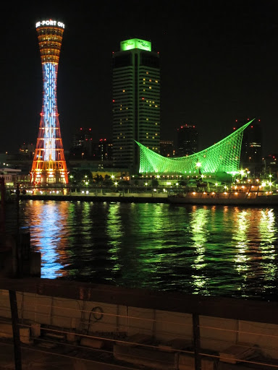
The 9th PCB workshop
PCBs risk evaluation and environmental protection
Date :
Oct. 9-13, 2016
Venue :
Kobe Convention Center /Portopia Hotel
URL http://ee-net.ne.jp/pcb2016e/

Slide 2

The 9th PCB workshop
PCBs risk evaluation and environmental protection
Date :
Oct. 9-13, 2016
Venue :
Kobe Convention Center /Portopia Hotel
URL http://ee-net.ne.jp/pcb2016e/

Slide 3
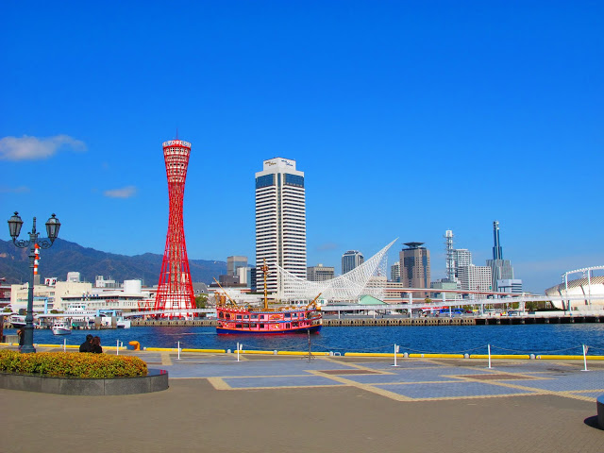
The 9th PCB workshop
PCBs risk evaluation and environmental protection
Date :
Oct. 9-13, 2016
Venue :
Kobe Convention Center /Portopia Hotel
URL http://ee-net.ne.jp/pcb2016e/

Slide 4
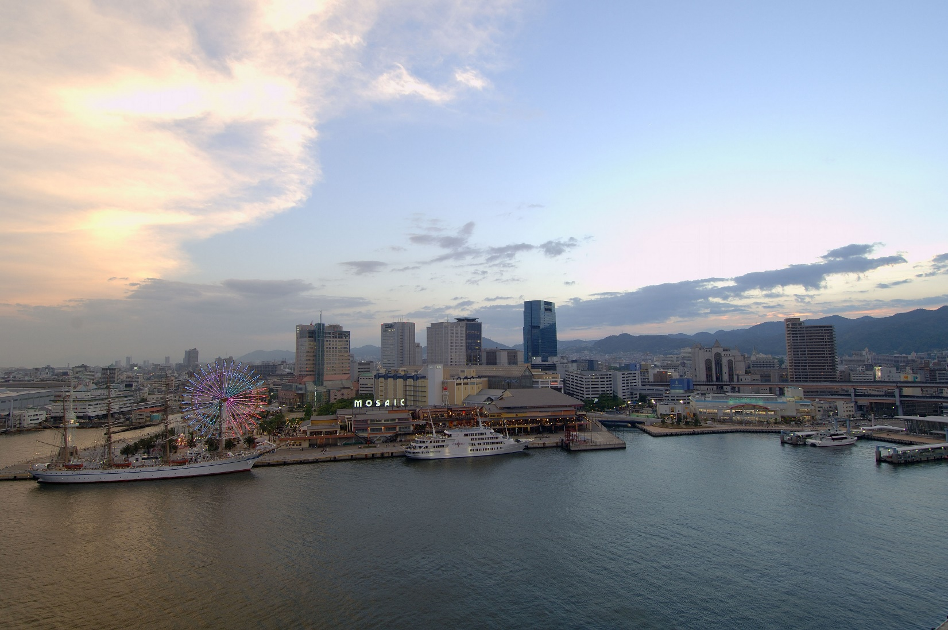
The 9th PCB workshop
PCBs risk evaluation and environmental protection
Date :
Oct. 9-13, 2016
Venue :
Kobe Convention Center /Portopia Hotel
URL http://ee-net.ne.jp/pcb2016e/

